Slide 1
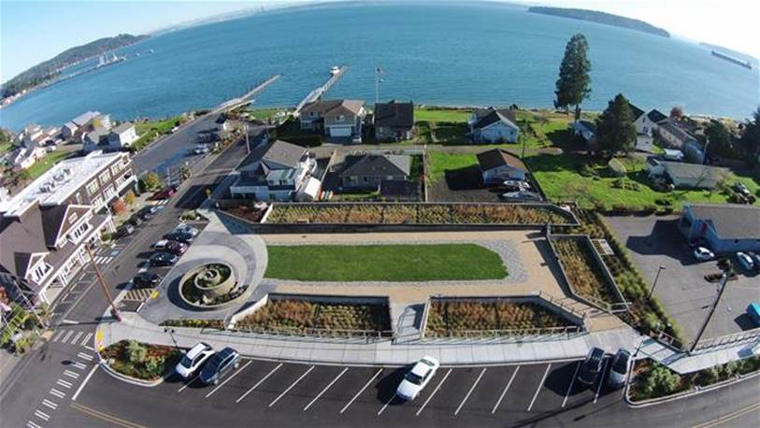
Presentation Overview
1.) Water As A Resource
Policy
2.) Site Assessment &
Planning Packet
3.) Group Exercise
Manchester LID Stormwater Park, Kitsap County, WA
Photo Courtesy: Chris May, Kitsap County Public Works

Slide 2
Water is a Resource NOT a Waste Stream
Guiding Principals
Preserve Natural Hydrology
Conserve Groundwater Resources
Reduce Pollutant Loading of Ground & Surface Waters
Maintain Natural Low Energy Flow Regime
Use Land for Multiple Purposes
Continually Refine Management Tools to Reflect Latest Technology & Innovations
Asset Development, Management, & Redevelopment
Development Codes & Regulations
Outreach to Staff, Customers, Citizens, & Contractors
Annual Reports on Implementation & Integration
Notes:
2009-Applies to all departments

Slide 3
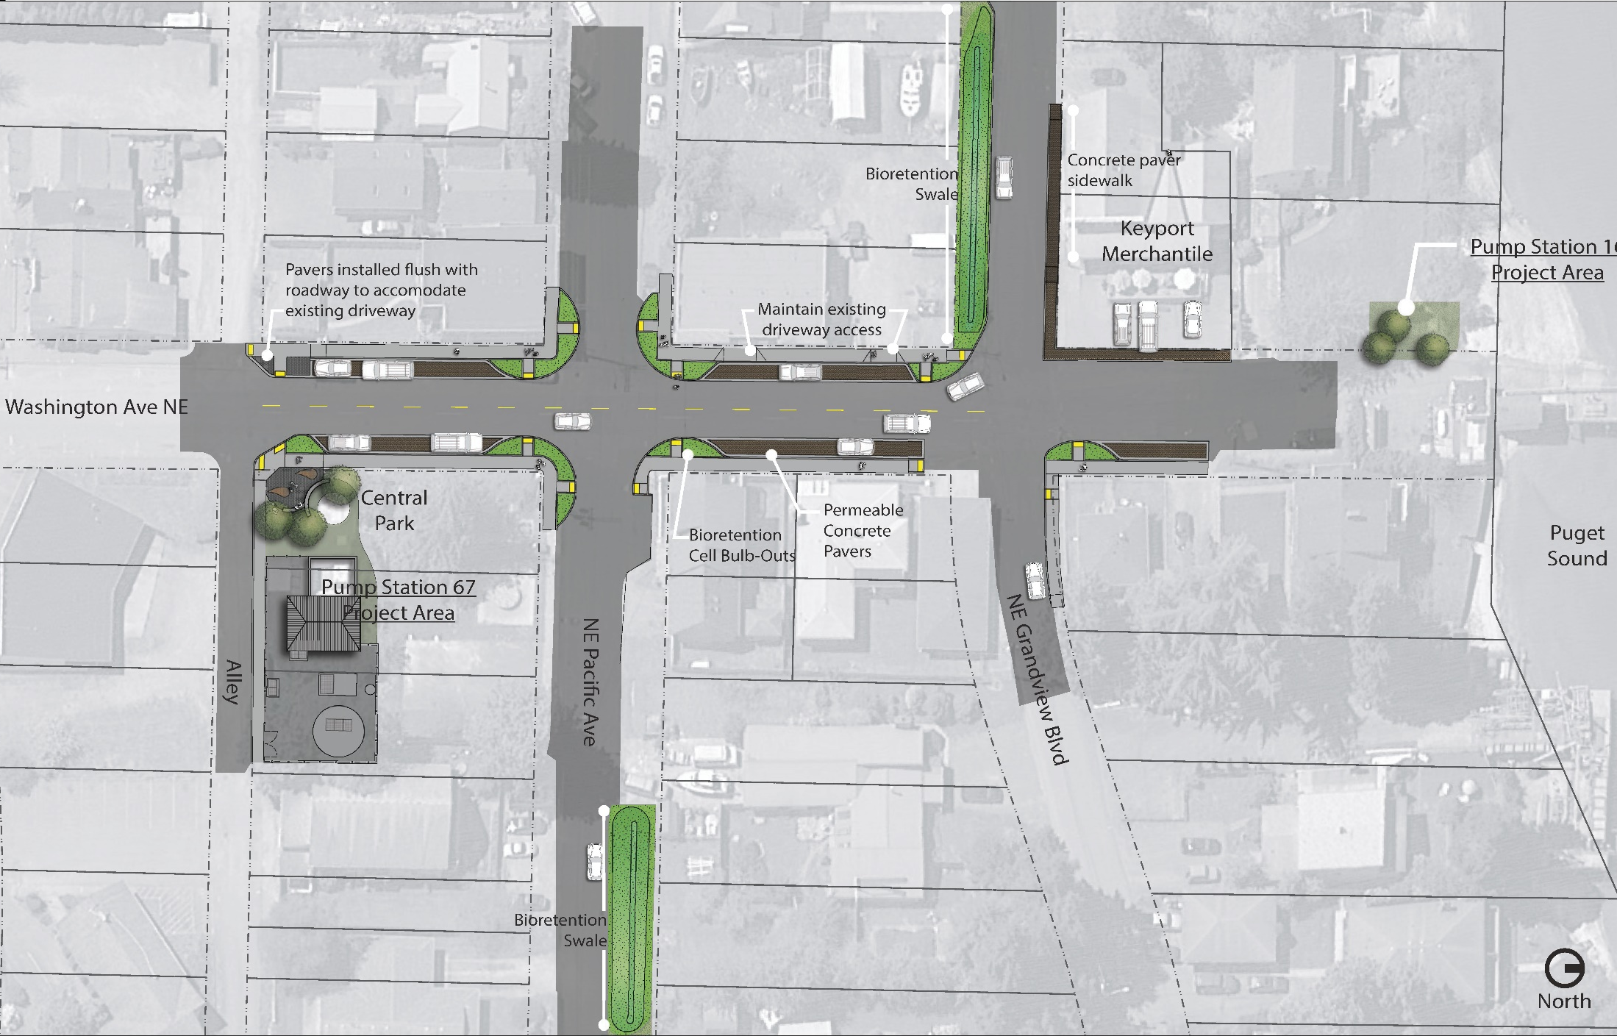

Slide 4
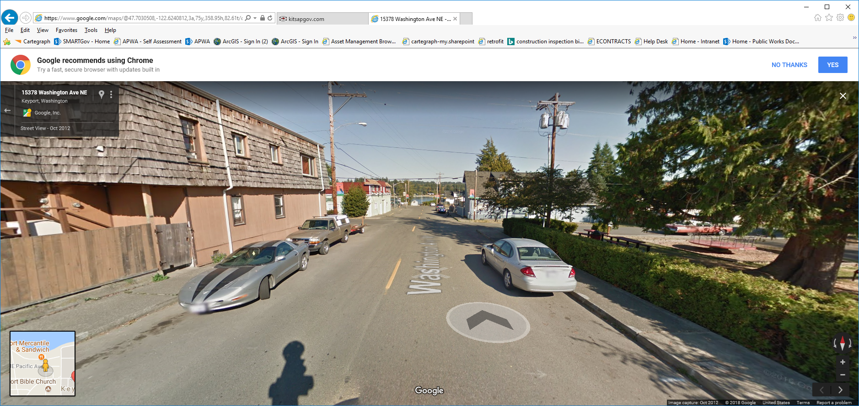
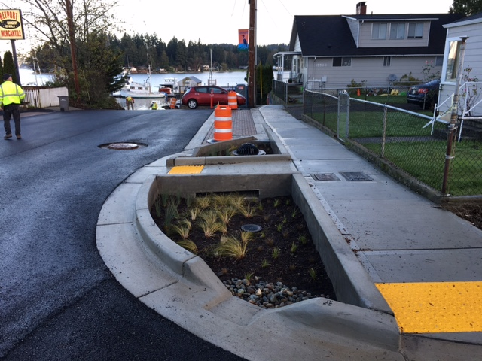
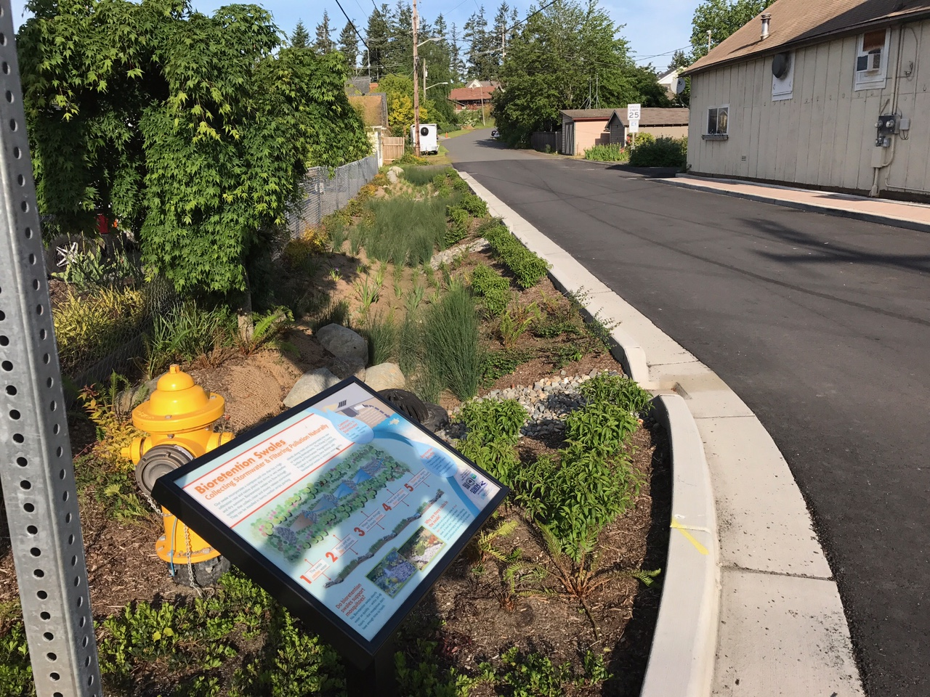

Slide 5


Slide 6

Site Assessment & Planning
Project Boundaries and Structures
Soils
Critical Areas
Topography
Hydrologic Patterns & Features
Vegetation
Land Use Controls
Access
Utility Availability & Conflicts

Slide 7
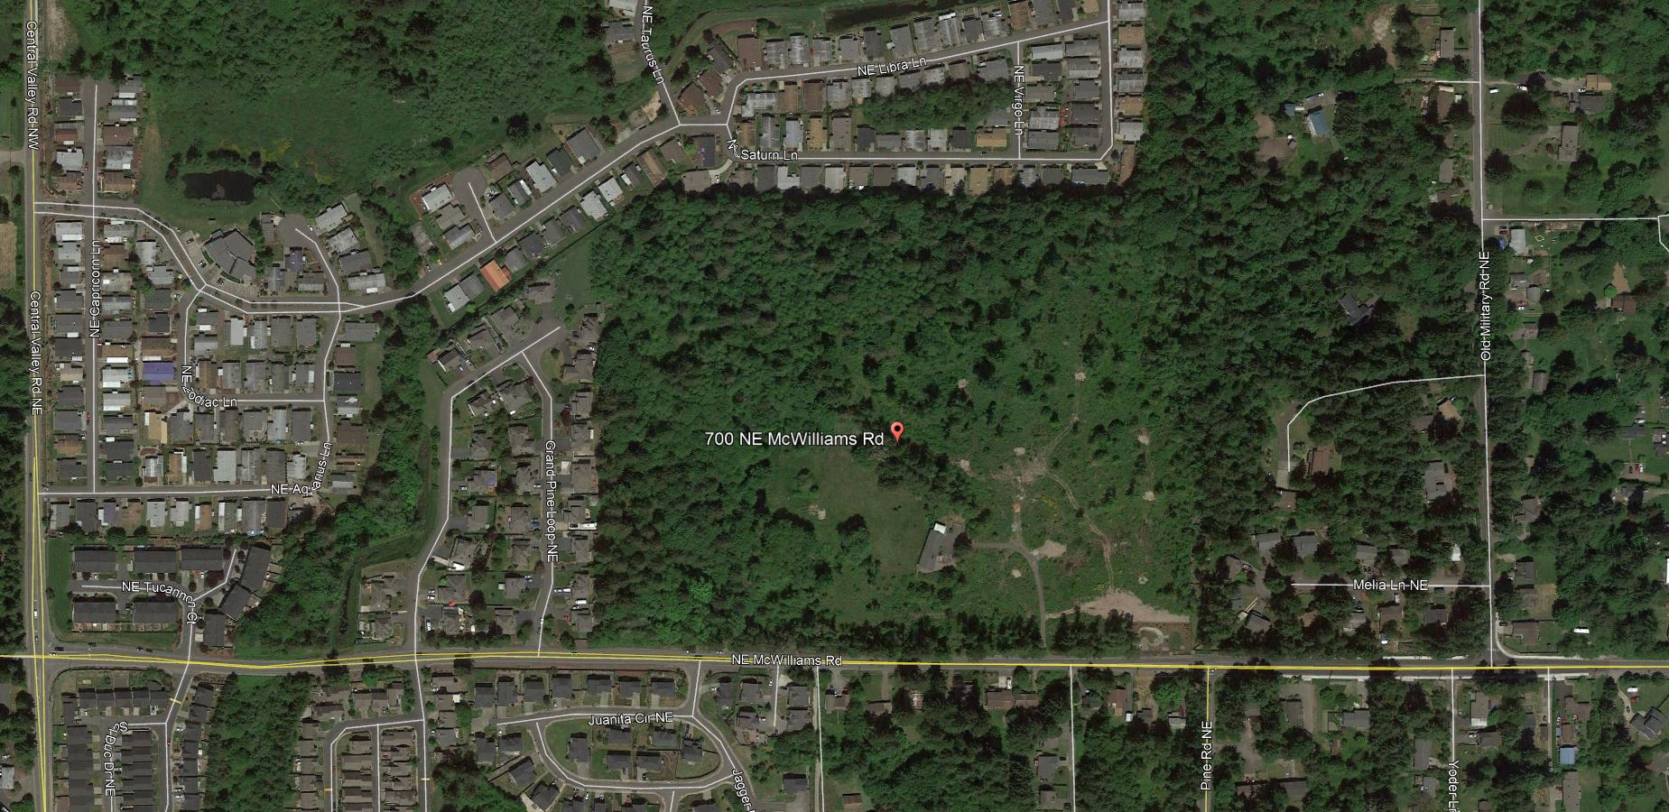
Site Assessment & Planning
Notes:
2009-Applies to all departments

Slide 8
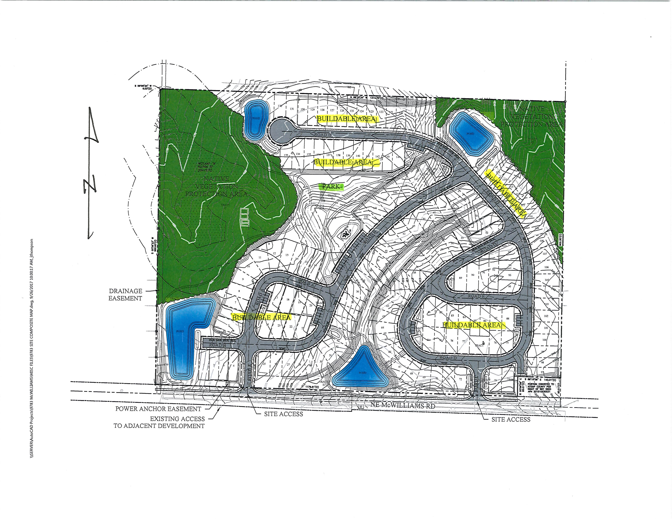
Site Assessment & Planning
Notes:
2009-Applies to all departments

Slide 9
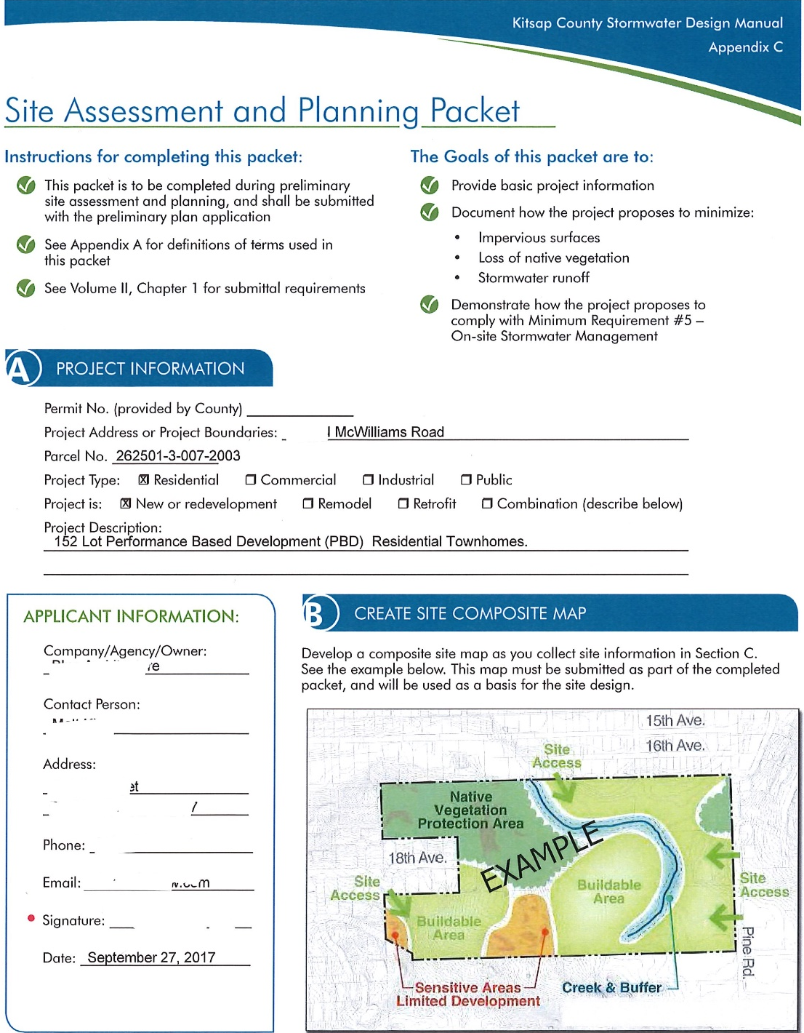
Site Assessment & Planning Packet
Notes:
2009-Applies to all departments

Slide 10
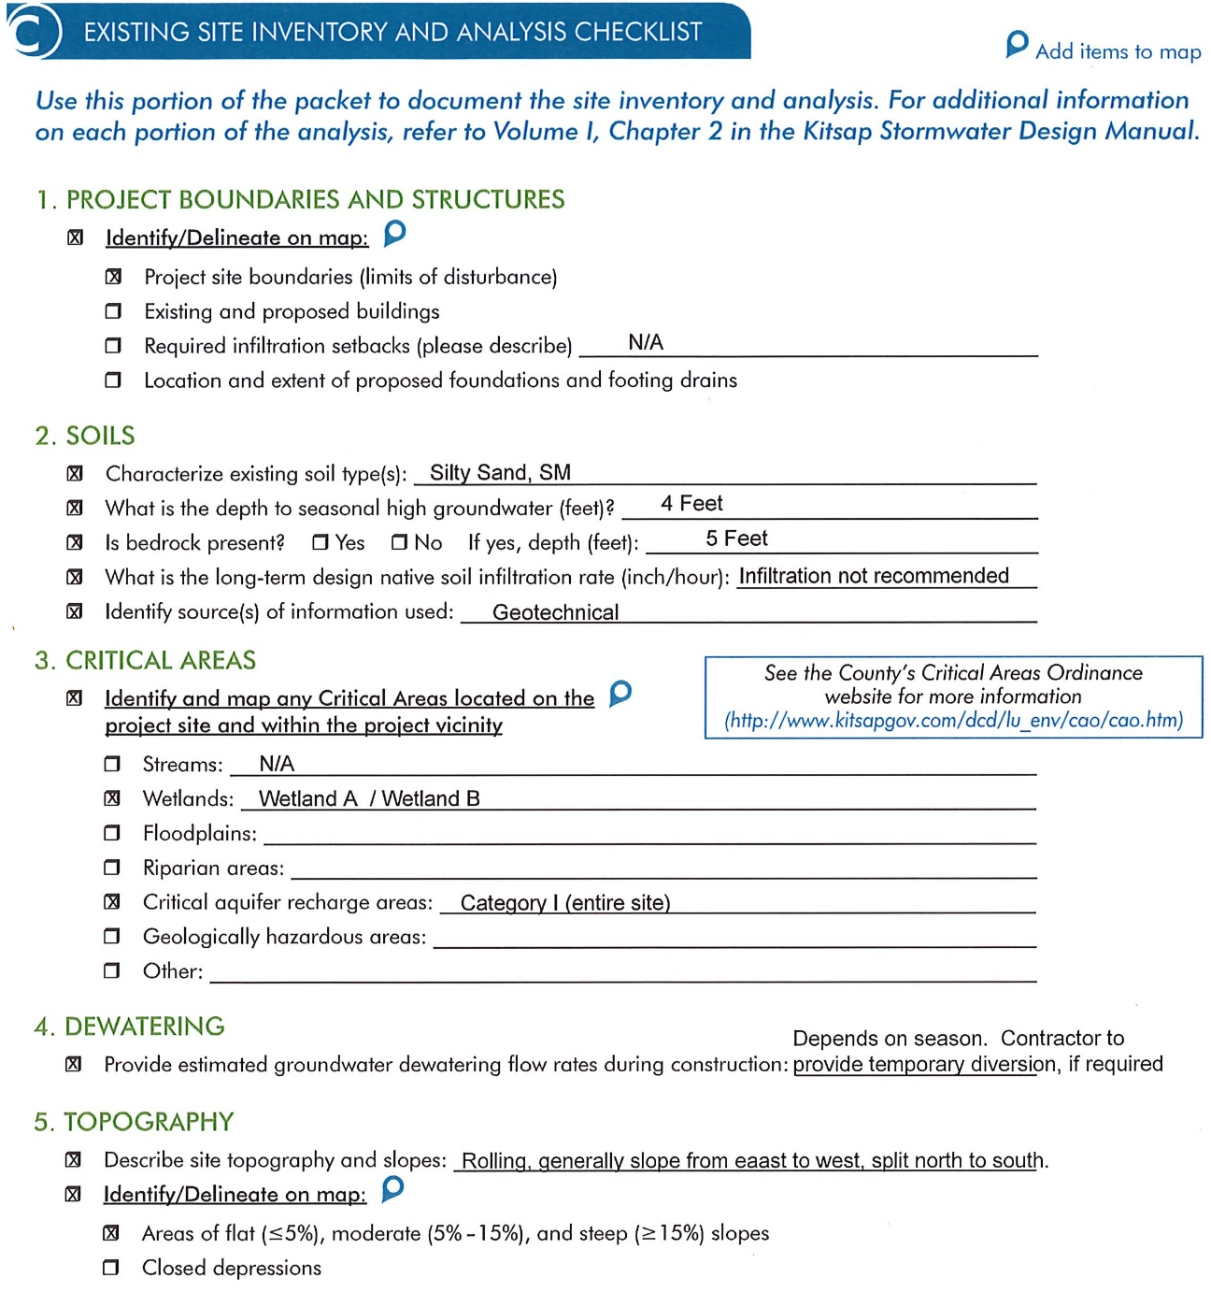
Site Assessment & Planning Packet
Notes:
2009-Applies to all departments

Slide 11
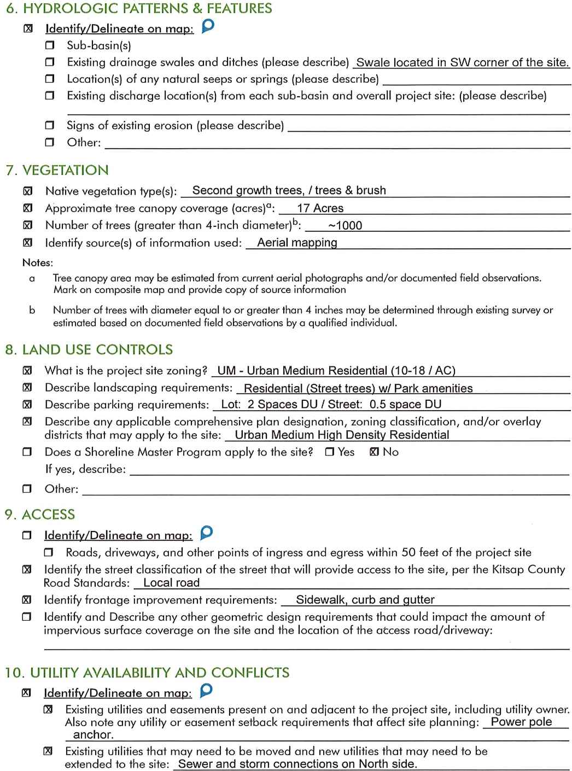
Site Assessment & Planning Packet
Notes:
2009-Applies to all departments

Slide 12
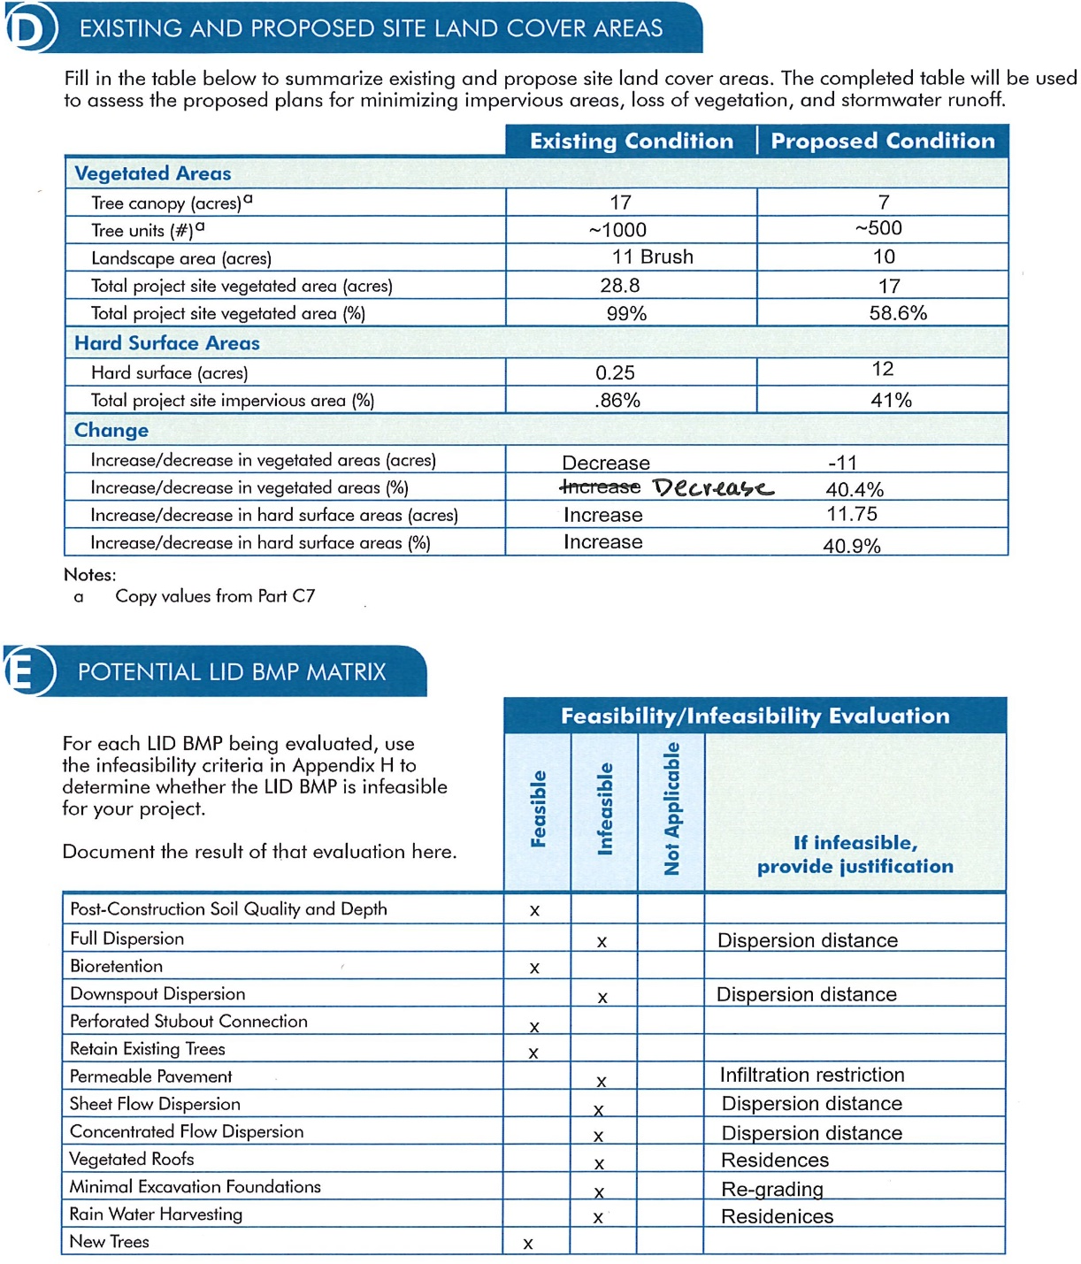
Site Assessment & Planning Packet
Notes:
2009-Applies to all departments

Slide 13
Site Assessment & Planning
Notes:
2009-Applies to all departments

Slide 14
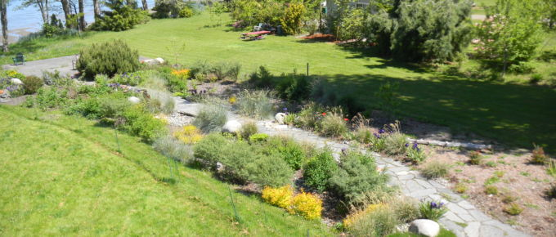
Exercise – Site Analysis and Planning
Notes:
Design and engineering of Bioretention for SW management purposes

Slide 15
Site Assessment & Planning
Project Boundaries and Structures
Soils
Critical Areas
Topography
Hydrologic Patterns & Features
Vegetation
Land Use Controls
Access
Utility Availability & Conflicts

Slide 16
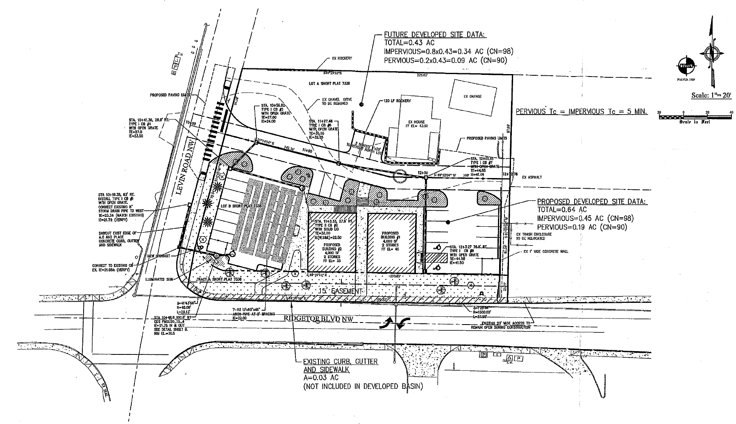
Hypothetical Office Park Development*
*See handout packet with hypothetical information and assumptions

Slide 17
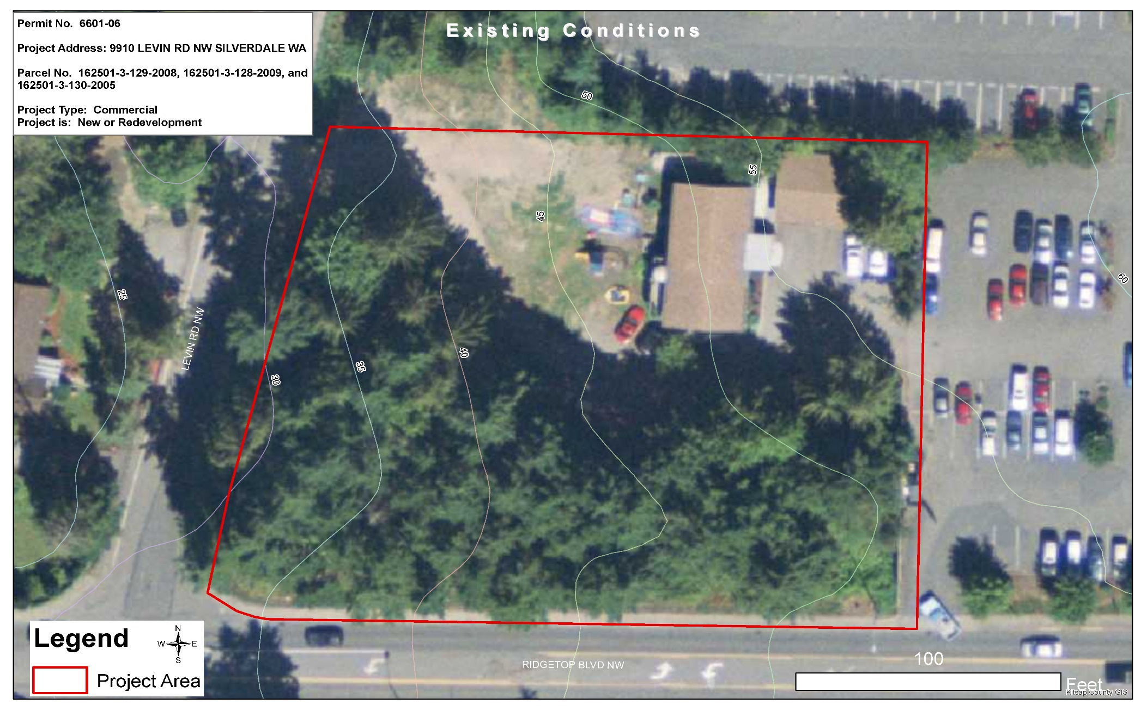
Predevelopment Conditions

Slide 18
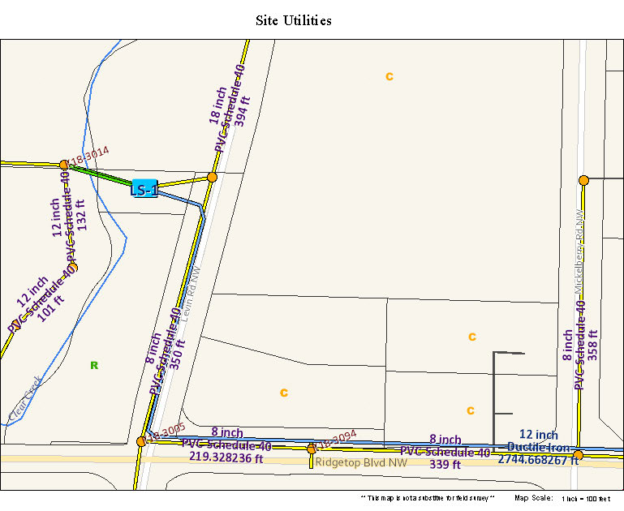
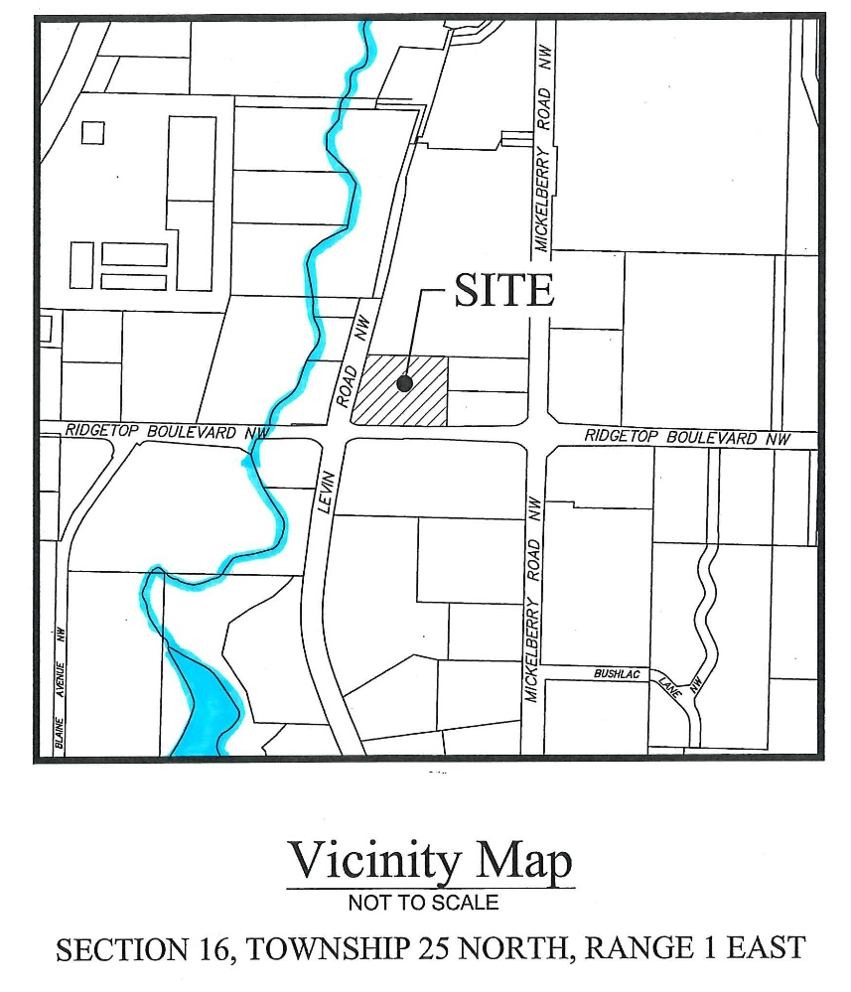
Additional Site Information

Slide 19
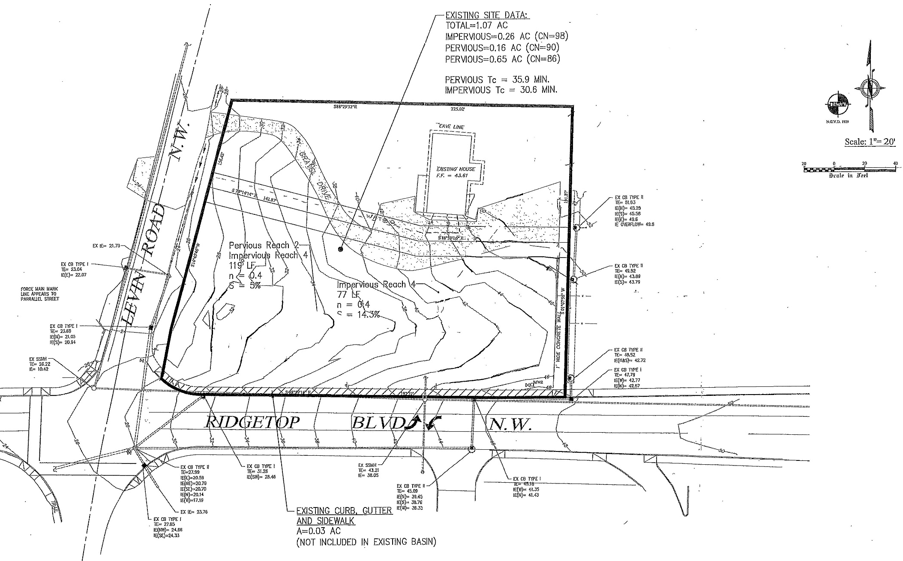
Basemap

Slide 20
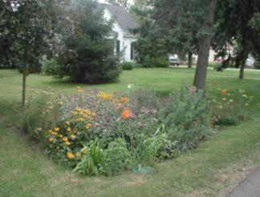
Questions?
Notes:
Design and engineering of Bioretention for SW management purposes

