Slide 1
Stormwater Control Transfer Program Overview January 31, 2018
Water Quality Program
Dan Gariépy, P.E.
Senior Stormwater Engineer

Slide 2
Stormwater Control Transfer Program (SCTP) Background
Responds to:
Recurring complaint that SW Req’mts discourage urban redev
Building Cities in the Rain Initiative
Stipulated Order in settlement of municipal permit appeal
Articulates municipal permit flexibility
Identifies Ecology expectations
Consistent with PS Ecosystem Recovery Targets (improve lightly to moderately impacted basins)

Slide 3
Stormwater Control Transfer Program Overview: What it is
Alternative approach to satisfy permit requirements associated with flow control at new and redevelopment sites that…
Accelerates environmental improvements in priority watersheds and is…
Implemented through a basin planning provision in Phase I and II Municipal Stormwater Permits in…
Western Washington.

Slide 4
SCTP Overview: What it is not
Relaxation of stormwater requirements
Wetlands Mitigation Banking
TMDL-driven pollutant trading
An alternative to structural retrofitting required by Phase I permit
Phase II permit does not require retrofitting existing development with flow control or treatment BMPs

Slide 5
SCTP Guidance Overview
Section I:
Overview
General Principles
Key Elements
Specific Guidelines
Section II: Prioritization Analysis Support & Principles
Section III: Effectiveness Monitoring Plan Considerations
Section IV: Determining Debits/Credits & Tracking Transfers

Slide 6
Section I: General Principles
Environmental Goal: Full attainment of WQS
NO increased stormwater impacts to any receiving water
Directs stormwater improvements to “priority watersheds”
Prioritization is science-based
Ecology approval required
Other, more stringent requirements may still apply
TMDLs
S4.F.3. adaptive management
Future stormwater requirements

Slide 7
Section I: Key Program Elements
Replaced and New Surface Transfers to high priority watershed
Municipal permittee verifies facility long-term O&M
Offsite facilities must be online before transfers allowed
Always match pre-project condition at project site
Only the “improvement” may be transferred

Slide 8
Section I: Key Program Elements, cont’d
Permittee must track flow control transfers
Annual reporting/accounting to Ecology
Dedicated fee-in-lieu accounts + capacity tracking

Slide 9
Section I: Guideline Tables (ex.)

Slide 10
Section II: Prioritization Analysis
Priority watersheds: Stormwater improvements provide more immediate environmental benefit
Science-based
Watershed-specific information
Specific prioritization goal, data sources
Input from natural resource agencies
Includes “tribal natural resources agencies”
Ecology concurrence

Slide 11
Section II: Prioritization Principles to Consider
Prioritize watersheds with:
Low to moderate impairment
Relative to the municipality
Permittee ability to influence
Possible synergy with other rehabilitation efforts (e.g., salmon recovery)

Slide 12
Notes:
Here’s a city.
2 creeks (A and B) each with 3 tribs

Slide 17
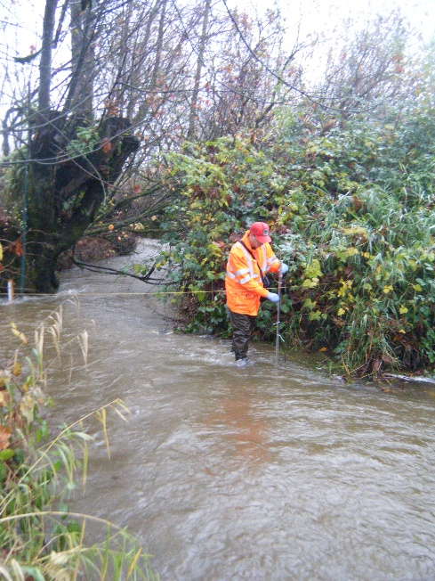
Section III: Monitoring
Purpose
Document effectiveness
Design depends on Transfer Types (flow, treatment, etc.)
Establish Baseline Condition
Repeat Monitoring after significant retrofitting

Slide 18
Section IV: Capacity Credit Calculations & Facility Options
Flow Control:
Detention, Retention, Combination
New or Expanded; Full size or undersized
Full Dispersion
Permeable Pavement; Bioretention
Reforestation

Slide 19
Section IV: Facility Transfer Tracking
Transfer currency is area by land cover type
Transfer tracking rules
Track to nearest 1/10 acre
Track flow control at project site
Track regional facility capacity used vs available
Track use of regional capacity by projects

Slide 20
Where is this guidance now?
Can submit a SCTP for approval under the current permit
Guidance is listed as “draft”
Provides good starting point for Ecology’s review
Jurisdictions should contact their Ecology permit manager before beginning

Slide 21
Where is it heading?
The wider principle may be something you want to have input on
Draft framework released in December, 2017:
Long-term municipal stormwater planning
Comment until February 2, 2018 at:
http://ws.ecology.commentinput.com/?id=tkx29
More to come:
Formal Draft Schedule for late Summer 2018

Slide 22
Questions and Discussion
Dan Gariépy
dan.gariepy@ecy.wa.gov
Abbey Stockwell
abbey.stockwell@ecy.wa.gov

