Slide 1
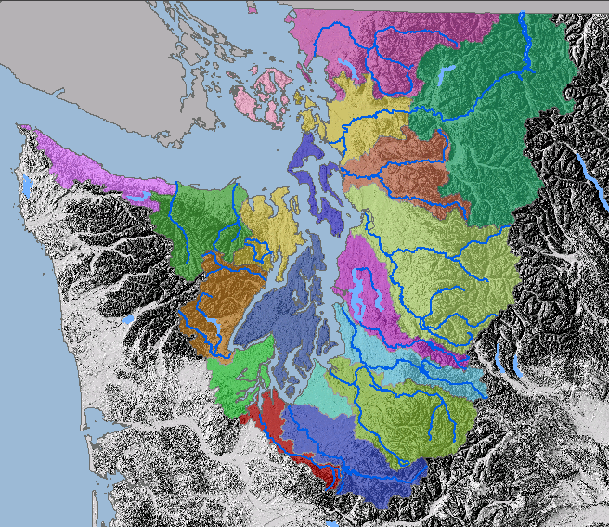
Protecting Aquatic resources using a watershed based approach
Stephen Stanley – Senior Watershed Scientist, Puget Sound Watershed characterization Project, Washington department of Ecology
ssta461@ecy.wa.gov
425 649 7007
WSU Stormwater Center Workshop - January 31, 2018

Slide 2
Objectives of Presentation:
1
To Understand:
Benefits of a watershed approach
Relationship between process, structure, function
Role of watershed processes
Example and exercise of applying watershed information to local planning
Notes:
Landscape Characterization
6/28/05
<number>

Slide 3
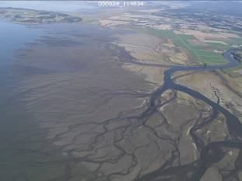
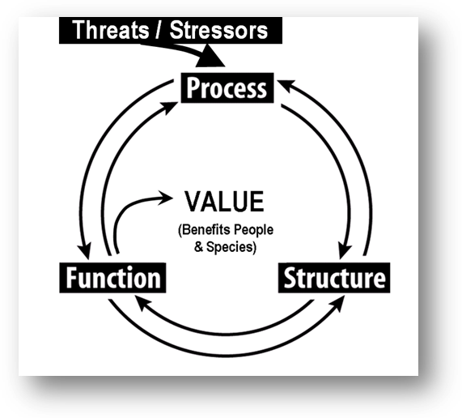
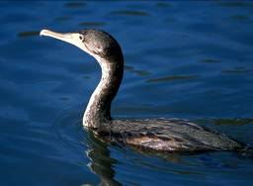
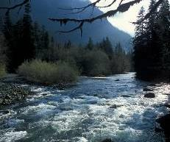
Land Use Planning Needs…..
An Ecosystem Approach
Assessment of:
  Freshwater processes
  Nearshore processes
  Fish & wildlife habitat
Integration of data
across temporal &
spacial scales
..such as water and sediment movement at
the watershed scale
Broad Scale
Ecosystem Services:
..such as habitat for birds
..such as a stream channel
or estuary delta
Fine Scale
Mid Scale

Slide 4
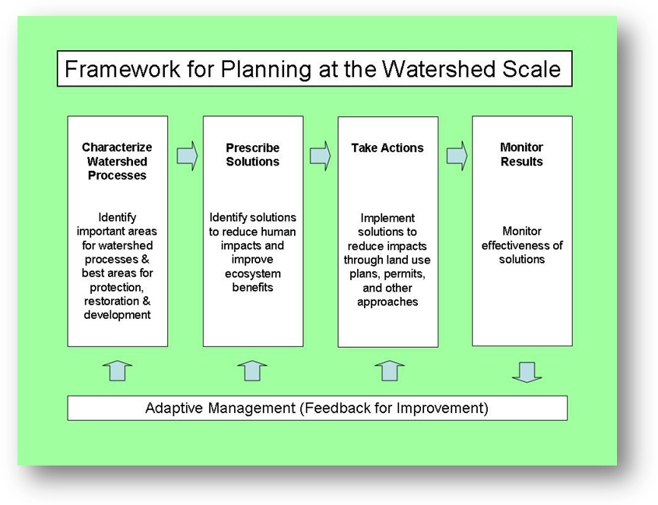
Land Use Planning Needs……
A consistent watershed planning framework

Slide 5
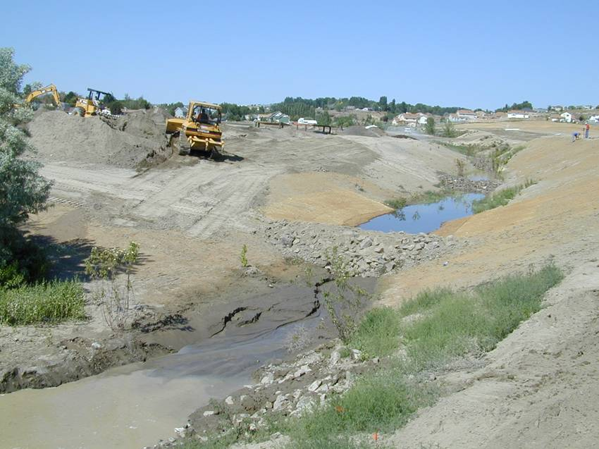
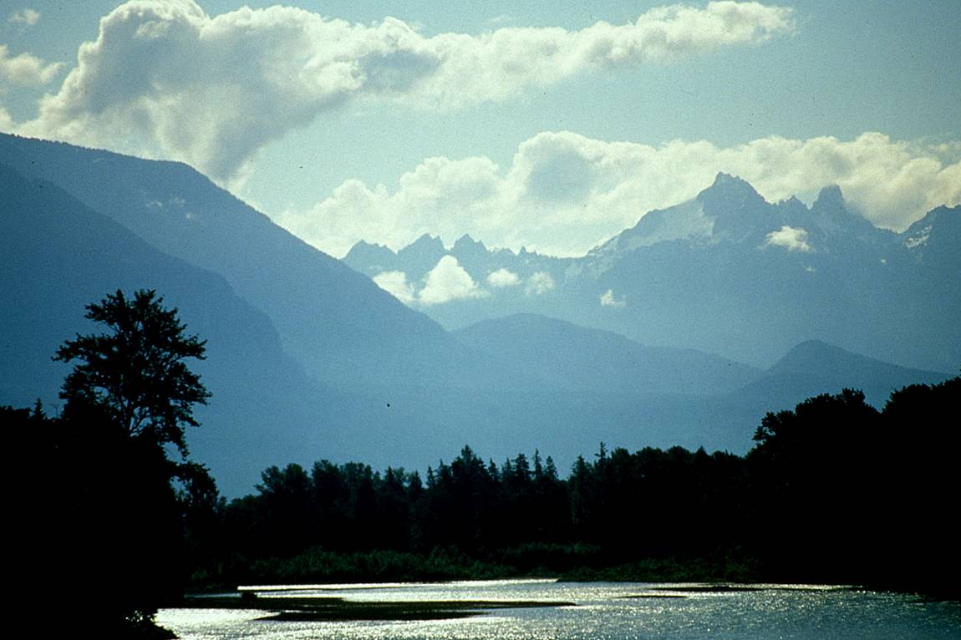
Understanding Watershed Processes can help…
<number>
Guide future development
  Identify and avoid development patterns that are difficult to correct
  Reduce cost of infrastructure for future development & streamline local permitting
  Supports comprehensive approach to Growth Management and Shoreline Management Acts
Notes:
Landscape Characterization
6/28/05
<number>

Slide 6
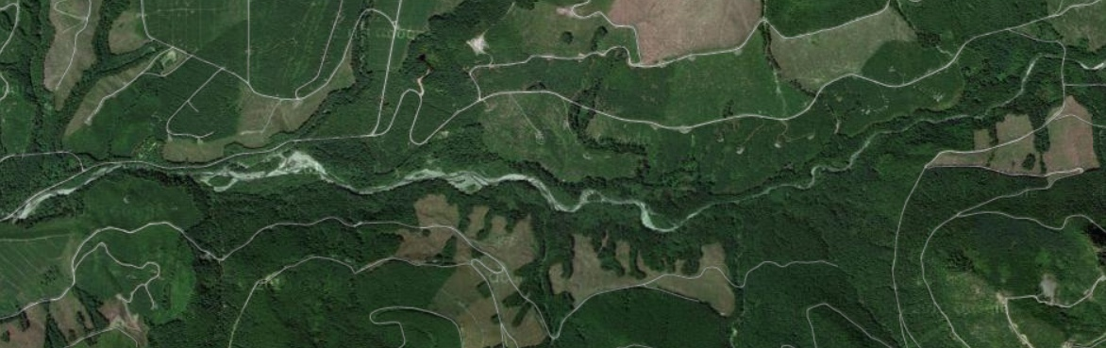
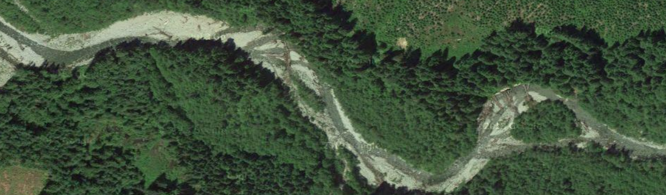
Why a Multi-scale Approach is Necessary
Site specific mitigation has resulted in a “net loss” of functions and value of aquatic habitat
The “root cause” of environmental problems for aquatic systems is seldom addressed
Typically, only the “symptoms” are mitigated for
Notes:
See Beechie et al. 2010. Process Based Principals for Restoration
<number>

Slide 7
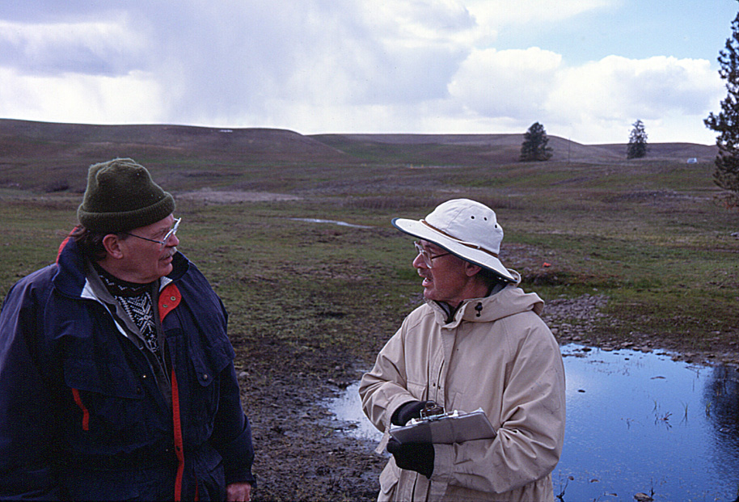
Existing Approach to Environmental Decision Making
Science attempts to answer questions (theoretical approach):
Can over-emphasize under-standing all mechanisms between the “cause” & “effect” before reaching any conclusion
Forces regulatory agencies to take a conservative approach
Unable to identify “solvable” problem
Notes:
Illustrates the basic conflict that exists at regulatory agencies like WDOE with programs regulating environmental impacts for water quality, water resources and land use/habitat and each program requiring absolute proof for causality (impact connection with environmental response) but not having the data to demonstrate that. This approach has basically arisen out of a fear of lawsuits and has made agencies somewhat closed to the idea of accepting a certain “degree of risk” in identifying “solutions” to environmental problems.
Mention how scientists, planners, decision makers might deal with uncertainty.
What should we do, what actions can we take, before we understand all mechanisms?
<number>

Slide 8
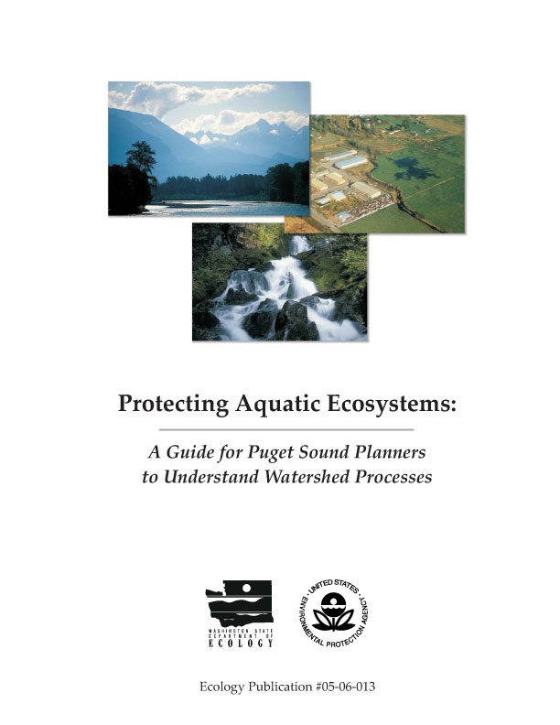
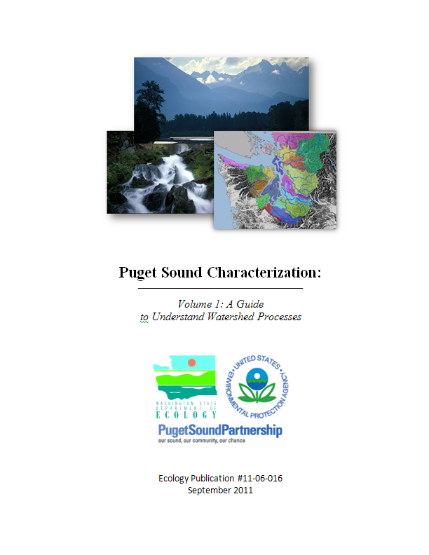
Puget Sound Characterization
<number>
Originally Published in 2005. Peer Reviewed.
Revised in 2008 & 2010 & 2016 Water Flow Models. Additional Peer Review
Latest Guidance – Peer Review of Water Quality Models

Slide 9
How Water Moves Through a Watershed
9
Notes:
Landscape Characterization
6/28/05
<number>

Slide 10
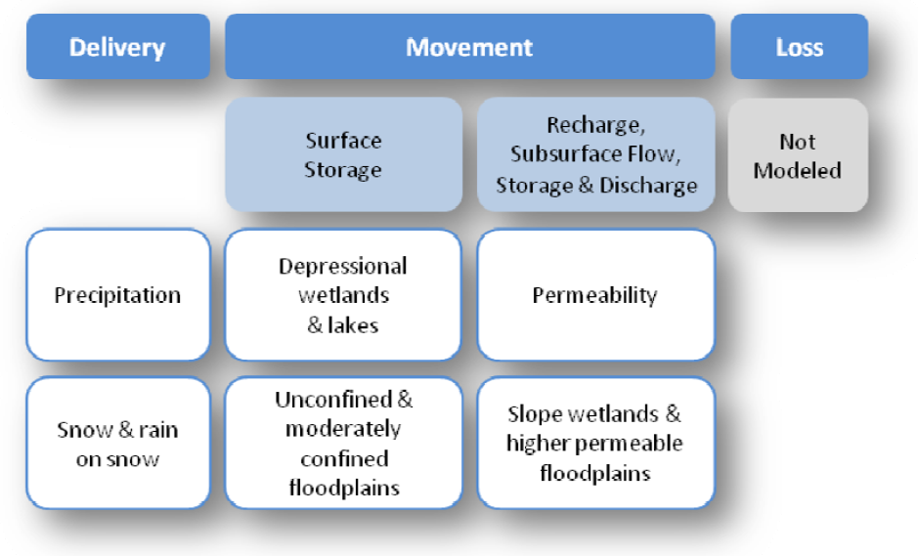
Model Water Flow Processes…..
10
Model 1 – Importance of Water Flow Processes
Model 2

Slide 11
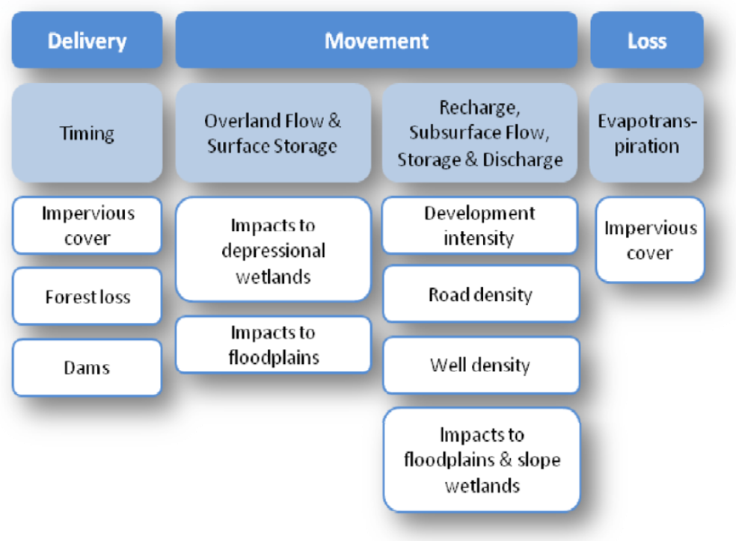
Model Water Flow Processes…..
11
Model 2 – Degradation to Water Flow Processes
Model 2

Slide 12
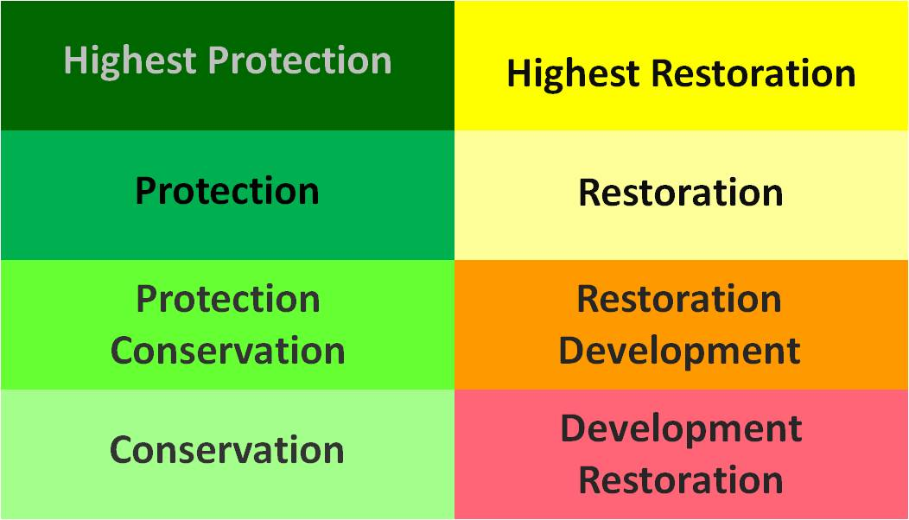
Combine Importance and Degradation models for certain planning scenarios
Water Flow Management Matrix
Highest
Pg 23-25, & Appendix A in User’s Guide
Level of Importance
Lowest
Level of Degradation
Highest

Slide 13
Combine Importance and Degradation models for certain planning scenarios
Water Flow Management Matrix
Highest
Level of Importance
Lowest
Level of Degradation
Highest

Slide 14
Combine Importance and Degradation models for certain planning scenarios
Water Flow Management Matrix
Highest
Level of Importance
Lowest
Level of Degradation
Highest

Slide 15
Combine Importance and Degradation models for certain planning scenarios
Water Flow Management Matrix
Highest
Level of Importance
Lowest
Level of Degradation
Highest

Slide 16
Combine Importance and Degradation models for certain planning scenarios
Water Flow Management Matrix
Highest
Level of Importance
Lowest
Level of Degradation
Highest

Slide 17
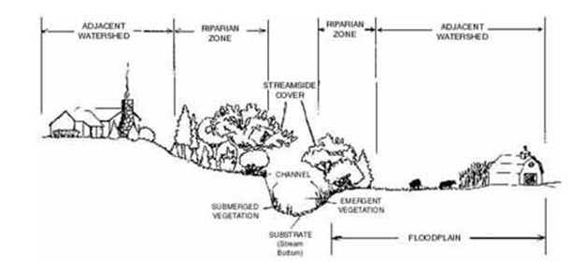
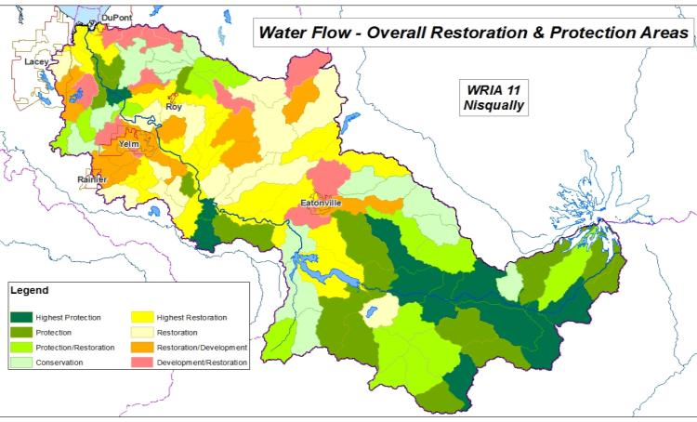
Helps protect/restore processes that maintain healthy stream systems
Mid & fine scale - Salmon recovery plan, using finer scale data, identifies specific location & design of stream restoration
Broad scale – water flow assessment
Water Flow assessment deals with upland land use that controls the delivery & movement of water to streams
Yellow colors tell planners that land-use practices should support restoration of watershed processes
Green colors indicate that land-use practices should continue protecting watershed processes

Slide 18
Helps protect/restore processes that maintain healthy stream systems
Mid & fine scale - Salmon recovery plan, using finer scale data, identifies specific location & design of stream restoration
Broad scale – water flow assessment
Water Flow assessment deals with upland land use that controls the delivery & movement of water to streams
“Yellow” agricultural areas around Eatonville require restoration
Yellow colors tell planners that land-use practices should support restoration of watershed processes
Green colors indicate that land-use practices should continue protecting watershed processes

Slide 19
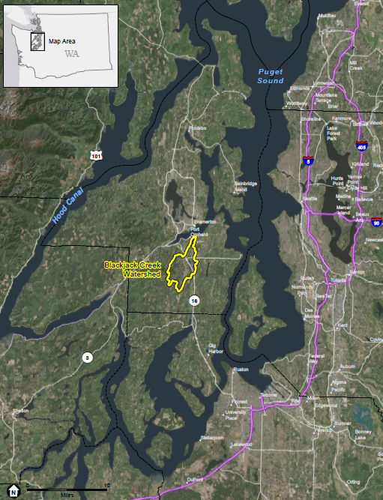
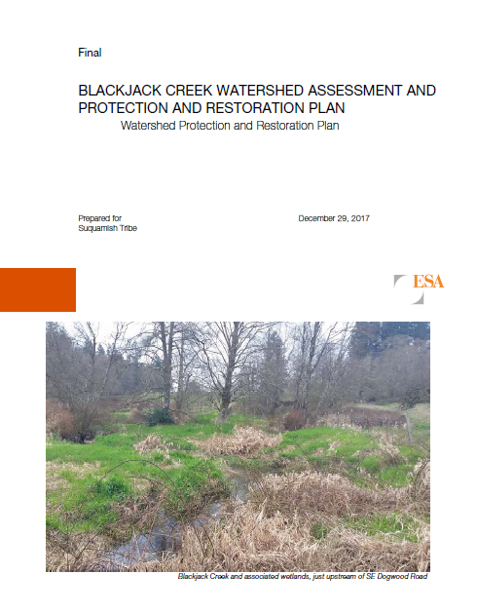
Blackjack creek characterization
<number>
https://suquamish.nsn.us/wp-content/uploads/2018/01/Blackjack_WatershedPlan_FINALv2_29Dec2017_complete.pdf
Notes:
Landscape Characterization
6/28/05
<number>

Slide 20
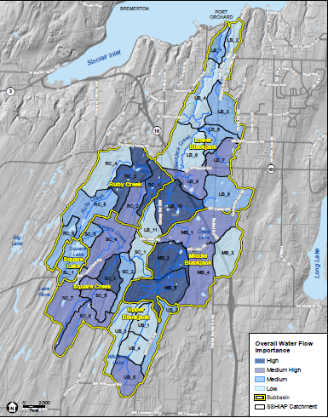
Water Flow Overall Importance
<number>
Lower
16
Middle
Upper

Slide 21
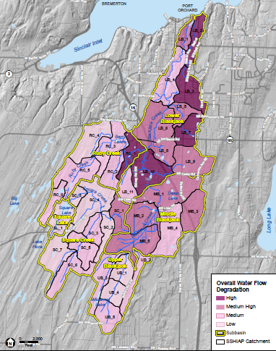
Level of Degradation Overall

Slide 22
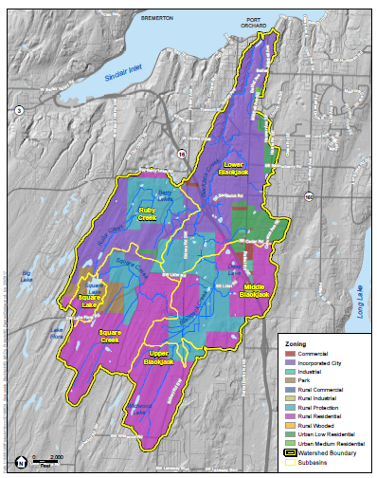
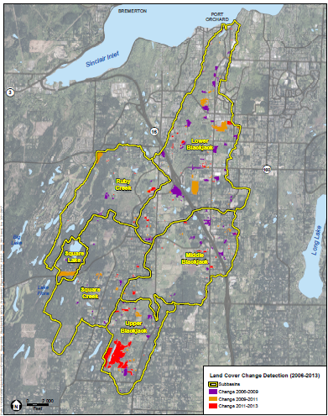
Existing Zoning &
Land Cover Change
Zoning
City of Port Orchard
Land Cover Change
Rural
Protection
Rural Residential

Slide 23
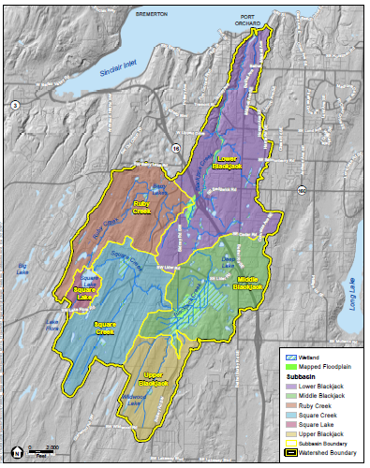
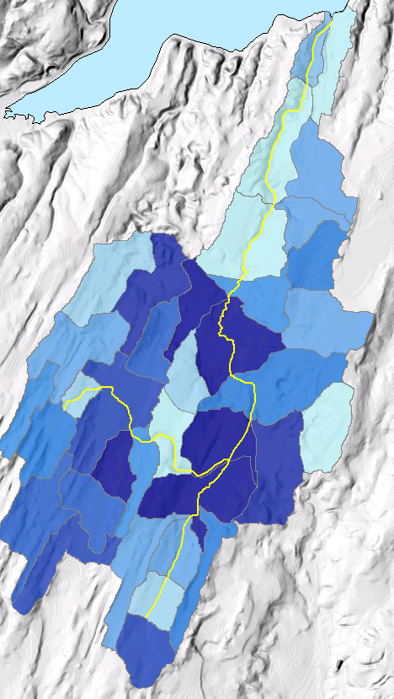
Storage Importance
Wetlands & Floodplains
Floodplain
Wetlands

Slide 24
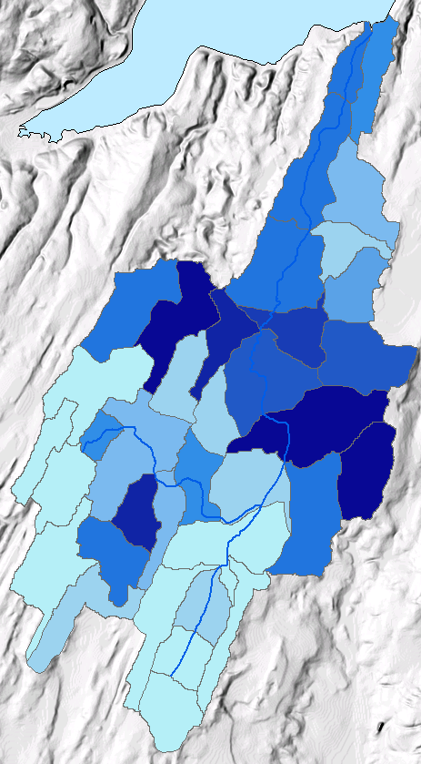
Recharge Importance

Slide 25
Existing Zoning &
Land Cover Change
Zoning
City of Port Orchard
Land Cover Change
Rural
Protection
Rural Residential

Slide 26
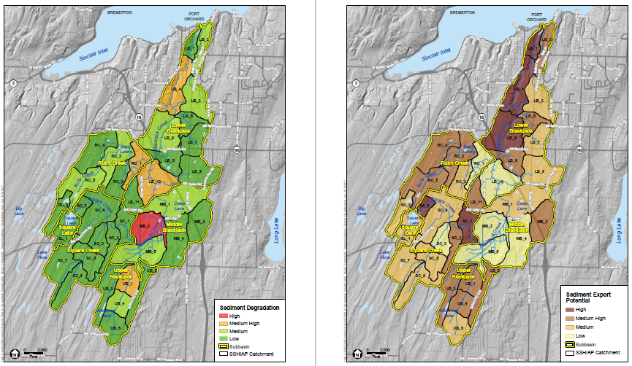
Sediment
Current Conditions Using NSPECT Model
Sediment Export Potential
Highest Export Potential in higher gradient stream corridor
Highest level of degradation
Lowest export potential due to low gradient and presence of storage of water by wetlands
Lowest level of degradation in green areas

Slide 27
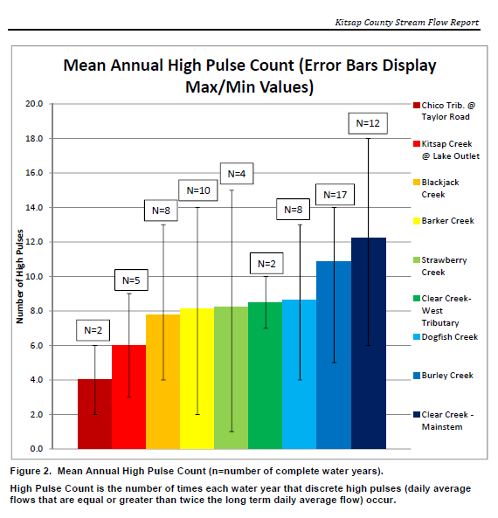
Hydrologic Metrics
High Pulse Counts can be a useful indicator of the hydrologic health of a stream system
Blackjack also has a relatively low High Pulse Count
Chico Creek watershed is relatively undeveloped & has a correspondingly low High Pulse Count of 2

Slide 28
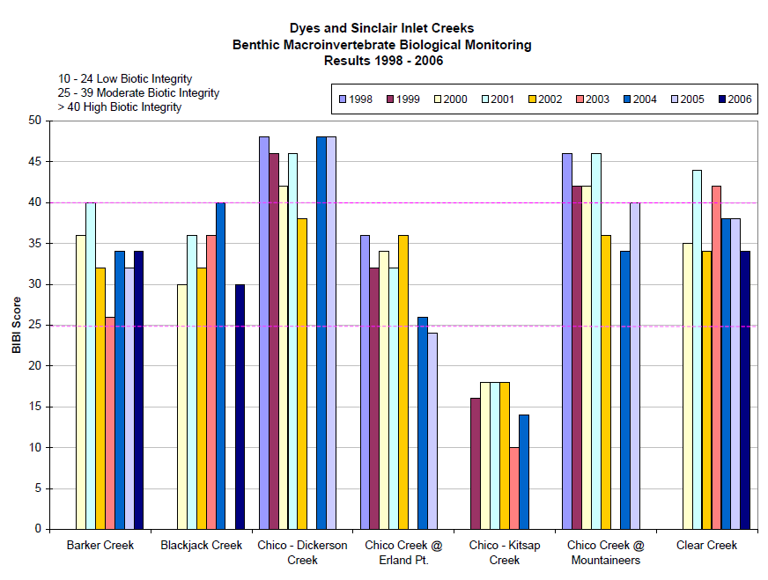
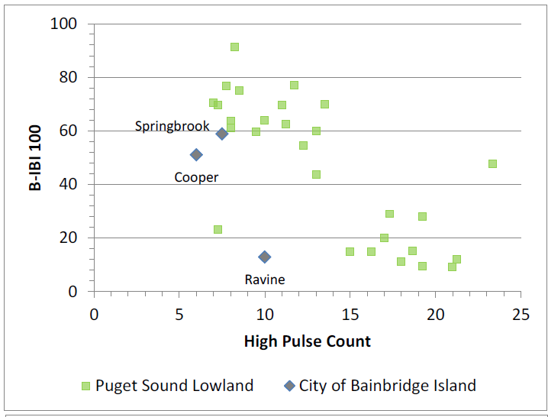
Hydrologic Metrics & BIBI (Benthic Index of Biological Integrity)
Blackjack <>

Slide 29
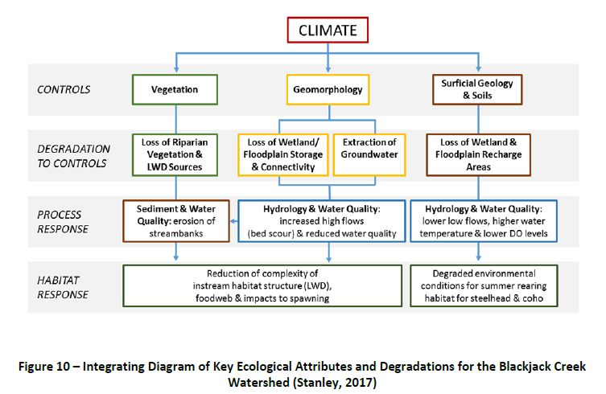
Blackjack Creek – Integration of watershed data over multiple scales

Slide 30
Workshop Exercise: Develop an Integrated Watershed Plan to Protect & Sustain Hydrology of Blackjack Creek (Use Figure 10 as Guide)
<number>
Questions to Address per Sub-basin – ( e.g. Lower, Middle Blackjack) :
What are the key problems this watershed faces?
What type of actions will best limit high flows and sustain low flows?
Based on #1 and 2, what and where are the priority actions to undertake (please rank and explain your basis)? This could include: riparian restoration, LID retrofit, restoring the estuary at the mouth of creek, wetland and floodplain restoration, acquisition of upper watershed lands.
What type of planning and regulatory measures would you undertake to deal with future development? Be specific as to the location of these measures.
Notes:
Landscape Characterization
6/28/05
<number>

Slide 31
Workshop Exercise – Results and Discussion

Slide 32
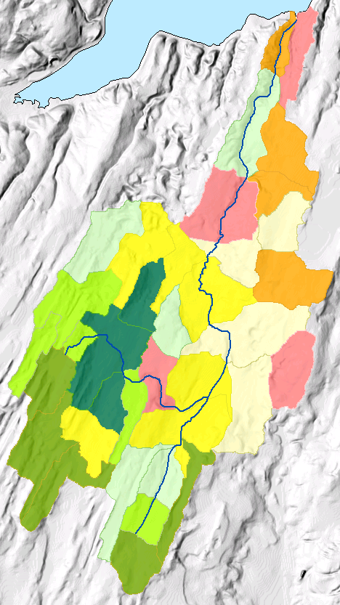
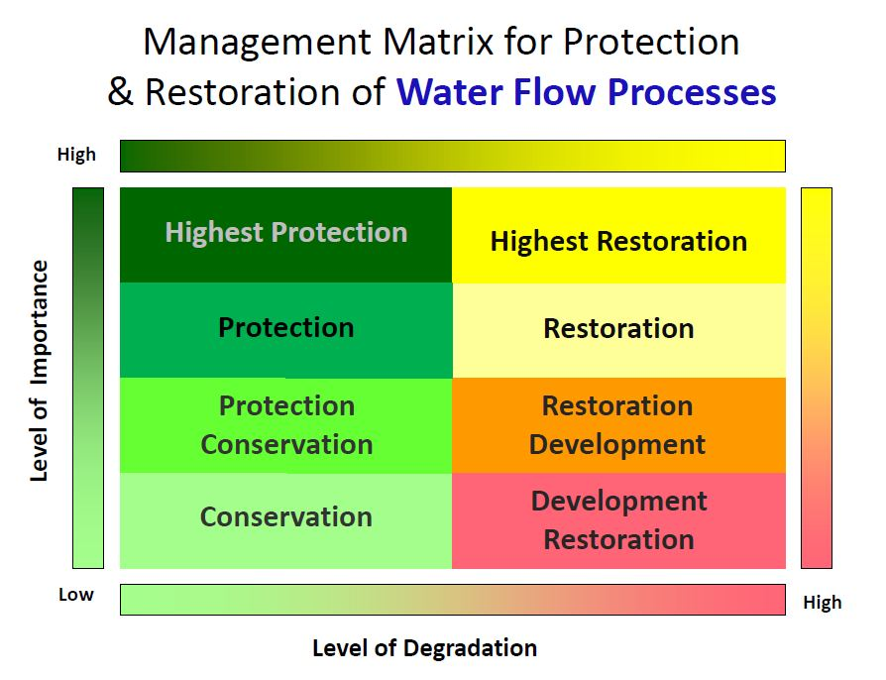
Comparing Your Results….
Overall Protection and Restoration
<number>
1
This is a suburban area within the City of Port Orchard
...wtshd\2016_WC\Blackjack\Blackjact Water Flow Assessment_06022016.pptx

Slide 33
Comparing Your Results….
Overall Protection and Restoration
<number>
1
This is a suburban area within the City of Port Orchard
For areas 1 and 2, which would be a priority for restoration?
2
This is a rural area primarily in pasture with low density housing
...wtshd\2016_WC\Blackjack\Blackjact Water Flow Assessment_06022016.pptx

Slide 34
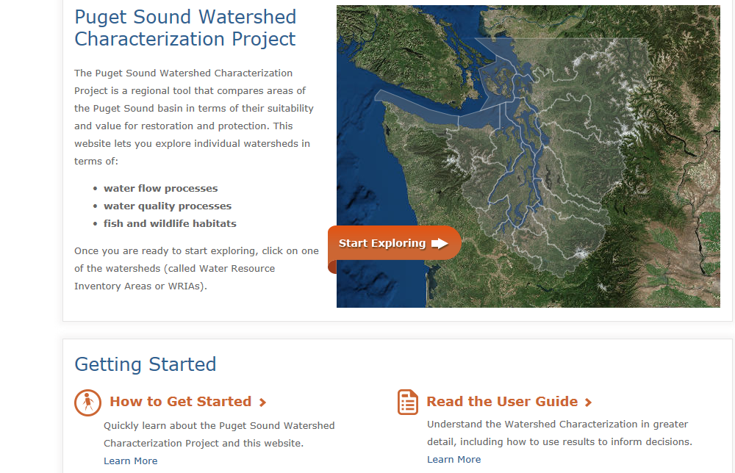
Exploring the Online Characterization Tool
<number>
Notes:
Landscape Characterization
6/28/05
<number>

Slide 35
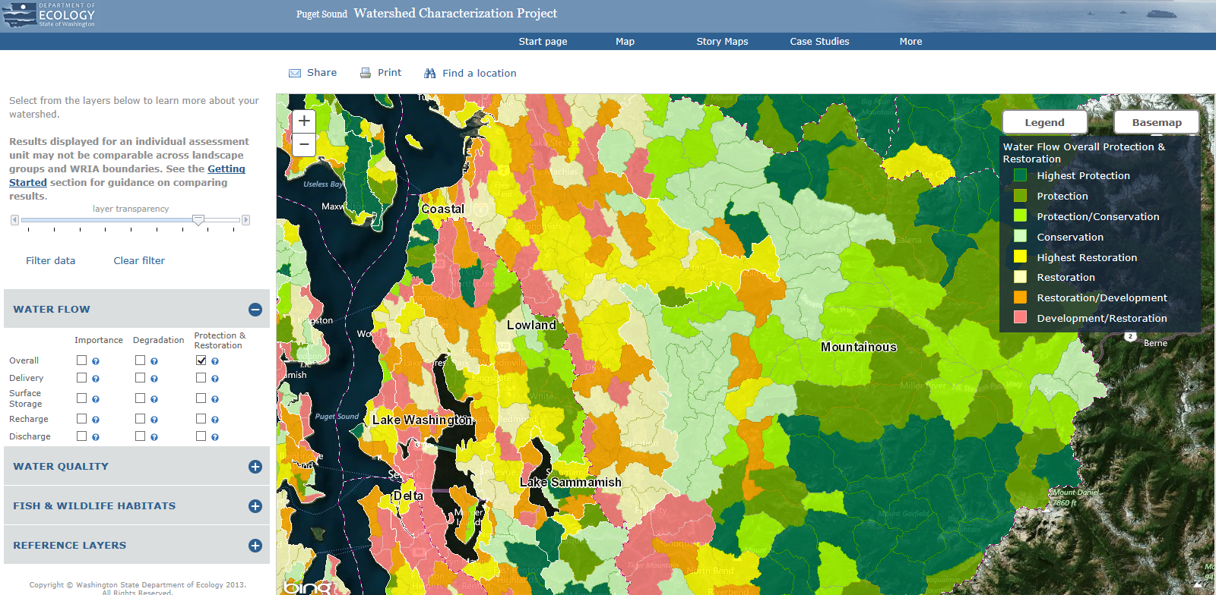
Exploring the Online Characterization Tool
<number>
https://fortress.wa.gov/ecy/coastalatlas/wc/landingpage.html
Notes:
Landscape Characterization
6/28/05
<number>

Slide 36
Puget Sound Characterization Project Contacts
<number>
https://fortress.wa.gov/ecy/coastalatlas/wc/landingpage.html
Colin Hume, Manager – chum461@ecy.wa.gov 425 649-7139
Susan Grigsby, GIS Scientist – gris461@ecy.wa.gov 360 407 7546
Brad McMillan, GIS Scientist – bram461@ecy.wa.gov 407 407 6047
Stephen Stanley, Watershed Scientist – ssta461@ecy.wa.gov 425 649-7007
Notes:
Landscape Characterization
6/28/05
<number>

