Slide 1
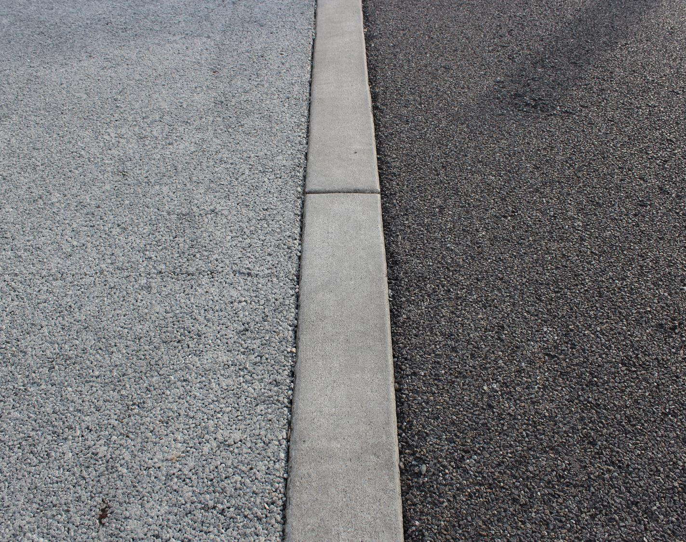


Permeable Pavements Maintenance above and beyond cleaning to maintain infiltration rates
Ani Jayakaran, PhD PE
Agricultural and Natural Resources Program Unit, Washington Stormwater Center

Slide 2
Adoption = education + regulation
lower the cost of compliance
+ ε
Notes:
.

Slide 3
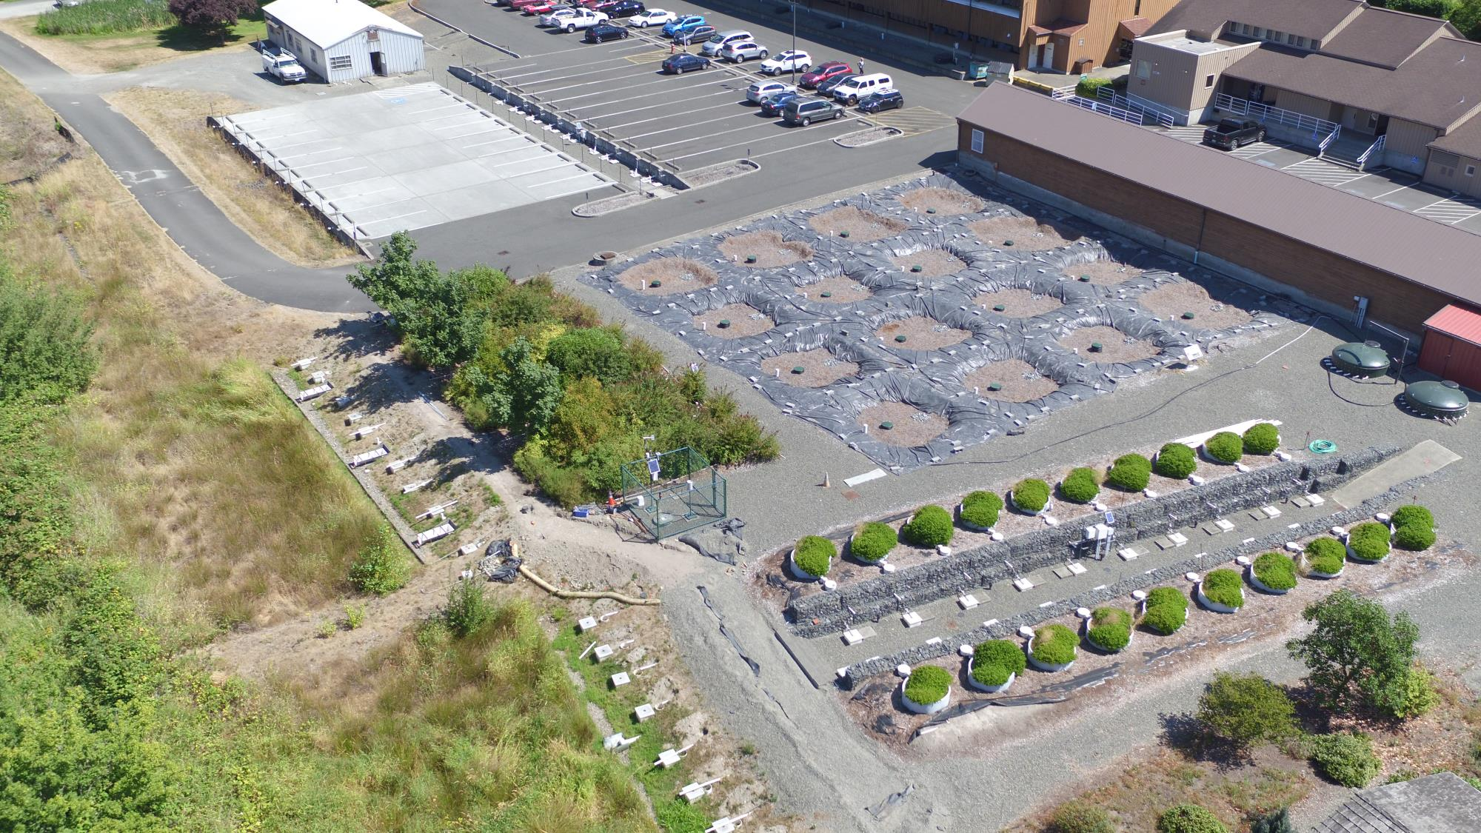
Washington Stormwater Center

Slide 4
Permeable pavements
Image from “Permeable Pavements” – ASCE 2015

Slide 5
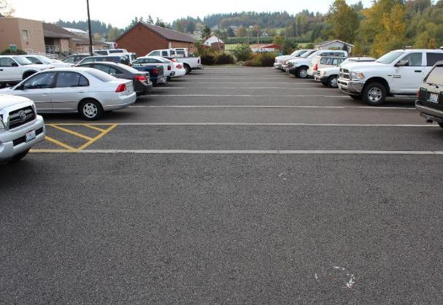
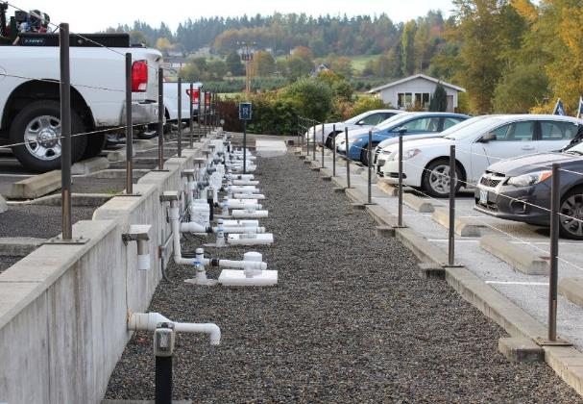
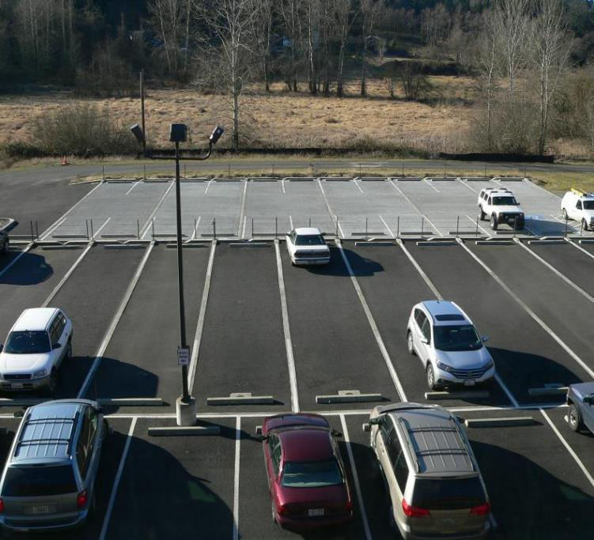
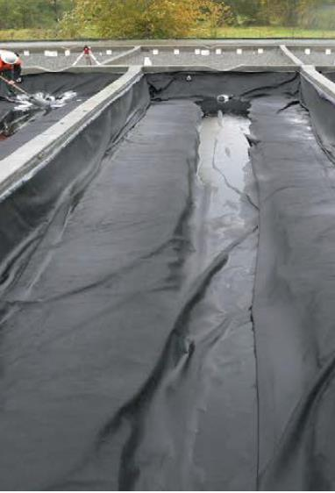
Porous asphalt study
Objectives
Water quantity impacts
Water quality remediation

Slide 6
Porous asphalt STORMWATER QUANTITY
Porous asphalt STORMWATER QUALITY
Attenuates peak flows, absorbs a LOT of rainfall
Knappenberger, T., Jayakaran, A.D., Stark, J.D. and Hinman, C.H., 2017. Monitoring Porous Asphalt Stormwater Infiltration and Outflow. Journal of Irrigation and Drainage Engineering, 143(8), p.04017027
Great for particulate matter!
Jayakaran, A.D., Knappenberger, T., Stark, J.D. and Hinman, C., 2019. “Remediation of Stormwater Pollutants by Porous Asphalt Pavement”. Water, 11(3), p.520. https://doi.org/10.3390/w11030520
Notes:
Porous asphalt does attenuate stormwater flows with very little runoff coming off the surfaces, but maintenance using an annual cleaning with a regenerative air street sweeper did not improve clogging. Traffic use appeared to be a greater driver of infiltration variability.
Maintenance using a regenerative air street sweeper improved functioning.

Slide 7
Jayakaran, A.D., Knappenberger, T., Stark, J.D. and Hinman, C., 2019. “Remediation of Stormwater Pollutants by Porous Asphalt Pavement”. Water, 11(3), p.520. https://doi.org/10.3390/w11030520

Slide 8
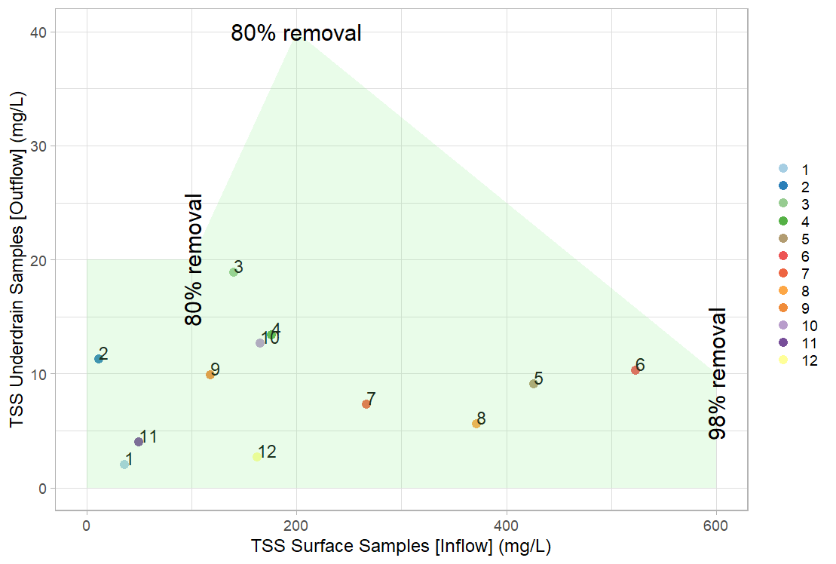
Ecology’s Performance Goal: Basic Treatment - achieve 80% removal of total suspended solids for influent concentrations that are greater than 100 mg/l, but less than 200 mg/l. For influent concentrations greater than 200 mg/l, a higher treatment goal may be appropriate. For influent concentrations less than 100 mg/l, the facilities are intended to achieve an effluent goal of 20 mg/l total suspended solids.

Slide 9
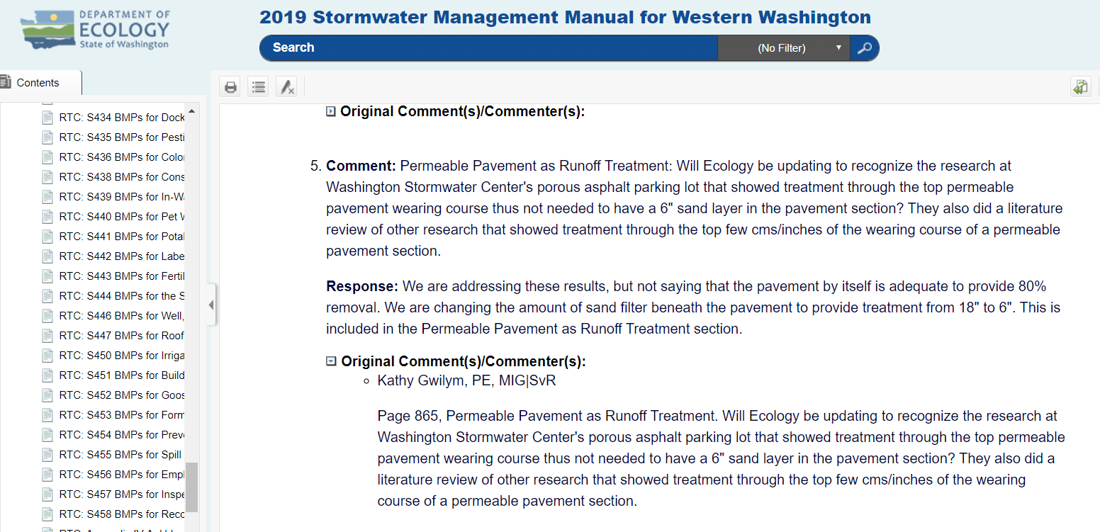
What I did
2019 Stormwater Manual for W Wa. - amended
$274K per mi. of roadway

Slide 10
Table from “Permeable Pavements” – ASCE 2015

Slide 11
1 acre of porous asphalt
Porous Asphalt @ - $6/sq.ft
Medium frequency of maintenance
https://www.waterrf.org/research/projects/bmp-and-lid-whole-life-cost-models-version-20

Slide 12
CAPITAL COSTS | Total Cost
Total Facility Base Cost | 1 acre | $6/sq ft. | $348,500
Total Associated Capital Costs (e.g., Engineering, Land, etc.) |  |  | $34,850
 |  |  | $460,050
REGULAR MAINTENANCE ACTIVITIES | Years between Events | Cost per Event | Total Cost per Year
Inspection, Reporting & Information Management | 1 | $350 | $350
Litter & Minor Debris Removal | 0.5 | $400 | $800
Permeable pavement sweeping | 0.5 | $640 | $1,280
 |  |  | $2,430
CORRECTIVE AND INFREQUENT MAINTENANCE ACTIVITIES (Unplanned and/or >3yrs. b/w events) | Years between Events | Cost per Event | Total Cost per Year
Intermittent facility maintenance | 0 | $0 | $0
Remove existing pavement & aggregate; wash and/or replace & reinstall* | 35 | $348,500 | $9,957
Totals, Corrective & Infrequent Maintenance Activities |  |  | $9,957
WERF LID Cost Calculator (Version 2.0, 2009)

Slide 13
Table from “Permeable Pavements” – ASCE 2015

Slide 14
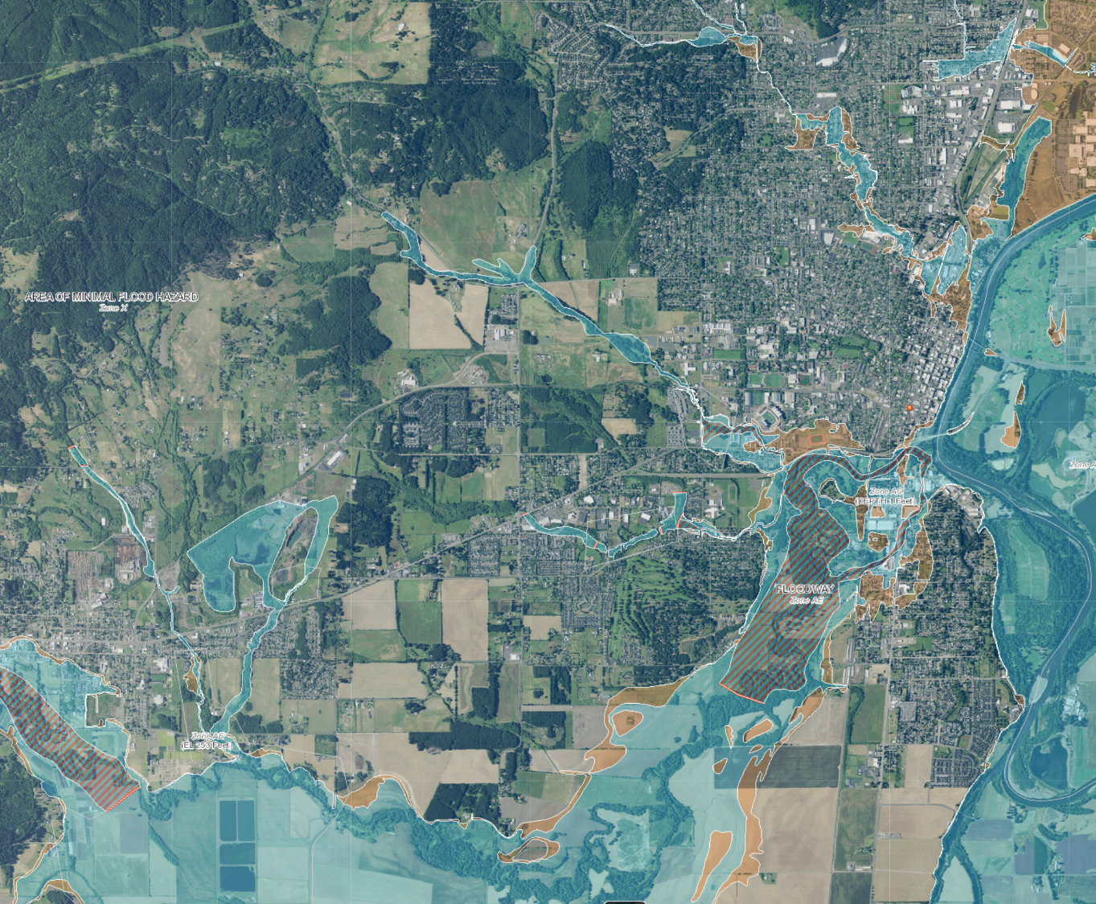

Corvallis OR
Long Zhou, Guoqiang Shen, Thomas Woodfin, Tian Chen & Kun Song (2018), Ecological and economic impacts of green roofs and permeable pavements at the city level: the case of Corvallis, Oregon, Journal of Environmental Planning and Management, 61:3, 430-450, DOI: 10.1080/09640568.2017.1314859
Retrofit Green roofs + Permeable Pavements ($453M -$502M)
carbon sequestration
stormwater infrastructure improvement
amenity value
habitat creation
stormwater purification
avoided stormwater infrastructure costs energy savings
food production
air quality benefits
$210M to $219M in benefits using LID over 10 years incl. $150M flood damage
$540M - $552M w/o flood loss
Notes:
Assuming a 100-yr flood causing $150M worth of damage

Slide 15
Design Suggestions
Build part pervious, part impervious (max drainage area 1.5 -2:1)
Combine gray repair and green infrastructure installs
Ensure pavement is the highest point on terrain. If that’s not doable, install a barrier between dirt and pavement

Slide 16
Maintenance Suggestions
Have a maintenance plan from the outset – it is the most important part of your system
Separate plans for homeowners vs jurisdictional crews
Keep sediment and organic material off pavements

Slide 17
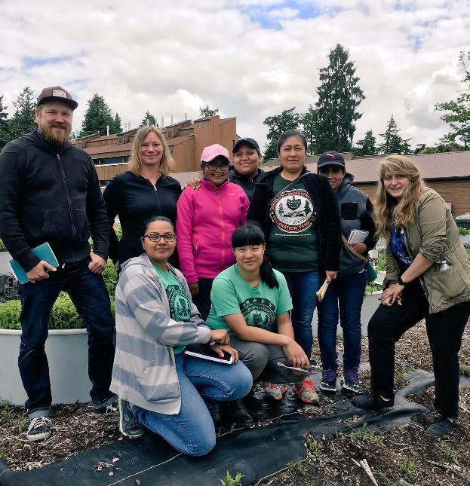
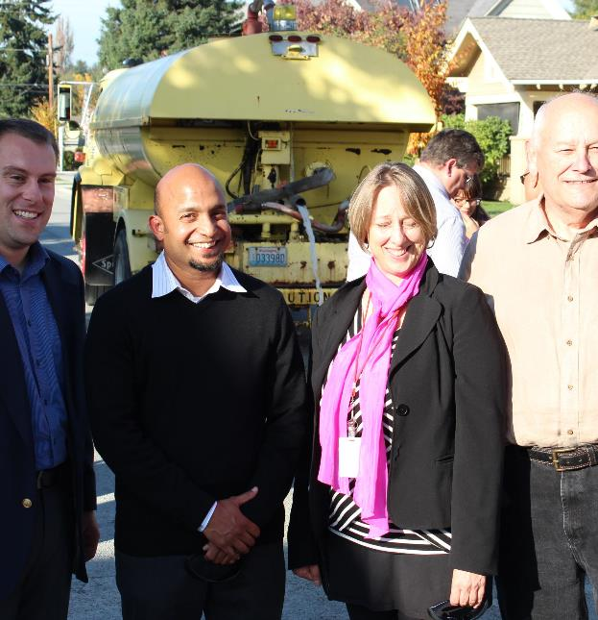
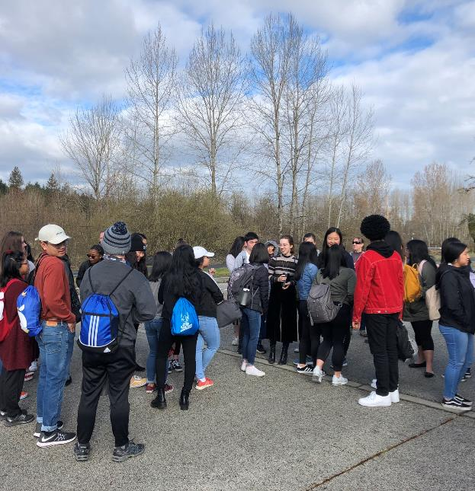
Community education
Notes:
The last scale encompasses a lot of what I do now as a 100% extension faculty at Washington State University, and maybe one of my biggest challenges. I really think of all the jobs I have held teaching, doing research and working in extension, extension is the most challenging and the most rewarding.

Slide 18
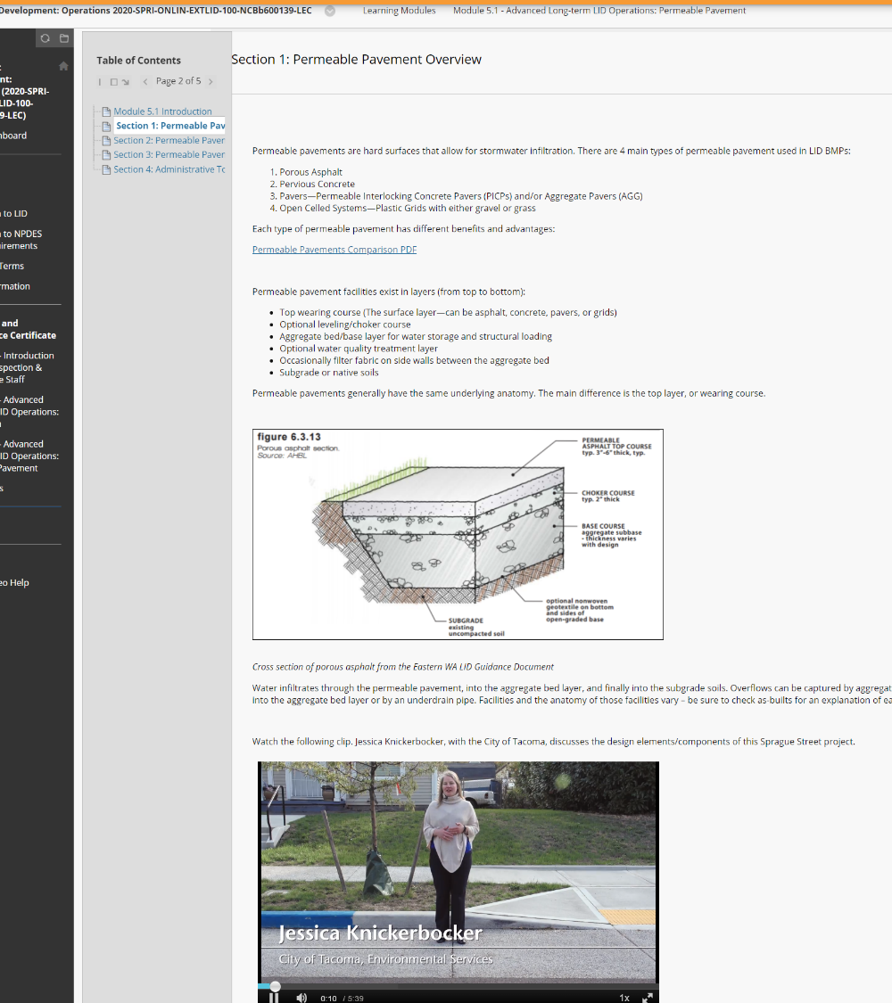

LID Operations and Maintenance Training

Slide 19
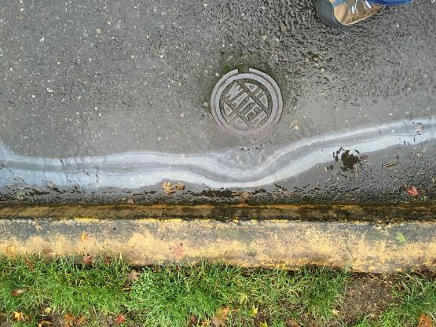





Thank you! anand.jayakaran@wsu.edu
Acknowledgments
Funding:
Washington State University + Extension
National Estuary Program, Washington State Dept. of Ecology, Boeing Inc, Stormwater in Action
Technicians
Carly Thompson, Brandon Boyd
Students
Chelsea Mitchell
Others
Andrew Flury, Jason Berg

Slide 20
https://forms.gle/xMT28DSb37V6hPWU7

Slide 21
“Permeable Pavements” – ASCE 2012

Slide 23
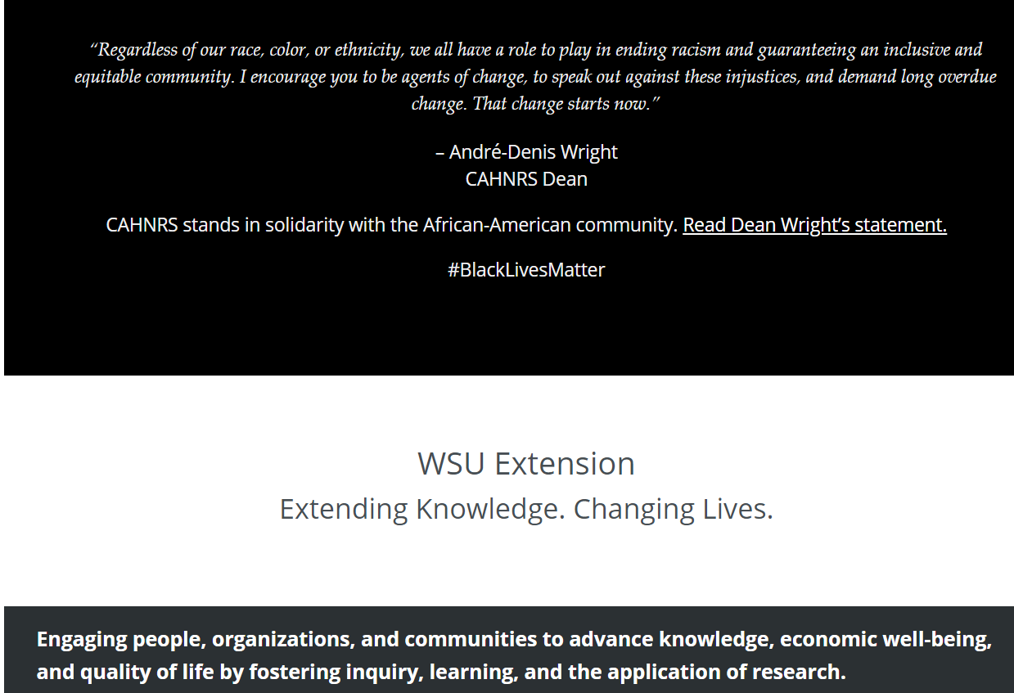
WSU Extension – The Land Grant Mission

