Slide 1

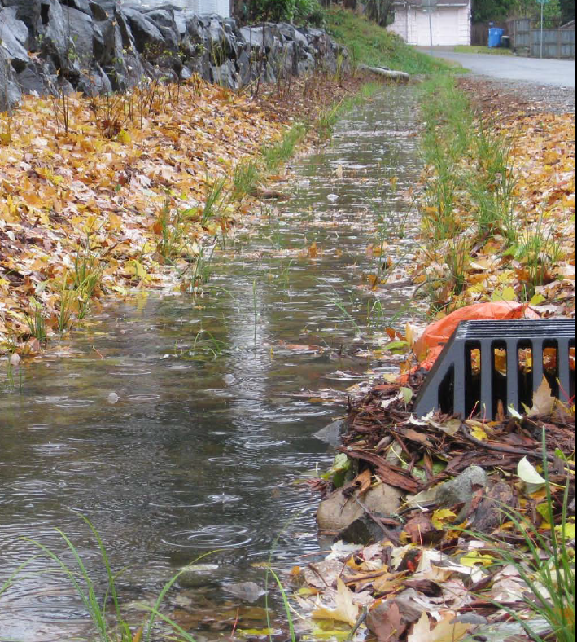
Building Cities in the Rain:
Watershed Prioritization for Stormwater Retrofits
Heather Ballash
Senior Planner
Growth Management Services
Photo: SvR Design
January 31, 2018

Slide 2
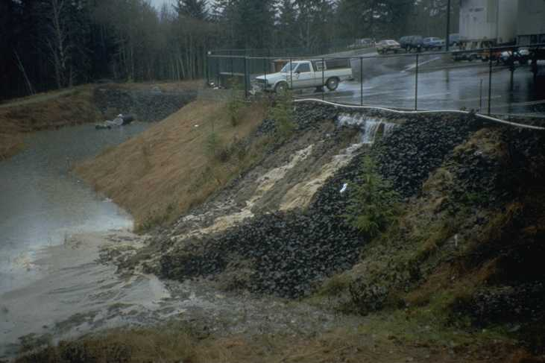
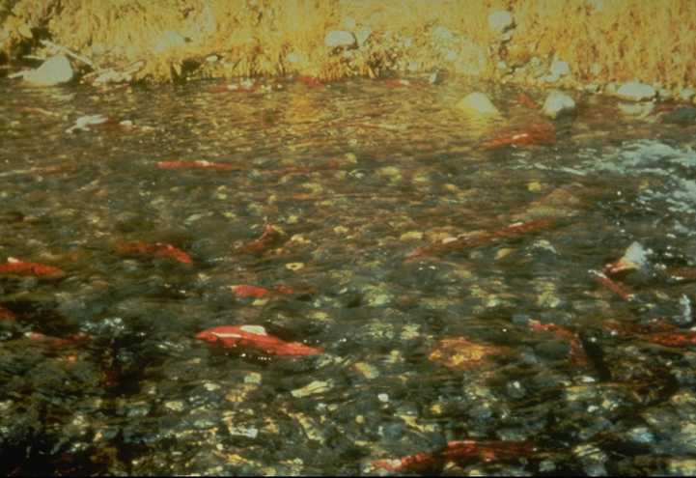

Overview
Growth Management Act, NPDES, and Salmon Recovery
Building Cities in the Rain – Watershed Prioritization Guidance
Uses of the Guidance

Slide 3
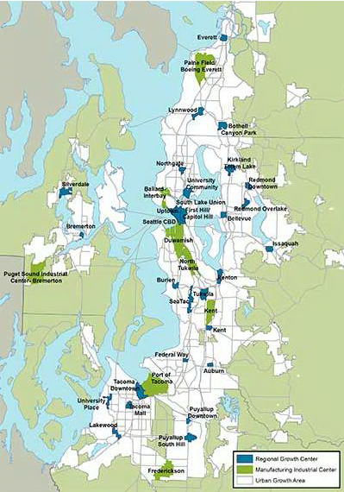
VISION 2040: Regional Growth Centers
Regional strategy focused on designated centers linked by transit:
29 Regional Growth Centers
2.5% of total UGA (≈25 sq mi)
Currently 29% of region’s jobs
8 Manufacturing/Industrial Centers
3.7% of total UGA area
Notes:
The Puget Sound Regional Council is unique in the state in that it is required by the GMA to adopt multi-county policies for Pierce, King, Snohomish and Kitsap Counties and the cities within them that guide local comprehensive plans.
VISION 2040, and now VISION 2050, provides the policy framework for accommodating 1.7 million more people by 2040. As you heard from Erika, the numbers have already been updated since BCitR was published in September 2016.
PSRCs VISION calls for a major transformation of how our communities grow over time. In interviews with federal, state, and local stormwater managers and planners, their response is consistent with VISION that the best strategy for accommodating future population growth is:
To Build Up, not Out
To redevelop existing impervious areas, rather than greenfields, to reduce stormwater runoff
To build compact urban centers, linked with transit, that reduces dependence on cars, roads and parking – sources of polluted urban runoff
The focus of Building Cities in the Rain is on those designated regional centers in VISION where a significant portion of growth is planned for. And that means a focus on including stormwater in local comprehensive planning for those regional centers.

Slide 4
Puget Sound Action Agenda (2011)
Commerce Near Term Action A1.2.1:
“Land Use Planning Barriers, BMPs and Example Policies”: address barriers to policies that encourage compact growth, increased density, water quality standards, redevelopment…..”
South Central LIO Near Term Action SC13: “Develop recommendations for incentives and cost effective tools to meet stormwater management and GMA … to encourage infill… in urban centers instead of greenfield… and to improve water quality.”
Notes:
Commerce NTA: Identify land use planning barriers to policies that encourage compact growth, increased density, water quality standards and redevelopment. And develop BMPS and example policies to address those barriers.
South Central LIO NTA: Develop recommendations for incentives and cost effective tools to meet SW management and GMA requirements. Caucus was very clear that these incentives and tools would not diminish any environmental regulations.
Source of funds for Commerce’s role in this project is an NEP Grant to Ecology and Commerce for Watershed Protection and Restoration that helps implement the Action Agenda.

Slide 5
Puget Sound Regional Council
“NPDES v. GMA”
NPDES v. GMA: Stormwater regulations are often more costly in ultra-urban areas than in green-fields.
NPDES & GMA/Regional Growth Strategy: How to encourage development in designated urban centers and manage stormwater effectively?
Notes:
This project started with a series of discussions at the PSRC GMPB.
Are NPDES regulations contributing to developers building outside UGAs?
Or are developers building beneath the stormwater regulatory thresholds to the detriment of desired density?
Source: Problem statement “NPDES v GMA” is from the May 2013 presentation from City of Tacoma’s David Boe
Flow control requirements for development and redevelopment under the Municipal Permit require meeting forested condition standards. This has a restoration component that is not required under the GMA for critical areas – protection of existing conditions. Compliance with the flow control requirements will result in improved conditions, but can be very costly for redevelopment projects in already urban areas.
***********************************************************
From Commerce-LIO Scope of Work, here is the full problem statement:
“Current regulatory and legal requirements, including stormwater management, provide important environmental protections but can also make development in urban centers more expensive than in less dense areas. What approaches can the region use to both encourage development in dense urban centers to meet land use goals, while meeting water quality requirements?”
Stormwater controls can take up to 10% of the land designated as an urban center. And then you end up using very expensive solutions to meet density goals and stormwater requirements on the same parcel.

Slide 6
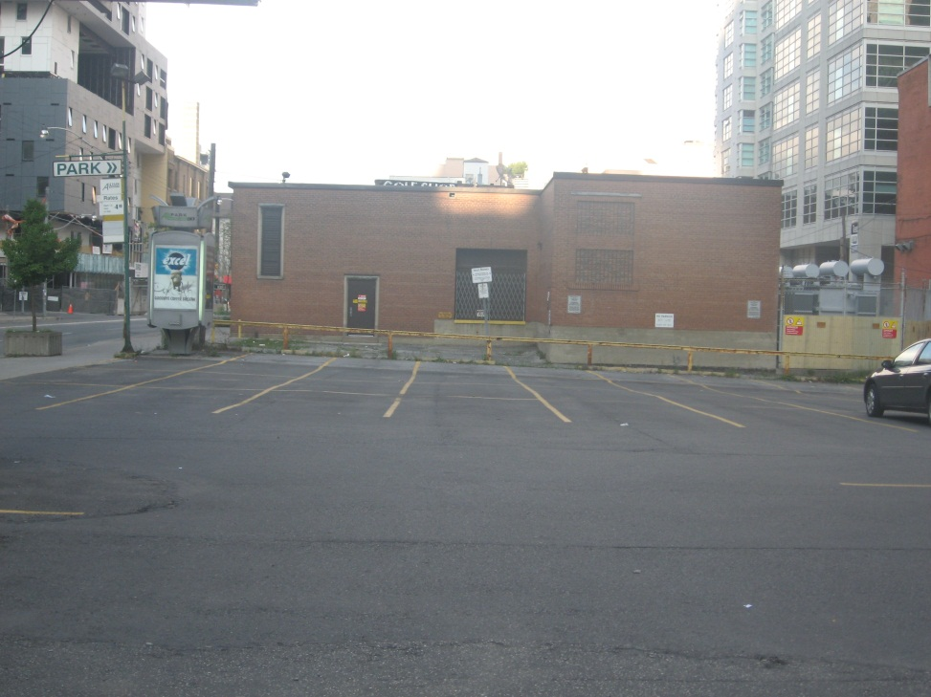
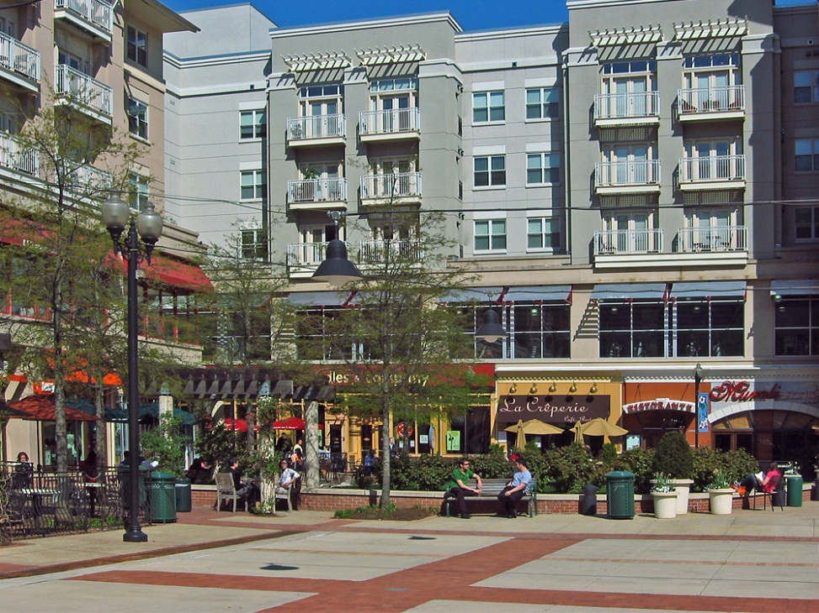
NPDES and Urban Infill Redevelopment
Before: little or no water quality and flow controls, pollutant generating impervious surface
After: less impervious surface and some green infrastructure, little or no pollutant generating impervious surface
Photo by A. Easton
Photo by Brett VA
Photo by A. Easton
Photo by Brett VA
Notes:
If redevelopment doesn’t occur in already urbanized areas, there are flow and water quality implications. For example, if this parking lot isn’t redeveloped, existing pollution and flows will continue at the site.

Slide 7
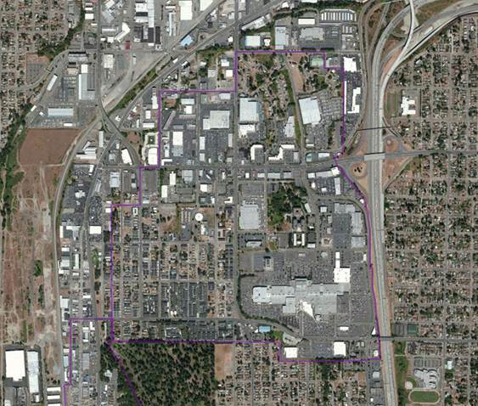
NPDES and Salmon Recovery
Waiting for redevelopment:
Based on market forces and not highest-priority watersheds
Not enough funding to retrofit all watersheds in the immediate future
Public investment is not targeted to high-priority watersheds
No opportunity to leverage funding for habitat restoration
Tacoma Mall Subarea
Notes:
The predicted annual rate of mitigation of new and redevelopment in Puget Sound is 1.6 percent over a 30-year period. (WRIA 9 study by King County). At this rate, it will take more than 60 years to retrofit all watersheds, and for any urbanized creek in Puget Sound to be healthy. Redevelopment will occur where the market demands, and not necessarily in the watersheds with the highest potential for environmental improvement or restoration.
Benefits of watershed prioritization to waterbody restoration:
Target retrofit investment where will be most effective in restoring waterbodies
Do not have to wait for redevelopment in high-priority watersheds
Begins to break down the silos between stormwater management and habitat restoration – provides opportunity to leverage habitat restoration funding with stormwater retrofit funding

Slide 8
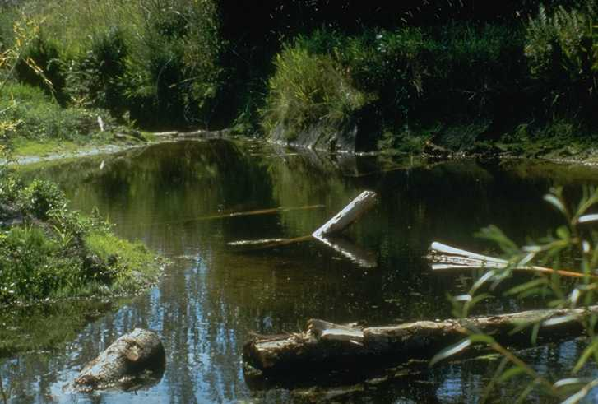
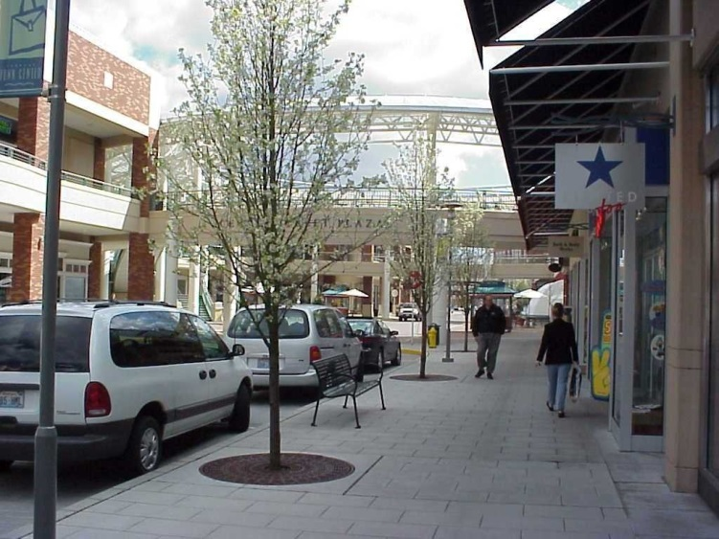
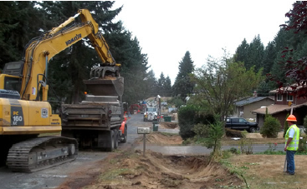
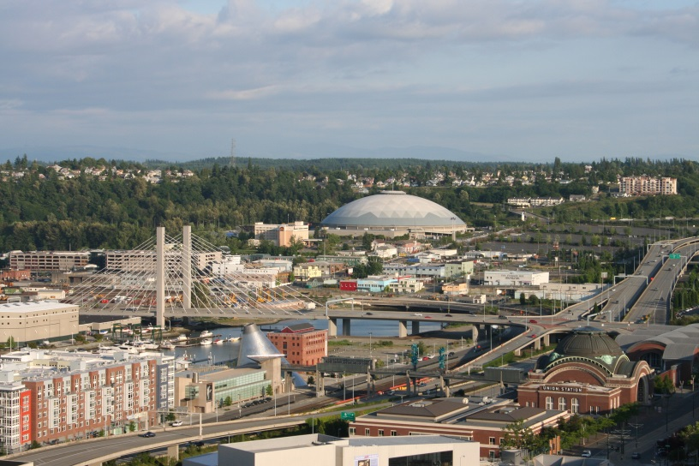
Desired Outcome = Vibrant Designated Urban Centers + Clean Water + Restored Fish Habitat
Photo: SvR Design
Notes:
The desired outcomes: The region has healthier watersheds and streams and vibrant, compact, designated urban centers, facilitated by stormwater mitigation for redevelopment in compact urban centers being as (or less) easy/expensive than in lower-density areas. I.e. having more knowledge, tools, resources, etc.
So, the conversation has changed from GMA v. NPDES to harmonizing GMA, NPDES and salmon recovery.

Slide 9
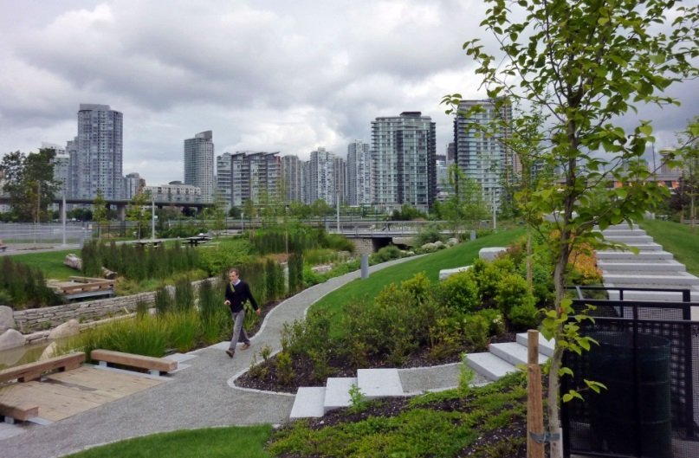
Building Cities in the Rain
Watershed Prioritization for Stormwater Investment
Notes:
Focus on designated Regional Growth Centers under VISION 2040’s regional growth strategy.

Slide 10
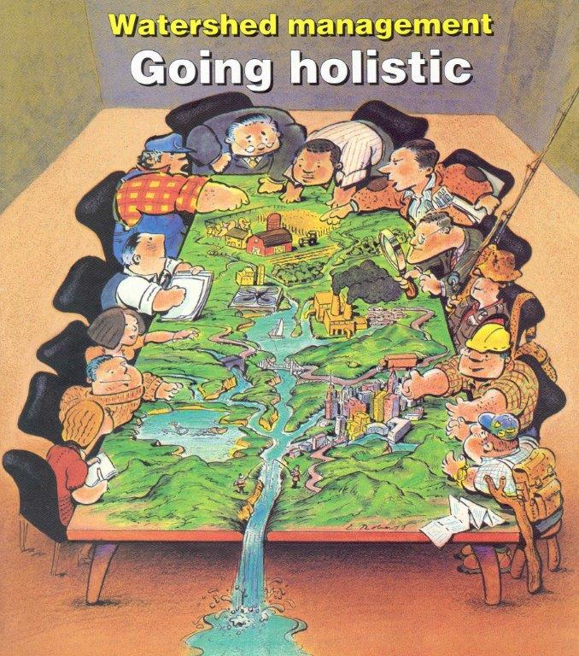
Building Cities in the Rain Work Group
Tacoma Issaquah
Redmond Bellevue
SeaTac Everett
King County Thurston County
Futurewise Ecology
WDFW WRIA 8
EPA Commerce
Puget Sound Regional Council
Puget Sound Partnership
Notes:
Interdisciplinary project – planners and engineers, biologists and watershed planners, all must work together to meet both GMA requirements for accommodating projected population growth, stormwater requirements under the Clean Water Act, and salmon recovery goals.
GMA is the context for meeting these types of requirements because it requires a city or county to look at an issue early in the planning process. Stormwater facilities are infrastructure needed to support development. Counties and cities must plan for that infrastructure in their comprehensive plan capital facilities elements. The GMA also requires special consideration to conservation or protection
measures necessary to preserve or enhance anadromous fisheries.

Slide 11
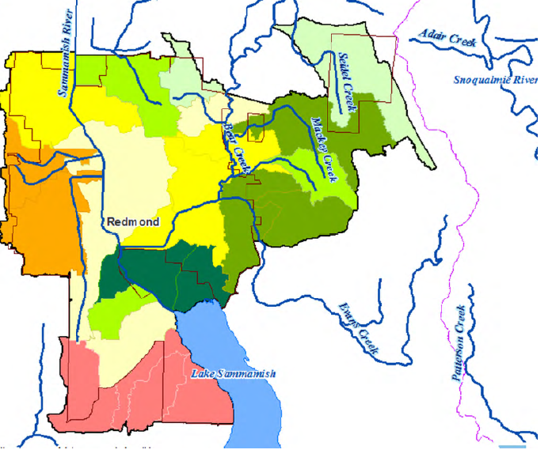
Process and Data for Prioritizing Watersheds
Establish prioritization goals/policies.
Review regional-scale information as initial screen. Refine with local data.
Seek input from stakeholders (tribes, resource agencies, your neighbors/the public).
Plan for stormwater retrofits where expected to accelerate environmental improvement.
Notes:
We are prioritizing watersheds (because that is where the retrofit, other actions will take place), with a primary consideration of restoring waterbodies.

Slide 12
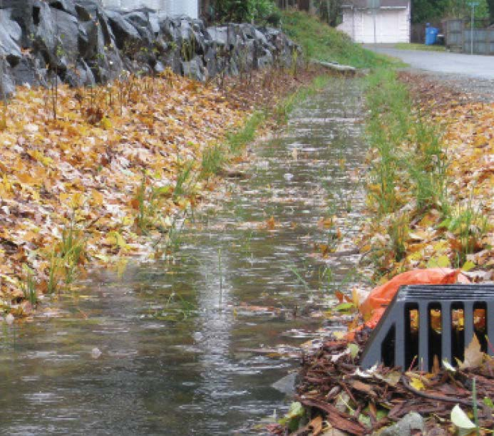
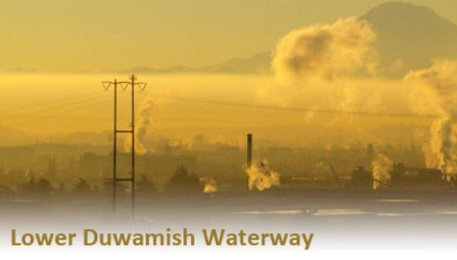
Data Recommended for Prioritization
Fish Use and Aquatic Conditions
Opportunity Assessment for Flow Control, Polluted Runoff Treatment and Low Impact Development
Considerations for Environmental Justice
Notes:
Actual or potential fish use data – WRIA plans, WDFW’s SalmonScape web site, then local information on physical and natural barriers.
Aquatic conditions data – tree canopy and/or the condition of buffers for habitat
Opportunity assessment data – existing land cover/amount of impervious surface, the age and condition of existing stormwater infrastructure, and coordination with state and local plans.
The EPA provides an Environmental Justice Screening and Mapping Tool that local governments could use as a tie-breaker if two or more watersheds are determined of equal priority using the other data sources previously mentioned.

Slide 13
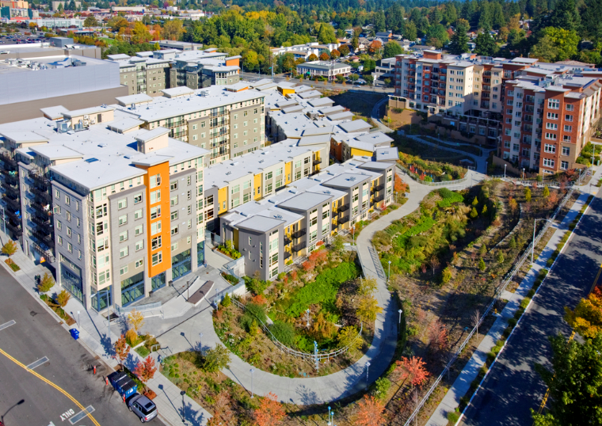
Uses for Watershed Prioritization
Basin planning for stormwater facilities – early planning for capital facilities (ala GMA)
Prioritizing project proposals for Ecology stormwater retrofit grants
Informing water clean up plans (TMDL)
Establishing a stormwater control transfer program per Ecology guidance
Photo: SvR Design
Notes:
The focus of this guidance is on early planning for capital facilities – the approach that is required under the GMA for all capital facilities planning to plan for adequate infrastructure to support development holistically than parcel-by-parcel as development is proposed. A programmatic basin-wide approach is most cost effective, especially when it is leveraged with private funds.
Can be used for regional facilities – early planning in capital facilities plans. Regional facilities can be green and not gray, and can provide much needed green space in some urban centers. Thornton Creek in Seattle is a good regional example.
Prioritizing projects for stormwater retrofit grants from Ecology
Informing clean up plans
As well as stormwater control transfer programs
This guidance is specific to planning for stormwater retrofits, but the holistic early planning approach using prioritization can be applied to planning for any type of capital facility. As you know, GMA requires a 20-year comprehensive plan for accommodating growth, with a six-year capital facilities program.

Slide 14
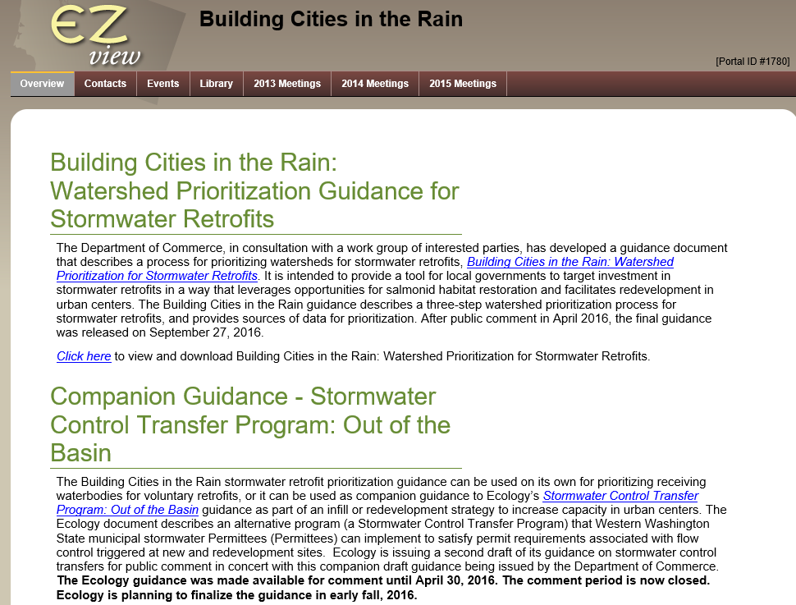
Watershed Prioritization Guidance
To view the guidance: www.ezview.wa.gov

Slide 15
Lessons Learned
Managing stormwater on site can be challenging in urbanized areas
1.7 million people coming
Not enough money to retrofit all watersheds now
Market drives retrofits
Need to plan (prioritize) early for stormwater retrofit investment
GMA & NPDES works
Compact development is a beneficial stormwater strategy
Stormwater investment can be leveraged for salmon habitat restoration
Working in multi-disciplinary teams help break down silos
Notes:
Requiring all stormwater to be managed on site is a challenge in an already urbanized environment, especially for flow control requirements.
We have to encourage redevelopment of urban centers to accommodate the 1.7 million more people that will be here by 2040
There isn’t enough money to retrofit all of our watersheds in the immediate future.
Redevelopment of existing areas that will allow for retrofits will be based on the market and not highest-priority watersheds
Need to plan early for stormwater investments, as we do for transportation and other infrastructure under the GMA
It doesn’t have to NPDES v. GMA, NPDES & GMA really can work - Cities and counties can benefit from planning for stormwater retrofits at a regional level rather than parcel-by-parcel ala GMA
Compact development is a beneficial stormwater strategy because it creates less impervious surface and vehicle travel per capita than more dispersed growth.
We can use these investments to leverage funding for salmon habitat restoration – prioritizing watersheds with most potential for environmental uplift, as well as leveraging restoration funding
A multi-disciplinary approach is truly beneficial to this kind of effort – planners, public works and stormwater planners start talking and learning together

Slide 16


Presented by:
Heather Ballash
Senior Planner
(360) 725-3044
heather.ballash@commerce.wa.gov
www.commerce.wa.gov

