Slide 1

Shift and Change: Building Cities in the Rain
Peg Staeheli, PLA FASLA, LEED AP
MIG|SvR
www.migcom.com
January 31, 2018

Slide 2
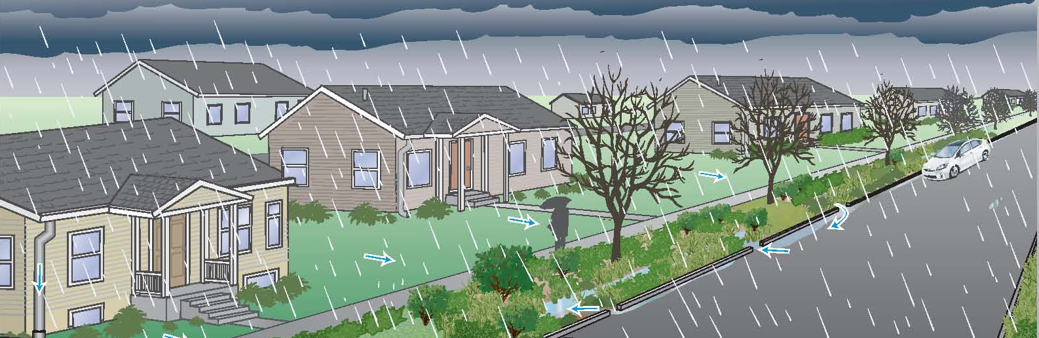
Anticipatory attitude change refers to shifting or changing one’s expressed opinion or attitude on a topic as a result of being informed that one will be exposed to a message or communication on the topic. Thus, prior to receiving any aspect of the message itself, people might adjust their opinions on a topic to be more positive, negative, or neutral simply in anticipation of receiving a message. In other words, when you know someone is going to try to change your mind, you may change it some already in advance, before even hearing what that person has to say

Slide 3

Me, change! Me, alter!
Then I will, when on the Everlasting Hill
A Smaller Purple grows—
At sunset, or a lesser glow
Flickers upon Cordillera—
At Day's superior close!
by Emily Dickinson

Slide 4
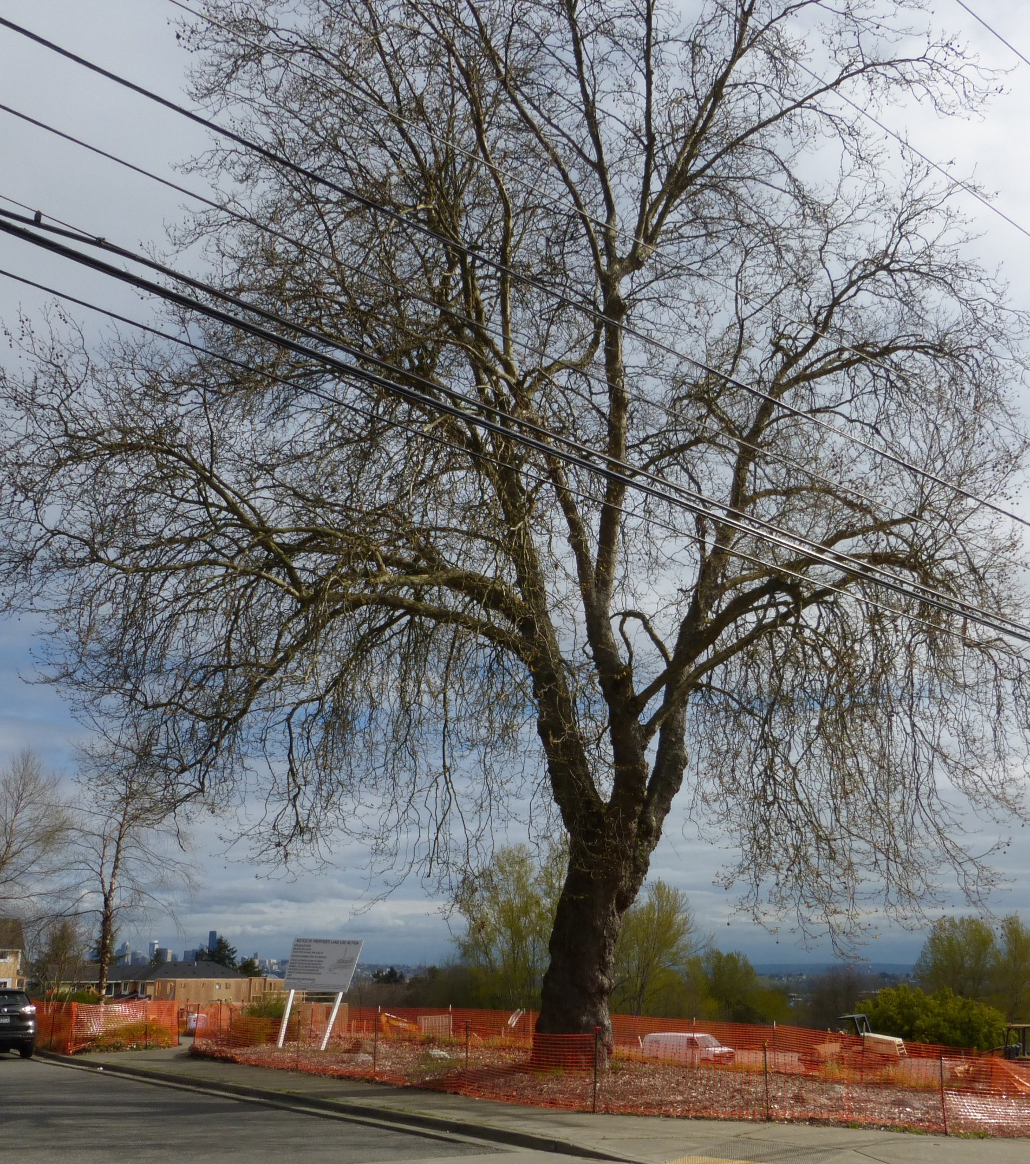
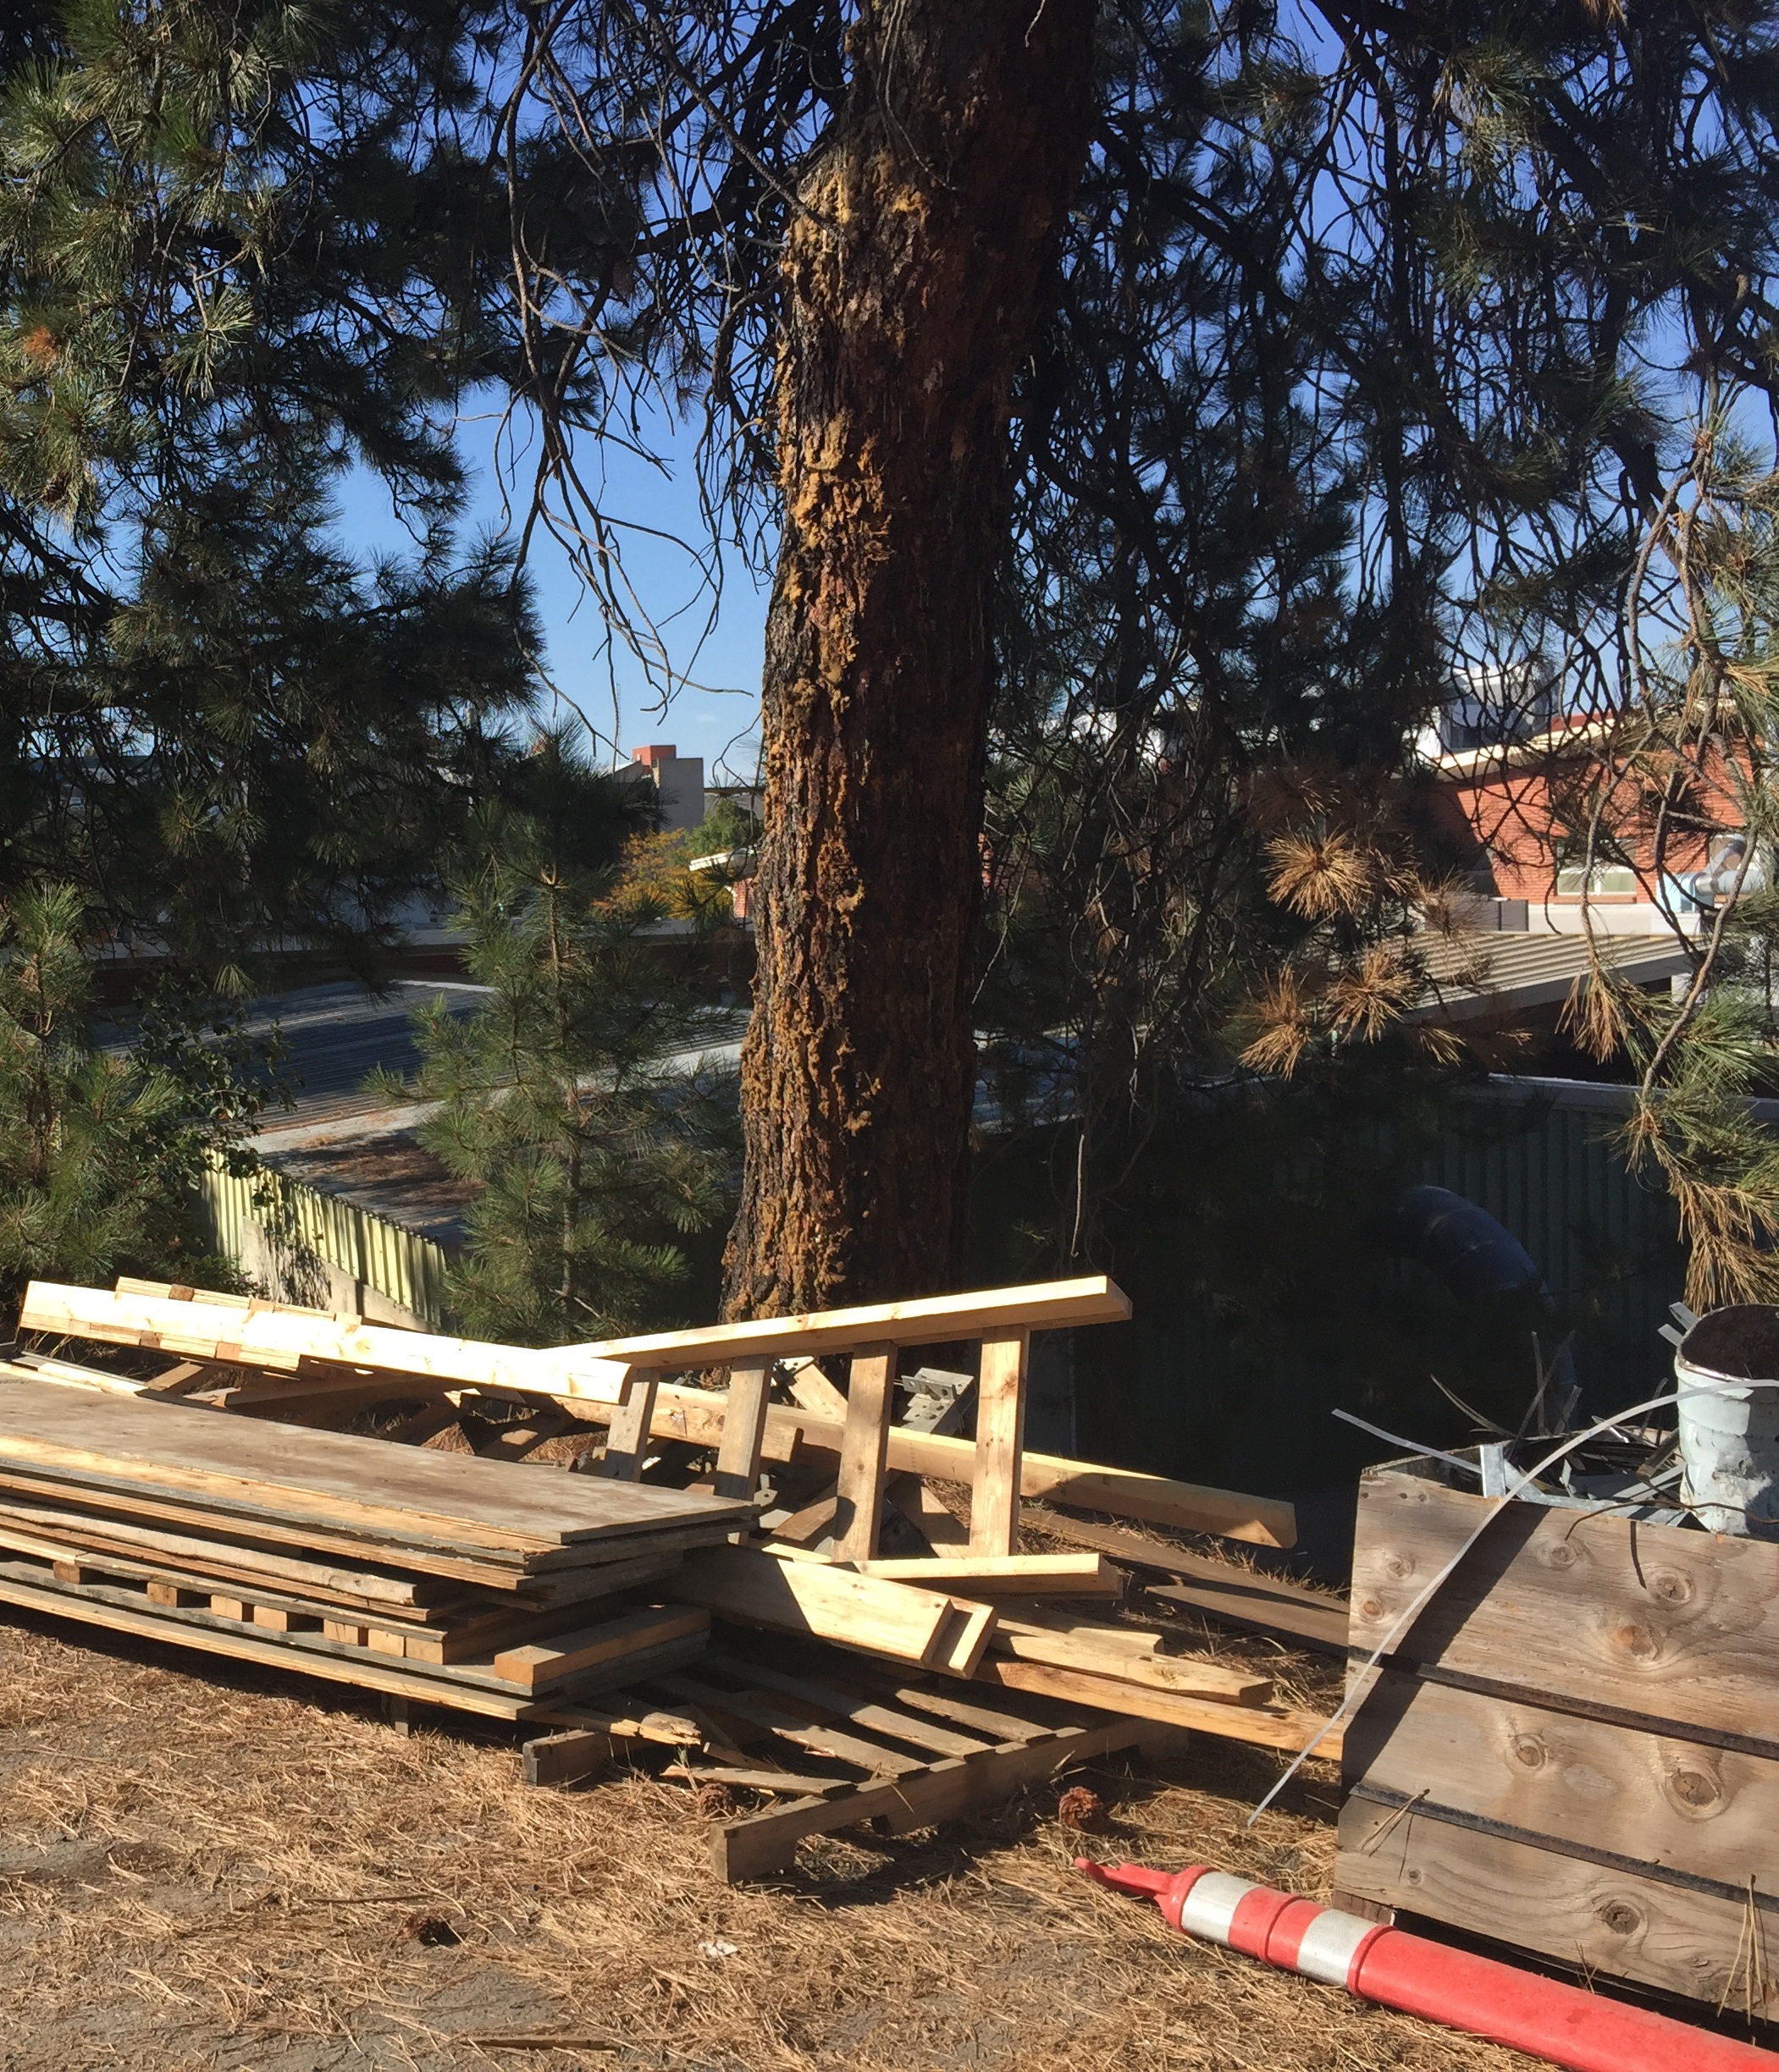
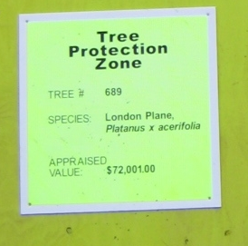
The individual does not necessarily experience changes in beliefs or evaluations of an attitude object, but rather is influenced by the social outcomes of adopting a change in behavior.
The individual is also often aware that he or she
is being urged to respond in a certain way.
Attitude change - Wikipedia
https://en.wikipedia.org/wiki/Attitude_change

Slide 5
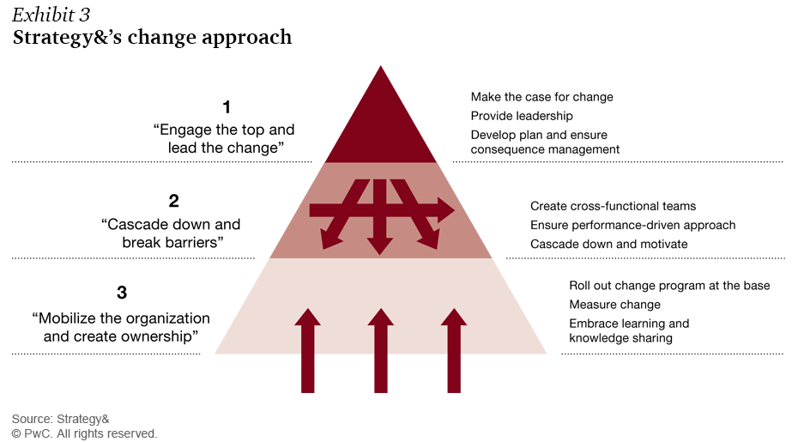
We are making progress!

Slide 6
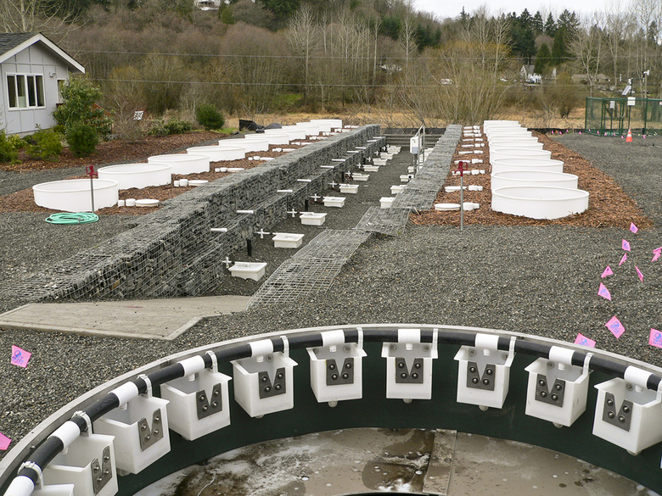
We will continue…
Solving the stormwater problem through teamwork
WSU April 14, 2016 https://www.seattletimes.com/.../solving-the-stormwater-problem-through-teamwork/

Slide 7
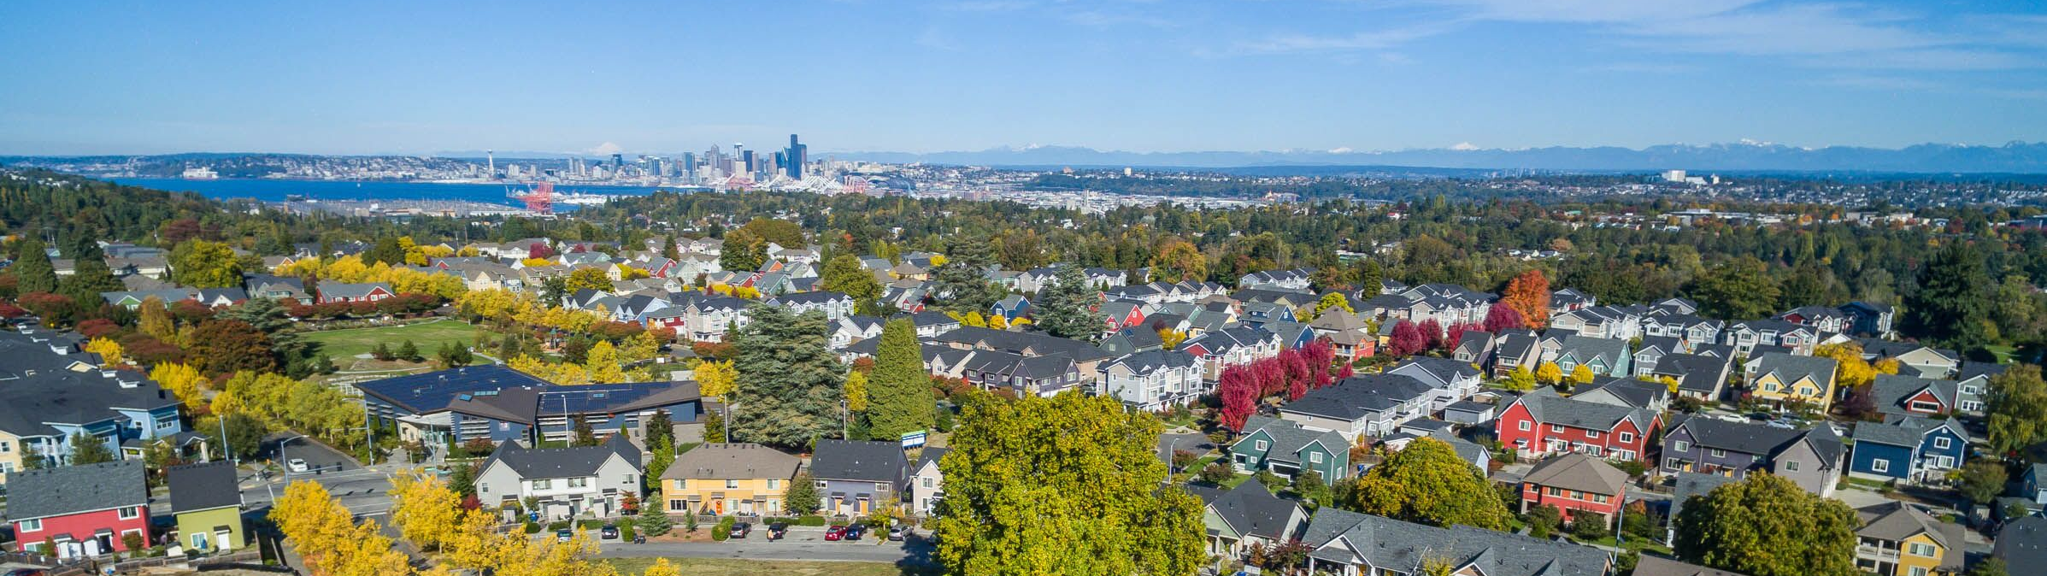
What will happen to change?
Will change change as all things?
Or will it develop immunity
And embrace hypocrisy?
Will change resist change
And go against its doctrinaire?
Why, will change change not
Should nothing be permanent, even change?
Since change is also a thing.
by ifedayo oshin
One Million More in Seattle-Tacoma-Bellevue by 2030

