Slide 1
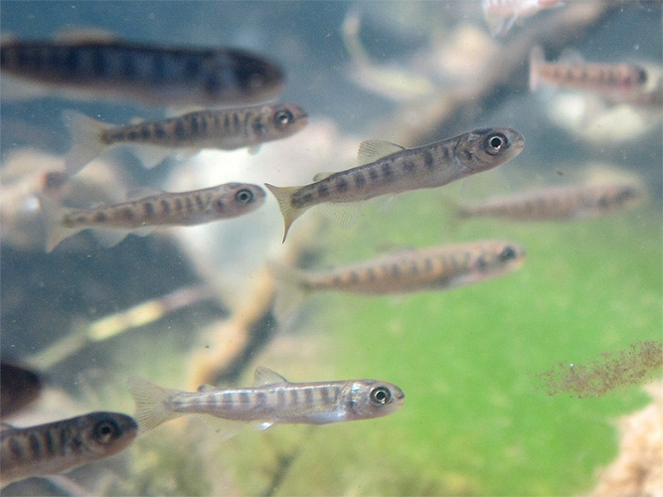
Shifting Paradigms to Save Salmon
By Valerie Streeter
and
Kelly Finley
Tulalip Tribes Natural Resources

Slide 2
Best Management Practices (BMPs)
Post-Construction: more green, less gray
Pollution Prevention: Pick it up before the rain does…and, don’t forget SEPTIC SYSTEMS
Outreach: Homeowners, business, students, fishermen
Education: Why, where and how?

Slide 3
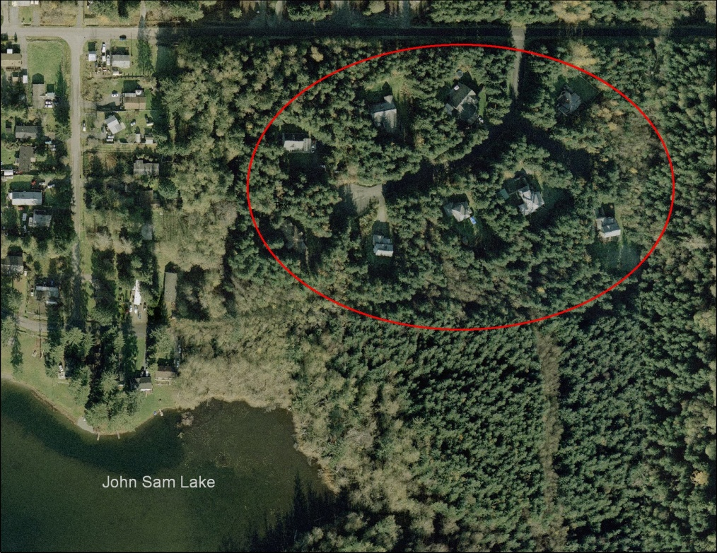
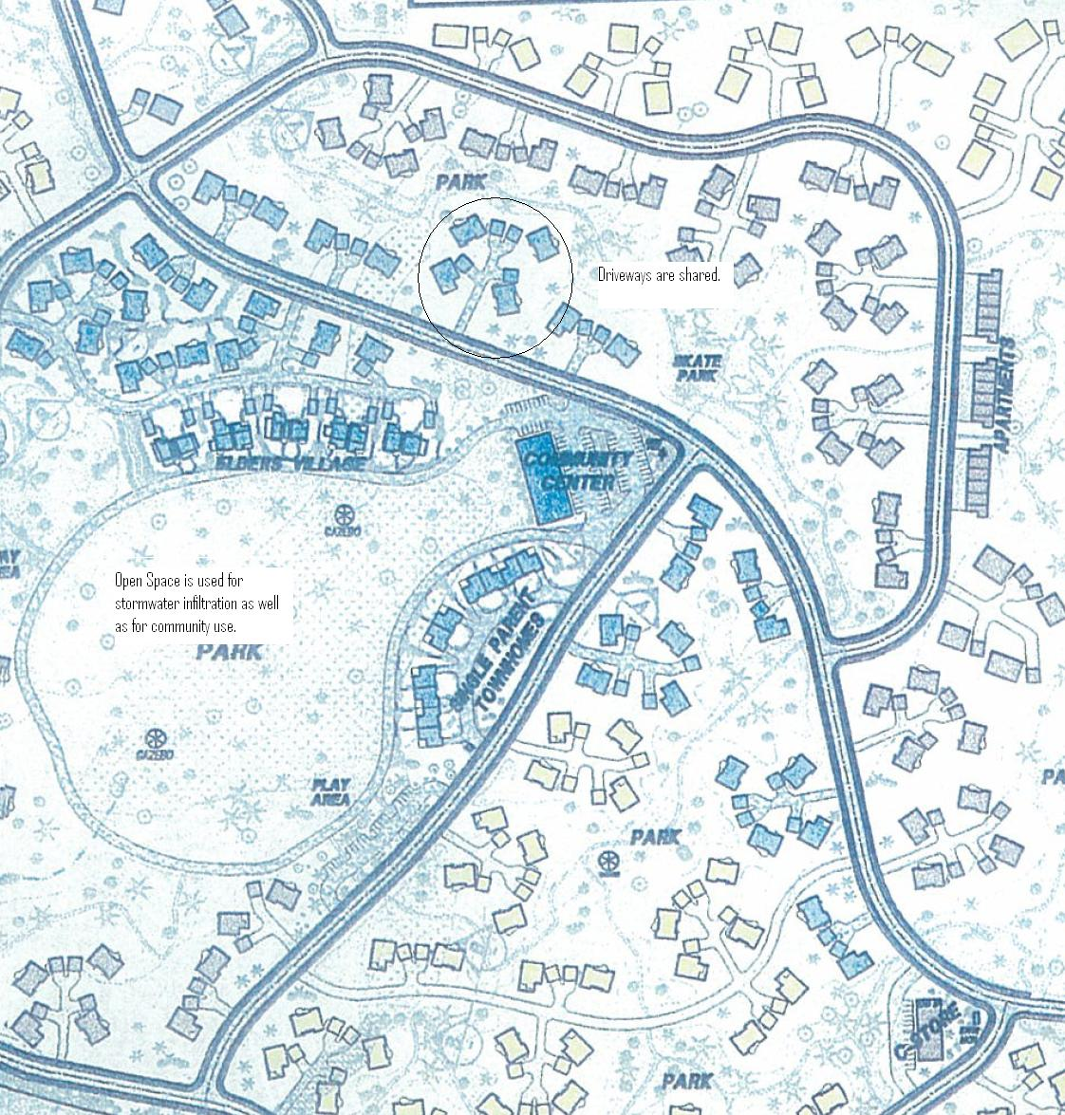
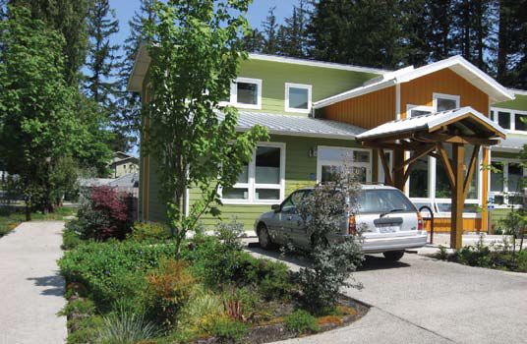
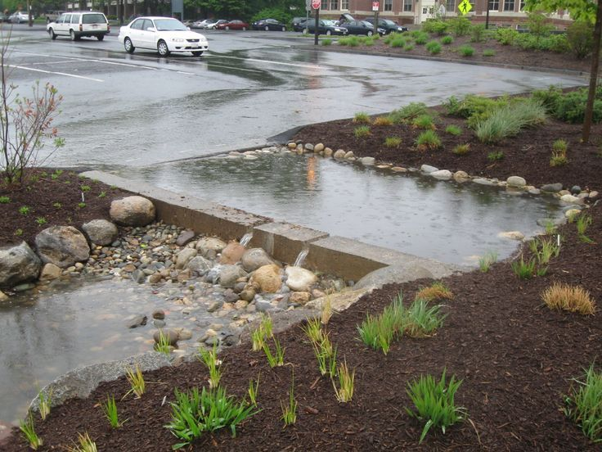
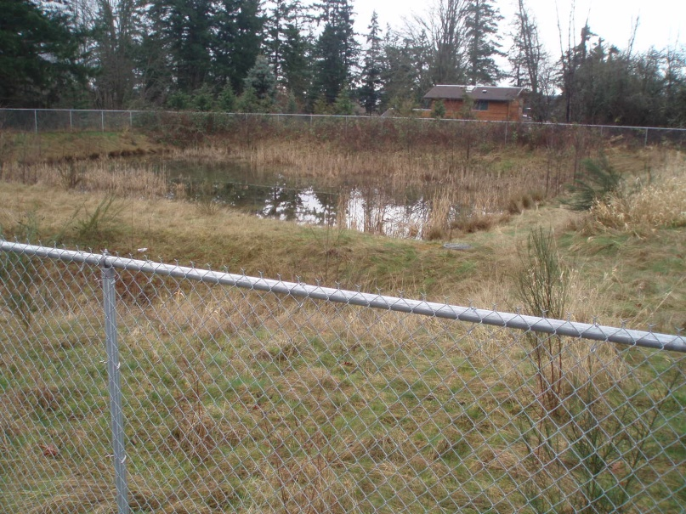
Low Impact Development
Minimize Clearing
Share
Smaller catchment areas
Infiltrate where possible
Slowdown runoff to clean

Slide 4
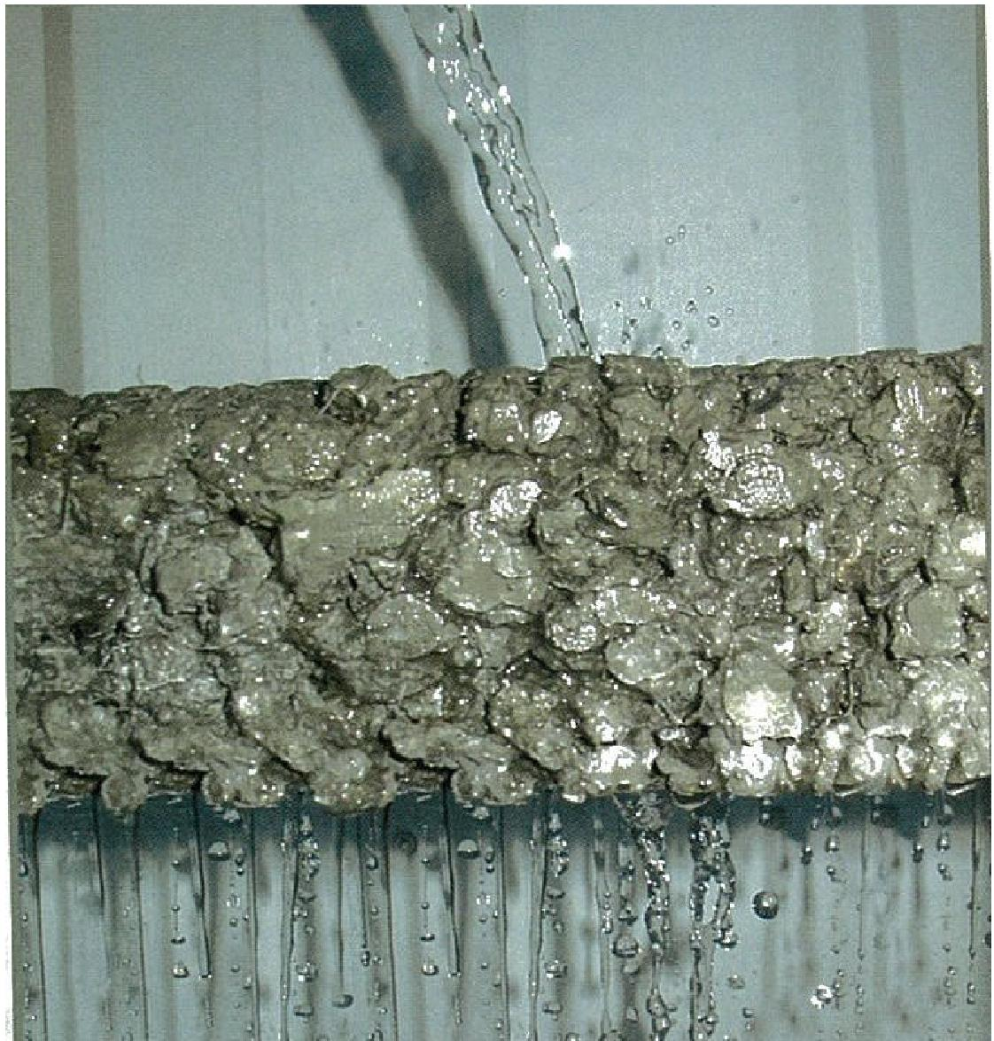
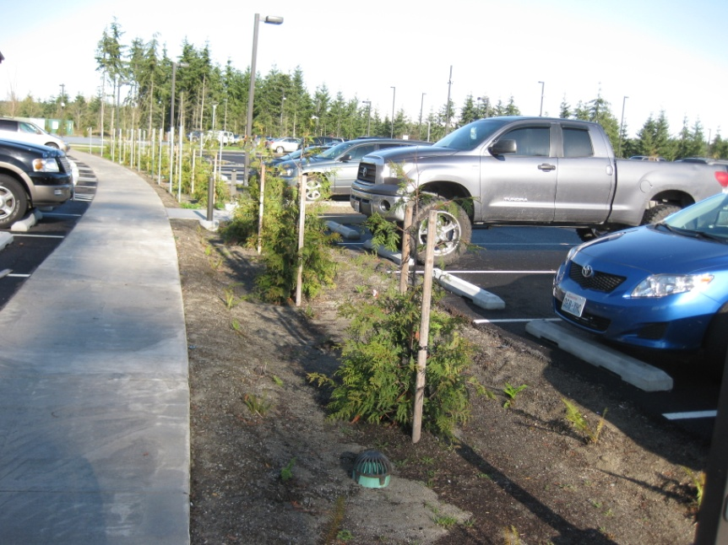
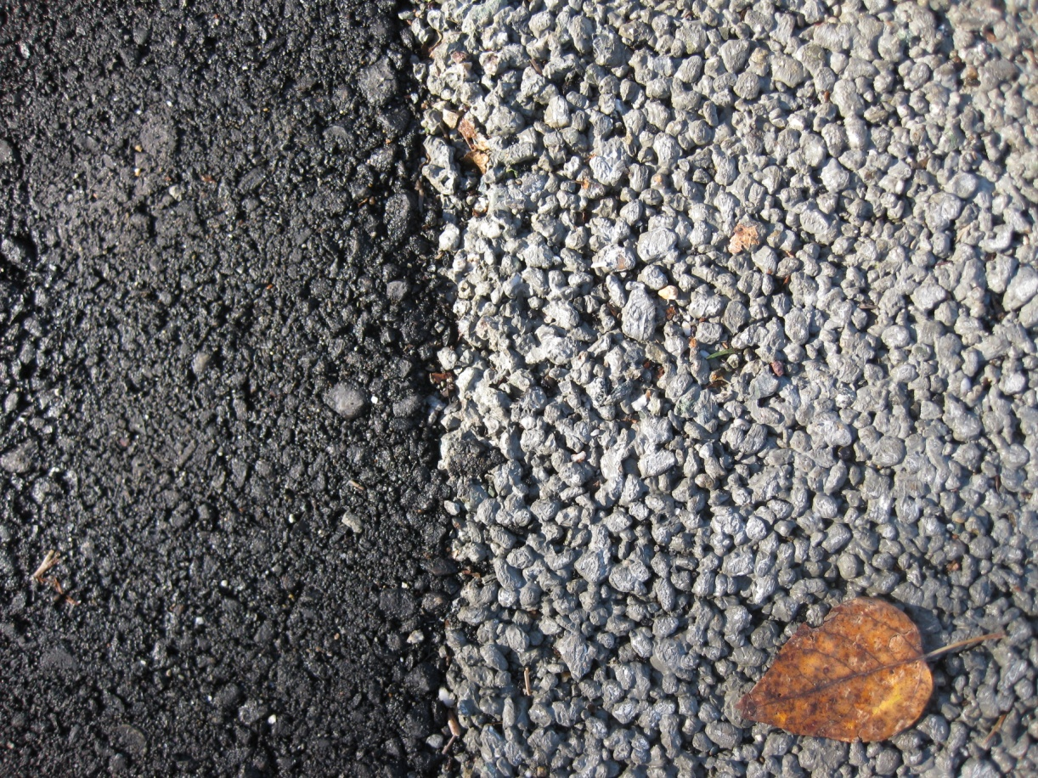
Green infrastructure
Impermeable
Permeable

Slide 5
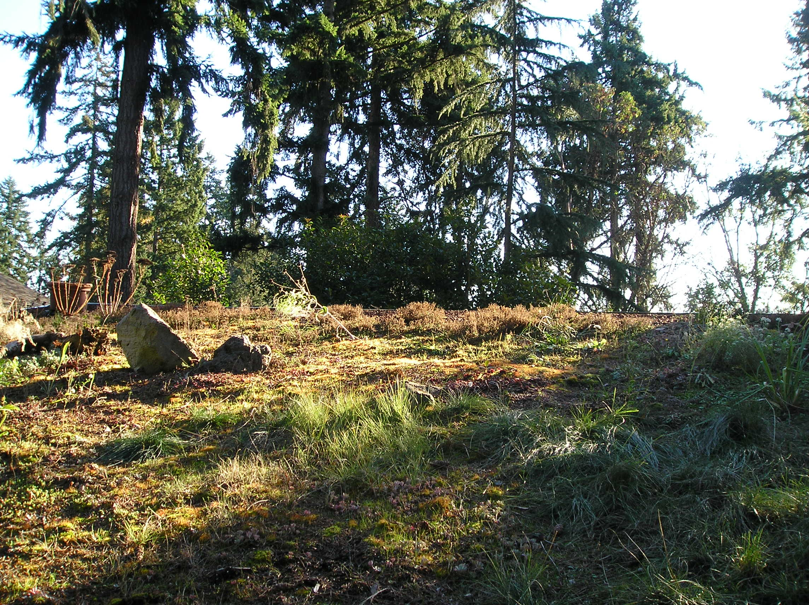
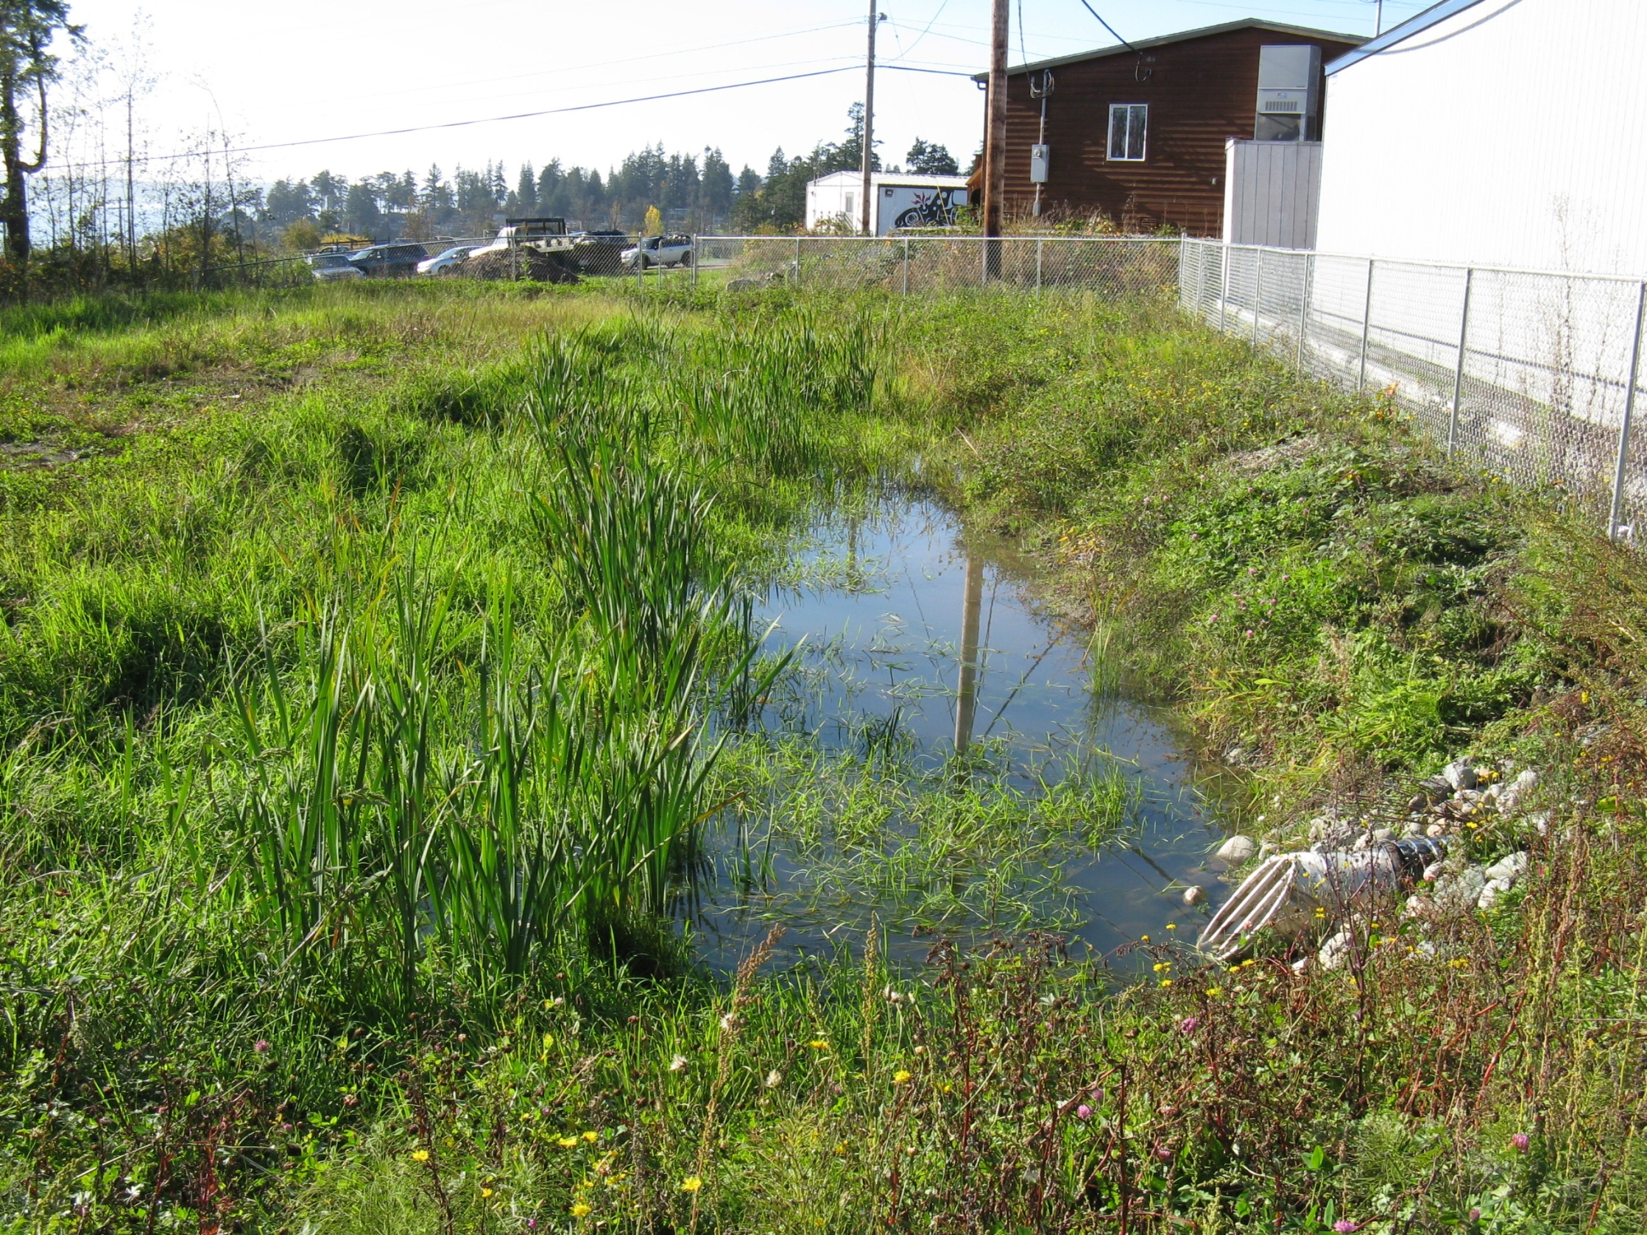
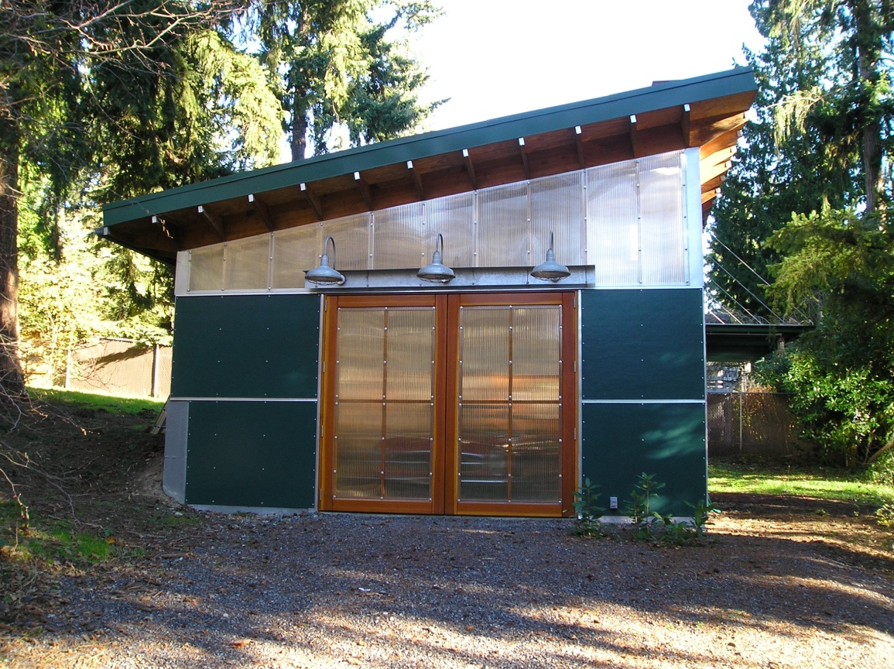
Green Infrastructure (continued)

Slide 6
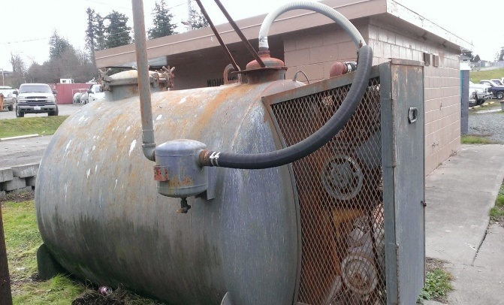
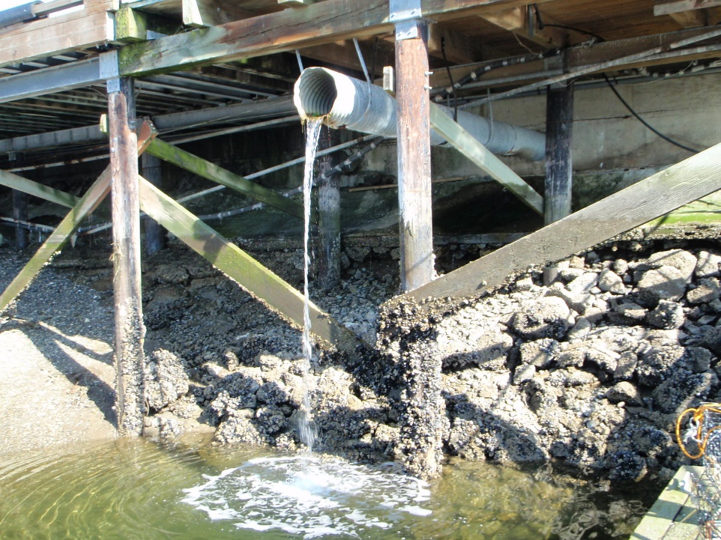
Improve Pollution Prevention
Marina Best Management Practices – gasoline transfer, bilge pumping, waste management
Spill Response Stations
Hazardous Waste Disposal
Bilge water management

Slide 7
Outreach
Specific messages depending on group: fishermen, homeowners, businesses, construction managers/workers, high school students, grade school students, etc.
Public Service Announcements (PSAs) on Tulalip TV
Pharmaceutical disposal https://vimeo.com/279329755
Watershed pollution adds up to problems https://vimeo.com/279329745
Are you going to pick that up? (pet waste)
Butts McGee (cigarette butt pollution)

Slide 8
The best BMP that beats every other BMP!
The way we think about Stormwater.
Waste
vs.
Resource
Stormwater is a type of wastewater.
Move it off site.
Stormwater is a valuable resource.
Reuse it for irrigation, hydrology for wetlands and streams, aquifer recharge.

Slide 9
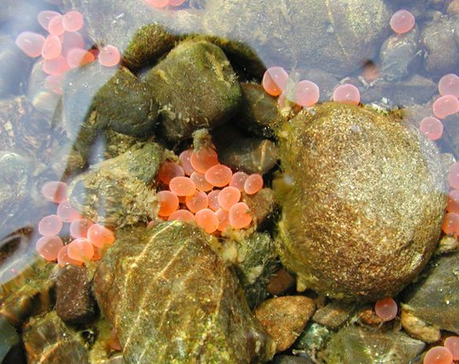
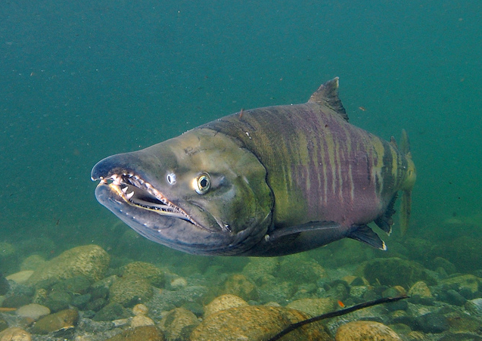
The power of stormwater management
Changing paradigms in how we manage stormwater can improve:
Water quality
Water quantity
Aquifer recharge
Land cover
in ways that will benefit salmon recovery.

Slide 10
Education
Why a salmon life cycle game?
Hands on learning – something hands on after every presentation
Needed a game that showed kids everything that stacks up against salmon
Fun is universal!

Slide 11
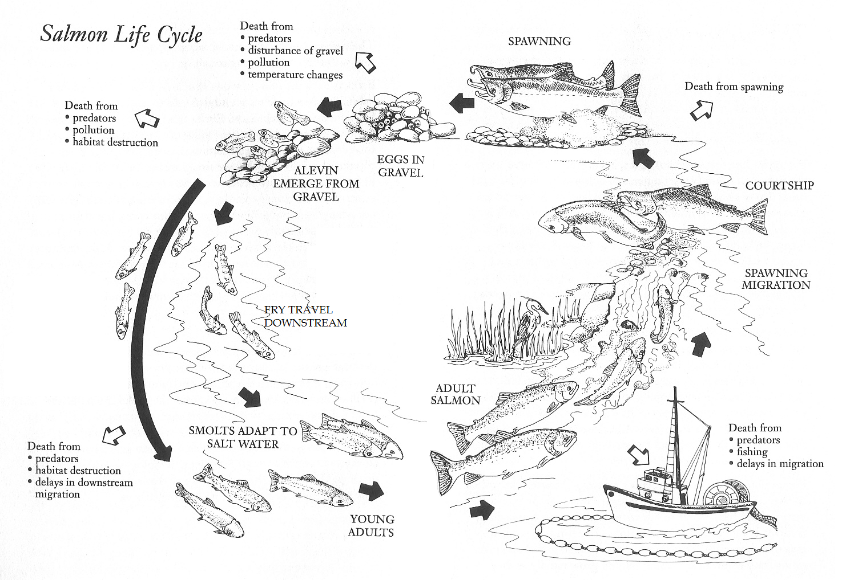

Slide 12
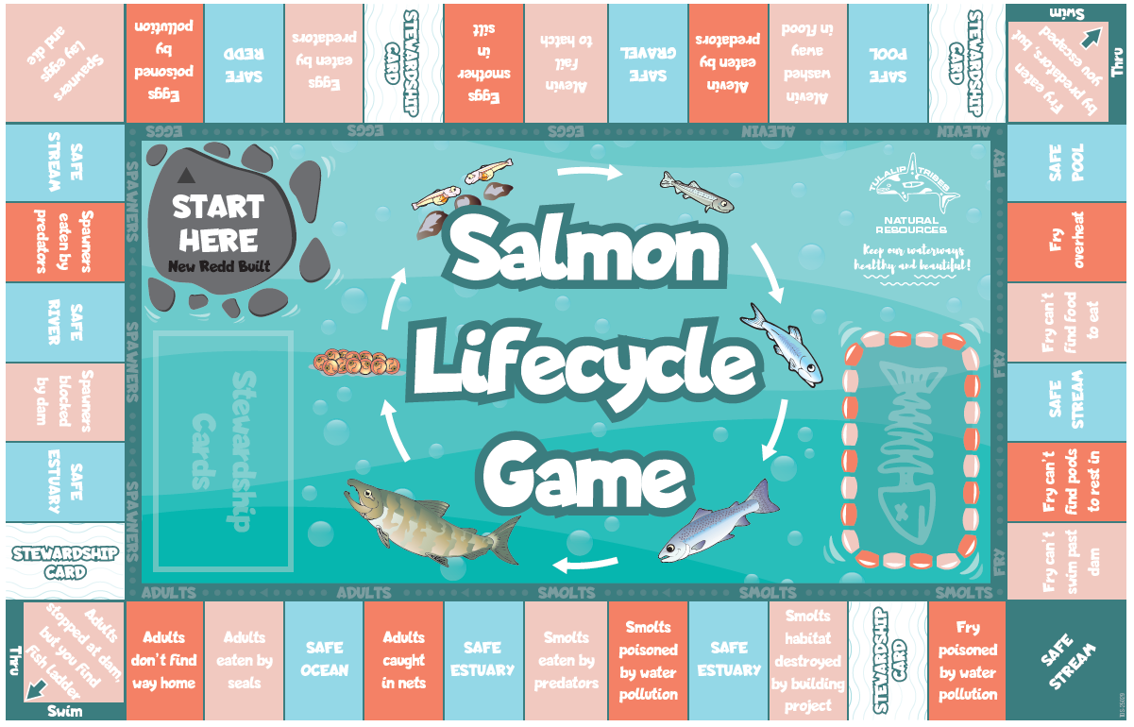
RULES
Each play starts with rolling the dice
If you land on a BLUE SPOT, you are safe and stay there and it is the next players turn
If you land on an ORANGE or CORAL SPOT, you move to the dead salmon
When it comes back to your turn again, you must roll a 3 or a 5 to move BACK TO THE CLOSEST BLUE SPACE FROM WHERE YOU LANDED ON THE ORANGE or CORAL. If you don’t roll a 3 or a 5, you stay on the dead salmon. BUT YOU ONLY LOSE ONE TURN. When it comes back to your turn again you move to the BLUE space.
If you land on a STEWARDSHIP CARD, you draw a card, read it aloud, and keep it.
THE FIRST PLAYER TO COLLECT 3 STEWARDSHIP CARDS, WINS!

