Slide 1
Brochure #1

Slide 2
Brochure #1

Slide 3
Flipbook for Contractors

Slide 4
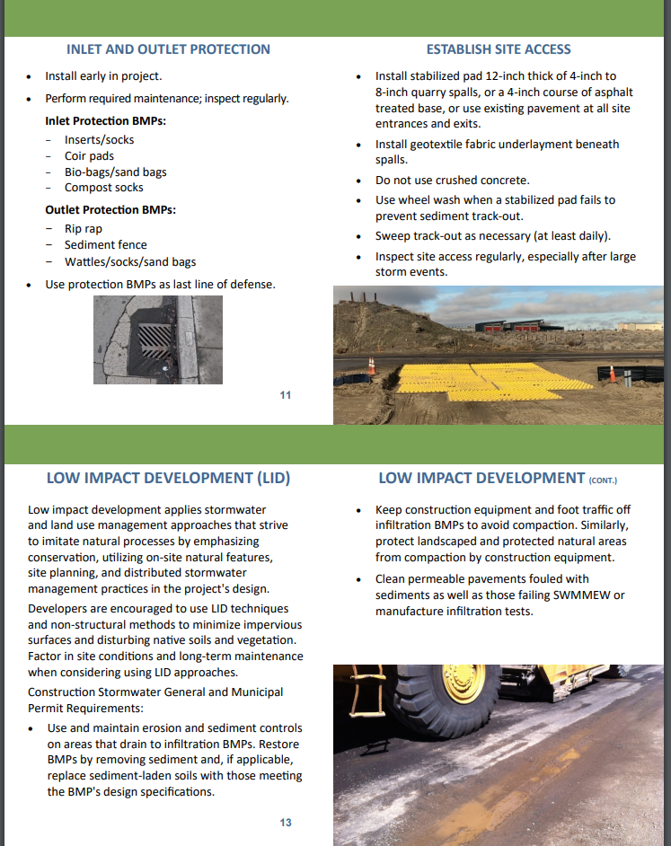
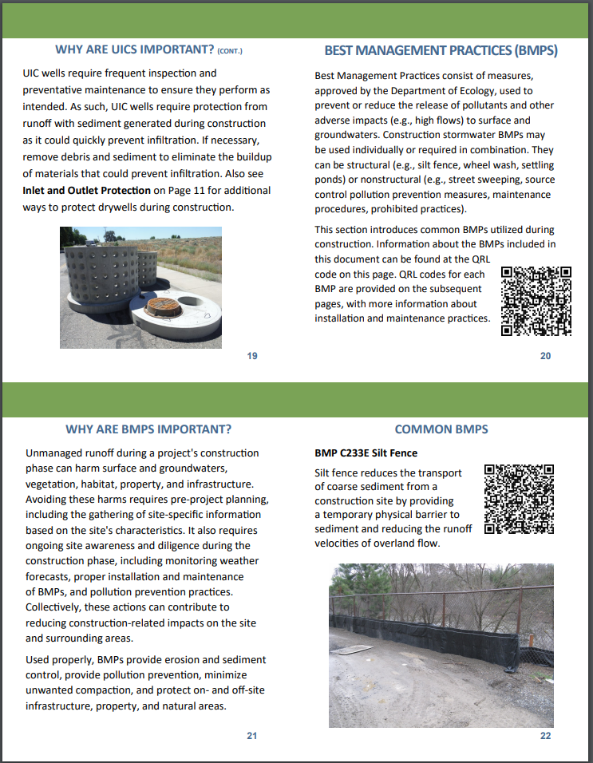

Slide 5
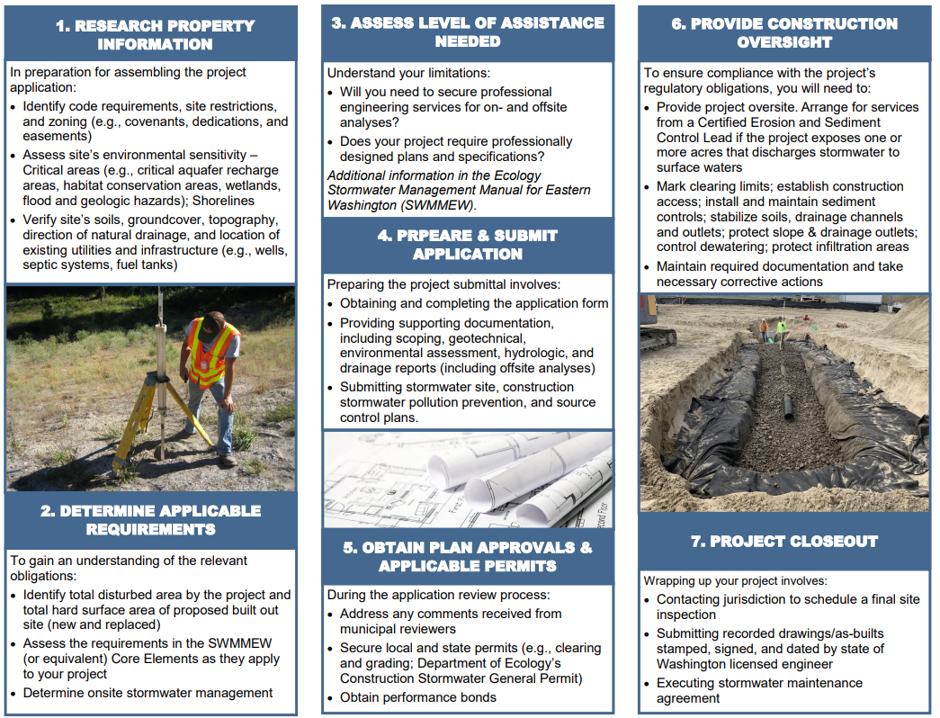
Requirements Overview for Developers

