Slide 1
Using Cityworks for Source Control and Water Quality Programs
Stormwater Services Data and Analytics Team

Slide 2
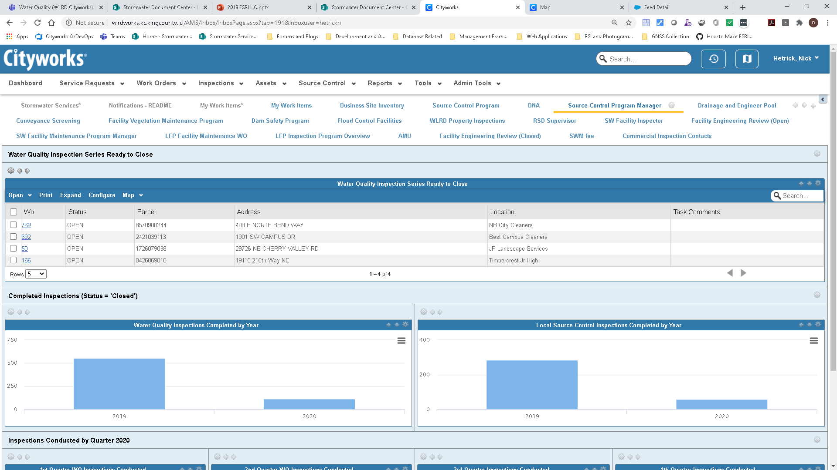
Cityworks at King County Stormwater Services
Deployed in 2019
70 end users (WLRD instance)
Supports multiple programs in water quality and asset management
805 LSC/Water Quality inspections completed.
99 Water Quality Issues reported

Slide 3
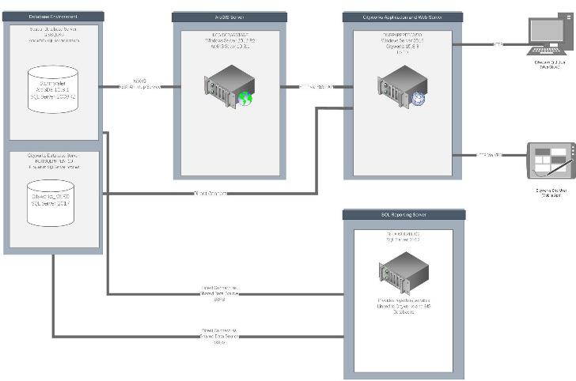
Technical Details
Back End Infrastructure
Application Server for Cityworks (On Premise)
SQL Server Database
ESRI ArcGIS Server
Front End Applications For Cityworks
Cityworks AMS (Primary Web Application)
Cityworks Mobile (iOS/Android)
Cityworks Respond (Responsive Web App)
GIS Applications Used for Inventory
ESRI ArcGIS Desktop Products (Pro/Desktop)
Used for data management and map service creation
ArcGIS Collector (iOS/android)
Used for data editing in the field

Slide 4
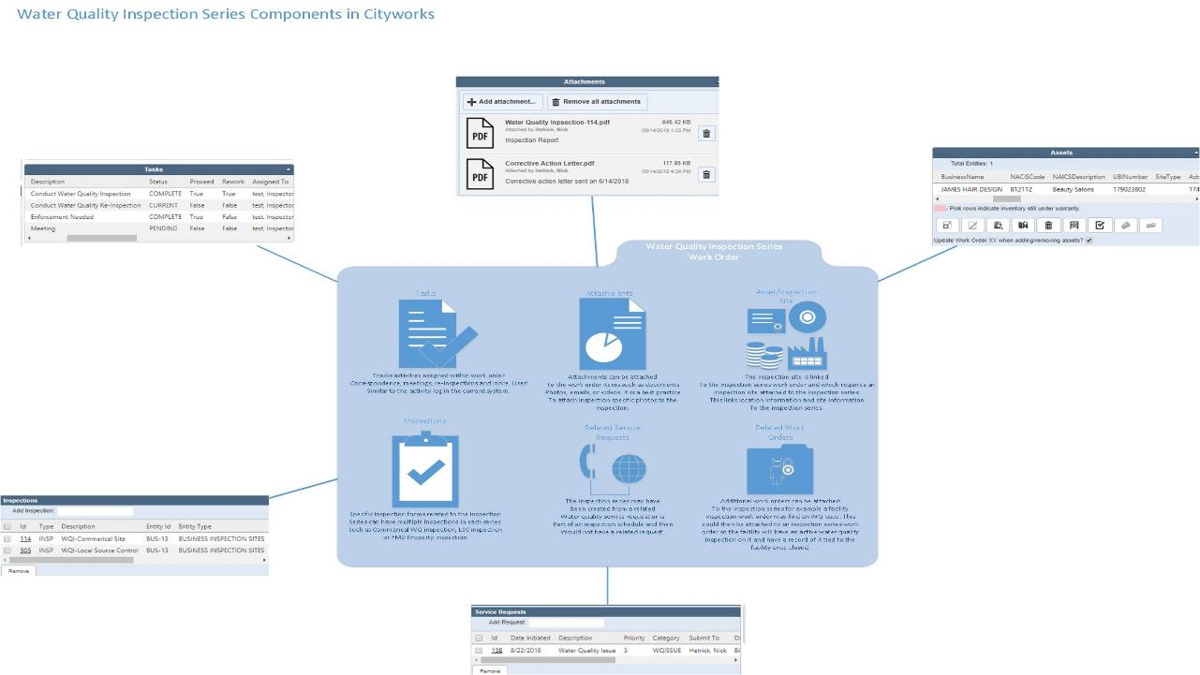

Slide 5
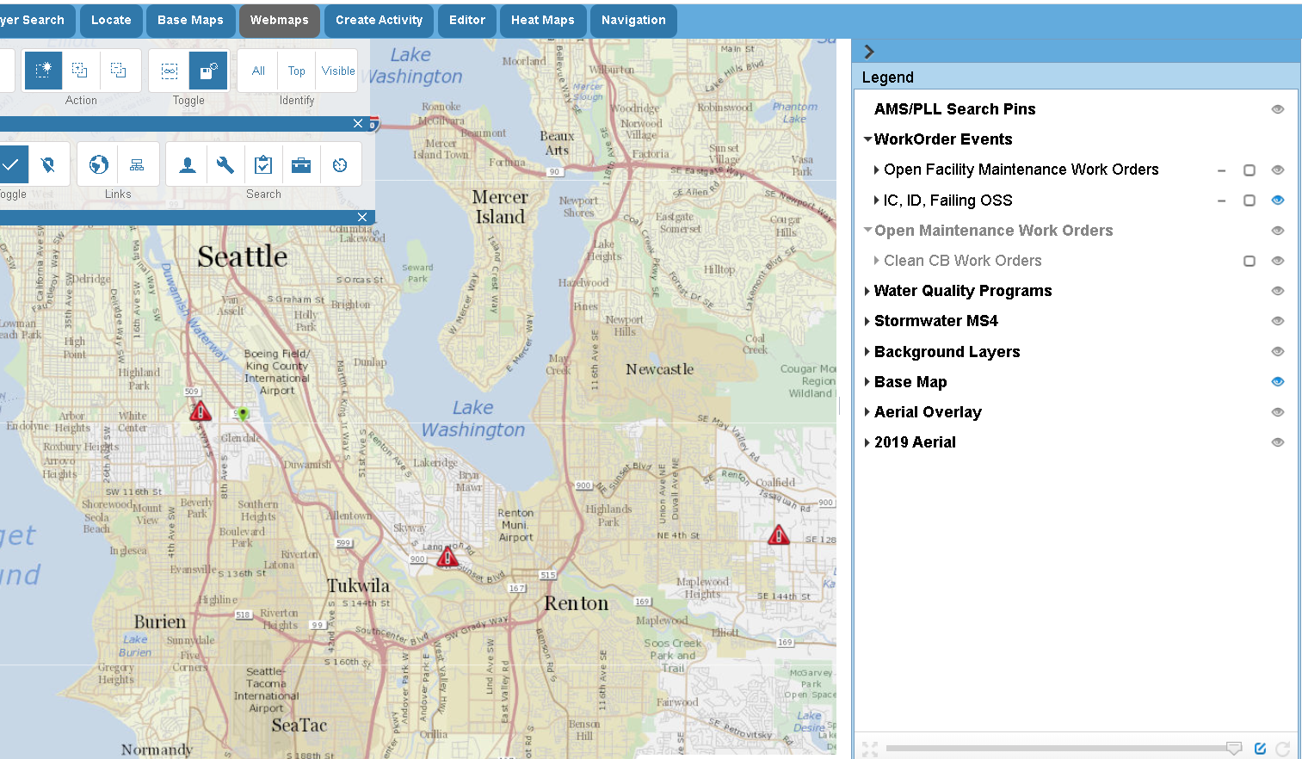
Demo

Slide 6
Future Enhancements
Automate spill reporting notification using web hooks
Fully automate XML extract to DOE
More Integration with NPDES Annual Reporting
Advanced Dashboards using Cityworks Analytics/ESRI Insights and Power BI
Implementing Cityworks Respond
Integration with financial system

Slide 7
Questions?
Lusha Zhou
Lusha.Zhou@kingcounty.gov
Nick Hetrick
Nick.Hetrick@kingcounty.gov

