Slide 1
Plan Review for NPDES Permit Compliance
Western Washington

Slide 2
Today’s Presentation
Presentation Location Information
Bathrooms
Water/Coffee
Snacks
Ask Questions at any time!
Feel free to stand up, stretch, get snacks, or move around at any time.
What’s all this stuff at my table?
Flowcharts
Dry Erase Markers
Scratch Paper
Morning Session Project

Slide 3
Trainer Introductions
Mieke Hoppin, P.E.
mhoppin@cityoftacoma.org
Merita Trohimovich, P.E.
mtrohimo@cityoftacoma.org
Laurie Larson-Pugh
Washington Stormwater Center

Slide 4
Good Morning, Bonjour, Gluten Morgen, Bom dia…
Name?
Phase I or Phase II Permittee?
Consultant?
Other?
New to Plan Review?
What do you hope to gain from training?

Slide 5
Today’s Training
Intended to help ensure compliance with NPDES Phase I and Phase II Permits Municipal Stormwater General Permits.
Based on Minimum Requirements contained in the Phase I and Phase II Permits and 2019 Stormwater Management Manual for Western Washington
Phase 2 effective date - June 30, 2022
Phase 1 effective date – June 30, 2021
Principles can be used across Washington State but remember each jurisdiction may have its own special requirements that are different than the MRs contained in the Permits.
Jokes!

Slide 6
Why? Regulations!
The Clean Water Act (1972) created the NPDES (National Pollutant Discharge Elimination System) Permit Program which required regulating point discharges.
1987 the Clean Water Act was amended to include stormwater discharges from MS4s.
1990 – Phase I regulations went into effect to allow discharges from MS4s (Municipal Separate Stormwater Systems).
Jurisdictions serving more than 100,000 people.
1995 – Ecology issued first Phase I Municipal Stormwater Permit.
1999 – Phase II regulations went into effect.
Smaller MS4s
2007 – Ecology issued first Phase II Permit

Slide 7
Why? Regulations!
NPDES Phase II Permit (Western Washington)
S5.C.6.c: “The program shall include a permitting process with site plan review, inspection and enforcement capability to meet the standards listed in (i) through (iv) below for both private and public projects, using qualified personnel.
(i) Review of all stormwater site plans for proposed development activities.”
S5.C.6.e: “Each Permittee shall ensure that all staff whose primary job duties are implementing the program to control stormwater runoff from new development, redevelopment, and construction sites, including permitting, plan review, construction site inspections, and enforcement, are trained to conduct these activities. Follow-up training must be provided as needed to address changes in procedures, techniques or staffing. Permittees shall document and maintain records of the training provided and the staff trained.”
Annual Report Questions (Appendix 3 – Cities, Towns, Counties)
Q. 45-Q55
Q. 47 – Reviewed Stormwater Site Plans for all proposed development activities that meet the thresholds adopted pursuant to S5.C.6.b.i.
Q47a. Number of site plans reviewed during the reporting period.
NPDES Phase I Permit
S5.C.5.vi, S5.C.5.viii, AR Q15-26

Slide 8
How? Regulations!
Permittees must document the technical basis for design criteria used to select and design BMPs. This includes:
how BMPs were selected,
pollutant removal performance expected from BMP,
the scientific basis, technical studies, and modeling specific to the design criteria to support performance claims
Assessment of how the selected BMP will comply with State water quality standards and meet AKART (all known, available and reasonable methods of prevention control and treatment).
So, how do we go about doing that…

Slide 9
How? Regulations!
The Presumptive Approach
Ecology’s SWMMWW is presumed to provide AKART when the proper BMPs are sized per the SWMMWW because the BMPs have been evaluated based on the design criteria.
Equivalent stormwater management manuals are presumed to provide AKART.
The Demonstrative Approach
Project proponents who choose not to follow the design criteria for BMPs in the SWMM are not following the presumptive approach and must demonstrate that their project will not adversely impact water quality by collecting and providing supporting data to show that the alternative approach is protective of water quality and satisfies state and federal laws
Will likely require sampling of BMP or approach.

Slide 10
Why? The Future Depends on You!
Many people interact with a plan set once it has been approved:
Contractors
Can a contractor understand what they are supposed to build?
Inspectors
Is it easy for an inspector to know all the components to inspect?
Asset Management Staff
Mapping, Database Management
Business Inspection Staff
1,5,10,20,50 years from now will a new employee be able to figure out what is on the property for required inspection?
Facility Inspection Staff
1, 5, 10, 20, 50 years from now will an employee be able to figure out what facilities are on a property and how they function.
Operation and Maintenance Staff
Can your crews figure out what the facility is and how to inspect and maintain the facility (is it even owned by the jurisdiction?)
Property Owners
Can a property owner find the facilities and assets they need to maintain years from now?
Complaints
10 years from now when there is a drainage complaint can City staff easily help a property owner navigate the assets on their site?

Slide 11
Basic Plan Review Steps
Project History
Where is the project?
What is the project?
What Minimum Requirements apply to this project?
Does their Stormwater Site Plan Report address the Minimum Requirements appropriately?
Does the plan set show the BMPs that are proposed to be used to meet the Minimum Requirements?
Is the design feasible?
Are there means in place to access the property for inspection after construction (C&E agreements, etc.)

Slide 12
Step 1 - Project History
Is this project associated with a land use action or other associated permit?
Land use actions can vest projects to previous regulations.
Land use actions or other permit requirements may have already defined the stormwater mitigation requirements.
Stormwater mitigation requirements may be different from SWMMWW because of vesting or specific site conditions.
Some jurisdictions use developer agreements that could affect stormwater mitigation.
Hearing Examiner Rulings may define specific requirements.
Where to Look: City/County Permit Records; Assessor Records; Parcel Records; Anywhere and Everywhere.
A parcel can have dozens of associated permits…

Slide 13
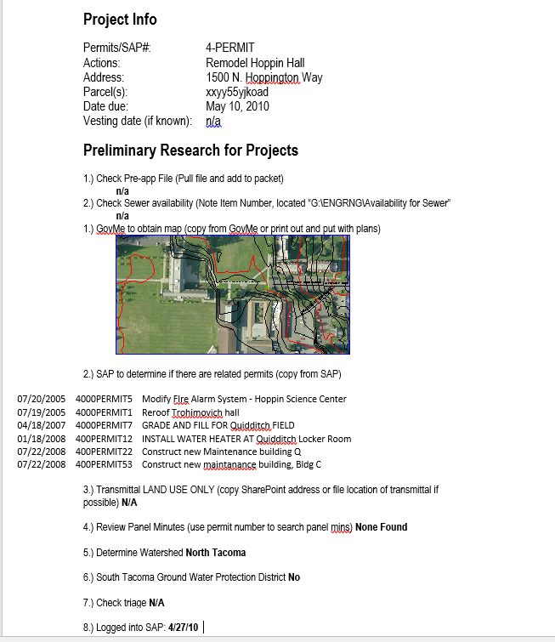
Project History
High Tech - Fancy Permitting Program that tells you all your history
Low Tech –
Word Document

Slide 14
Step 2 - Where is the Project?
Minimum Requirements are based upon the first receiving waterbody encountered downstream from the project site and based upon the ultimate discharge location.
A receiving waterbody – naturally and/or reconstructed naturally occurring surface water bodies, such as creeks, streams, rivers, lakes, wetlands, estuaries, and marine waters, or ground water, to which a MS4 discharges.
Phase I and Phase II permits require Permittees to map their MS4s and all receiving waters.
Use maps!
No easily accessible maps or map is confusing…time for a site visit…pop manhole lids…follow the flow path of pipes and structures to the receiving water! Note – the applicant should do this in SSP but you need to verify.

Slide 15
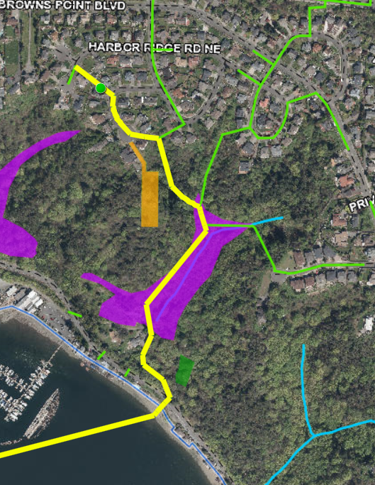
Where does Stormwater Go
https://www.tacomapermits.org/dart-map
Some GIS maps have a stormwater trace option.
In this example, the first waterbody is the wetland (purple) and the ultimate discharge is the Puget Sound.

Slide 16
Example Question
Where Does Our Water Go?
First Discharge Location:
Freshwater or Salt Water?
Ultimate Discharge Location:
Freshwater or Salt Water?
Pipe system to Flett Creek to Chambers Creek to Puget Sound.
Freshwater
Salt Water

Slide 17
Hilariousness – Episode 1
What’s the difference between an introverted engineer and an extroverted engineer?
An introverted engineer looks at their shoes when they’re talking to you, an extroverted engineer looks at your shoes when they’re talking to you.

Slide 18
Step 3 - What is the Project?
Know your definitions – review them for every project!!!

Slide 19
Is the Project Exempt?
Is the project solely on of the following:
Forest Practices
Regulated under Title 222 WAC, except Class IV- General forest practices that are conversions from timberland to other uses.
Commercial Agriculture
except Class IV general forest practices and construction of impervious surfaces.
Oil and Gas Field Activities and Operations
Pavement Maintenance:
Pothole and square cut patching
Overlaying existing asphalt or concrete pavement with asphalt or concrete without expanding the area of coverage
Shoulder grading
Reshaping/regrading drainage systems
Crack sealing
Resurfacing with in-kind material without expanding the road prism
Pavement preservation activities that do not expand the road prism
Vegetation maintenance
Underground Utility Projects that replace the ground surface with in-kind material or material with similar runoff characteristics

Slide 20
Things that Seem Like Pavement Maintenance But Are Not
These practices are not exempt but they really sound like pavement maintenance:
Removing and replacing an asphalt or concrete pavement to base course or lower or repairing the pavement base. These are considered replaced hard surfaces.
Extending the pavement edge without increasing the size of the road prism, or paving graveled shoulders. These are considered new hard surfaces.
Resurfacing, by upgrading, from dirt to gravel, a bituminous surface treatment (“chip seal”), asphalt or concrete; upgrading from gravel to chip seal, asphalt or concrete; or upgrading from chip seal to asphalt or concrete. These are considered new impervious surfaces.

Slide 21
Okay, the Project is Not Exempt…
Is the project considered to be new development or redevelopment?
New Development: land disturbing activities, including Class IV-General Forest Practices that are conversions from timber land to other uses; structural development, including construction or installation of a building or other structure; creation of hard surfaces; and subdivision, short subdivision and binding site plans, as defined and applied in chapter 58.17 RCW. Projects meeting the definition of redevelopment shall not be considered new development.
Redevelopment: on a site that is already substantially developed, (i.e., has 35% or more of existing hard surface coverage), the creation or addition of hard surfaces; the expansion of a building footprint or addition or replacement of a structure; structural development including construction, installation or expansion of a building or other structure; replacement of hard surface that is not part of a routing maintenance activity; and land disturbing activities.

Slide 22
Type of Construction?
Is the project:
residential?
multi-family residential,
commercial/industrial,
road-related?
Notes:
Used for determining Redevelopment Requirements and for Water Quality Type.

Slide 23
Example Question
Is our project new development or redevelopment?
What Type of Construction?
Residential?
Multi-family residential?
Commercial?
Road-Related?
Redevelopment
Commercial

Slide 24
Definitions
Used for determining Minimum Requirements
Definitions may vary by jurisdiction – below are from W. Washington Permits.
“Project – Any proposed action to alter or develop a site.”
“Project Site – that portion of a property, properties, or right of way subject to land disturbing activities, new hard surfaces, or replaced hard surfaces.”
“Site – The area defined by the legal boundaries of a parcel or parcels of land that is (are) subject to new development or redevelopment. For road projects, the length of the project site and the right-of-way boundaries define the site.”
Notes:
Minimum Requirements apply to a project. Project Site and Site are for determining MRs for Redevelopment Projects.

Slide 25
Important Definitions
“Hard Surface: An impervious surface, a permeable pavement, or a vegetated roof.”
“New Impervious Surface: A surface that is: changed from a pervious surface to an impervious surface; upgraded from gravel to chip seal, asphalt, concrete, or an impervious structure; upgraded from chip seal to asphalt concrete, or an impervious surface.”
“Impervious Surface: A non-vegetated surface area which either prevents or retards the entry of water into the soil mantle as under natural conditions prior to development. A non-vegetated surface area which causes water to run off the surface in greater quantities or at an increased rate of flow from the flow present under natural conditions prior to development. Common impervious surfaces include, but are not limited to, roof tops, walkways, patios, driveways, parking lots or storage areas, concrete or asphalt paving, gravel roads, packed earthen materials, and oiled, macadam or other surfaces which similarly impede the natural infiltration of stormwater. Open, uncovered retention/detention facilities shall not be considered as impervious surfaces for the purposes of determining whether the thresholds for application of Minimum Requirements are exceeded. Open, uncovered retention/detention facilities shall be considered impervious surfaces for purposes of runoff modeling.”

Slide 26
Important Definitions
“Replaced Hard Surfaces: For structures, the removal and replacement of hard surfaces down to the foundation. For other hard surfaces, the removal down to bare soil or base course and replacement.”
Vegetation Converted to Lawn/Landscaped: “Converted vegetation (areas): The surfaces on a project site where native vegetation, pasture, scrub/shrub, or unmaintained non-native vegetation (e.g., Himalayan blackberry, scotch broom) are converted to lawn or landscaped areas, or where native vegetation is converted to pasture.”
Native Vegetation Converted to Pasture: “Native vegetation: Vegetation comprised of plant species, other than noxious weeds, that are indigenous to the coastal region of the Pacific Northwest and which reasonably could have been expected to naturally occur on the site.”

Slide 27
Important Definitions
“Land disturbing activity – Any activity that results in a change in the existing soil cover (both vegetative and non-vegetative) and/or existing soil topography. Land disturbing activities include, but are not limited to clearing, grading, filling, and excavation. Compaction that is associated with stabilization of structures and road construction shall be considered a land disturbing activity. Vegetation maintenance practices, including landscape maintenance and gardening, are not considered to land-disturbing activity. Stormwater facility maintenance is not considered land disturbing activity if conducted according to established standards and procedures.”

Slide 28
What to do when there are no definitions…
Many words/phrases are not defined in Phase I or Phase II Permits, SWMMWW, or SWMMEW. Up to jurisdictions to interpret what these words mean…
Consistent definitions are necessary.
Ask other jurisdictions how they interpret the word/phrase.
Develop your own definition/interpretation.
Develop Interpretation Documents.
Keep track of your interpretation documents.
Internal interpretation documents
External interpretation documents

Slide 29
Quantifying the Project
Minimum Requirements are based upon the square footage of “impacts” to a project site.
There is no “net concept”. New hard surfaces are new hard surfaces and replaced hard surfaces are replaced hard surfaces – they both count toward thresholds.
Example – a school with a play field. An existing school that is being removed and a new school is being built on the old field – where the old school was will be the new field. The buildings are the exact same size…

Slide 30
Hilariousness – Episode 2
Why did the engineering student leave class early?
She was getting a little ANSI.

Slide 31
Minimum Requirement Thresholds
New Development – Site has Less than 35% Of Existing Hard Surface
Comply with Minimum Requirement #1-5 for the new and replaced hard surfaces and the land disturbed:
Results in 2,000 square feet, or greater, of new plus replaced hard surface area, or
Has land disturbing activity of 7,000 square feet or greater.
Comply with Minimum Requirements #1-#9 for the new and replaced hard surfaces and the converted vegetation areas:
Results in 5,000 square feet, or greater, of new plus replaced hard surface area, or
Converts ¾ acre or more, of vegetation to lawn or landscaped areas, or
Converts 2.5 acres, or more, of native vegetation to pasture.

Slide 32
Minimum Requirement Thresholds
Redevelopment
Comply with Minimum Requirement #1-5 for the new and replaced hard surfaces and the land disturbed:
Results in 2,000 square feet, or greater, of new plus replaced hard surface area, or
Has land disturbing activity of 7,000 square feet or greater.
Comply with Minimum Requirements #1-#9 for the new surfaces and the converted vegetation areas:
Results in 5,000 square feet, or greater, of new plus replaced hard surface area, or
Converts ¾ acre or more, of vegetation to lawn or landscaped areas, or
Converts 2.5 acres, or more, of native vegetation to pasture.
Comply with Minimum Requirements #1-9 for the new and replaced hard surfaces and converted vegetation areas if:
The total of new plus replaced hard surfaces is 5,000 square feet or more, and
For commercial or industrial projects: the valuation of the proposed improvements, including interior improvements, exceeds 50% of the assessed value of the existing Project Site Improvements.
For all other projects: the valuation of the proposed improvements, including interior improvements, exceeds 50% of the value of the existing Site Improvements.

Slide 33
Minimum Requirements – Permit Appendix 1
Minimum Requirement #1 – Preparation of a Stormwater Site Plan
Minimum Requirement #2 – Construction Stormwater Pollution Prevention Plan
Minimum Requirement #3 – Source Control of Pollution
Minimum Requirement #4 – Preservation of Natural Drainage Systems and Outfalls
Minimum Requirement #5 – On-Site Stormwater Management
Minimum Requirement #6 – Runoff Treatment
Minimum Requirement #7 – Flow Control
Minimum Requirement #8 – Wetlands Protection
Minimum Requirement #9 – Operation and Maintenance
Notes:
Don’t read this one.

Slide 34
Our Project
Which MRs should we review for our project?
Minimum Requirement #1-9
Notes:
Do flowchart here.

Slide 35
Break!!!

Slide 36
MR #1 – Stormwater Site Plan
A Report AND a Plan Set that describe existing site conditions and how stormwater will be handled in the final condition.

Slide 37
MR #2 – Construction Stormwater Pollution Prevention
A Report AND a Plan Set that describe existing site conditions and how stormwater will be handled during construction.
13 Elements of SWPPP must be considered and included in SWPPP.
Project below thresholds do not need to prepare SWPPP but must consider SWPPP elements during construction (Appendix 1, Page 16 of Phase II Permit).

Slide 38
MR #2 – 13 Elements
Element #1 – Preserve Vegetation/Mark Clearing Limits
Element #2 – Establish Construction Access
Element #3 – Control Flow Rates
Element #4 – Install Sediment Controls
Element #5 – Stabilize Soils
Element #6 – Protect Slopes
Element #7 – Protect Drain Inlets
Element #8 – Stabilize Channels and Outlets
Element #9 – Control Pollutants
Element #10 – Control Dewatering
Element #11 – Maintain BMPs
Element #12 – Manage the Project
Element #13 – Protect Low Impact Development BMPs

Slide 39
CESCL – Always Required?
BMP C160: Certified Erosion and Sediment Control Lead
Certified Erosion and Sediment Control Lead (CESCL) required on projects one acre or larger that discharge stormwater to surface waters of the state.
Below one acre – does not need to be certified.
Can be a CPESC – Certified Professional in Erosion and Sediment Control
Check Ecology’s database to see if their certification is current or always ask them to include a copy of their certification.
But applicant’s may not know at this stage who their contractor is…
Require a Preconstruction Meeting
Require before actual Permit issuance

Slide 40
MR #3 – Source Control of Pollution
Part of the Stormwater Site Plan; structural BMPs shall be shown on the plan set.
All known, available, and reasonable Source Control BMPs must be required for all projects. Source Control shall be selected per SWMMWW – Volume IV.
Required for:
Commercial Properties
Industrial Properties
Multifamily Properties
Boatyards
Sand and gravel mining operations

Slide 41
What Does MR #3 Look Like?
Hardware Store
Sweeping
Covering Garbage Bins
Keeping Outside Soils/Fertilizers Covered
Industrial Site
Secondary Containment
Process Inside
Sweeping
Structural BMP – Some Crazy Thing to Meet their Industrial (etc.) Permit Limits
Notes:
A little time about industrial permit and demonstrative approach.

Slide 42
MR #4 – Preservation of Natural Drainage Systems and Outfalls
Part of Stormwater Site Plan.
Natural drainage shall be maintained, and discharges from the Project Site shall occur at the natural location, to the maximum extent practicable. The manner by which runoff is discharged from the Project Site must not cause a significant adverse impact to the downstream receiving waters and downgradient properties. All outfalls require energy dissipation.
Requires an understanding of where your stormwater is flowing.

Slide 43
MR #4 – What Does This Look Like
In Urbanized Areas, not much – most areas are fully piped and no longer maintain their natural discharge locations but a parcel may go to discharge locations – marine and freshwater – those discharges must be maintained.
In Rural Areas, natural discharge locations still exist so careful consideration of discharge locations is necessary.

Slide 44
MR #5 – On-Site Stormwater Management
Dependent on discharge locations – flow control exempt.
Dependent on overall site improvements.
Can be met through “list approach” or LID Performance Standard (modeling approach).
List Approach
Evaluate BMPs provided in the List for feasibility for each surface type. Feasible BMPs must be utilized on-site.
Must analyze feasibility in order.
In SWMMWW there are infeasibility criteria for BMPs.
LID Performance Standard
Requires modeling.
Stormwater discharges shall match developed discharge durations to pre-developed durations for the range of pre-developed discharge rates from 8% of the 2-year peak flow to 50% of the 2-year peak flow.
Required for project outside the UGA on a parcel 5 acres or larger.

Slide 45
MR #5 – Flow Control Exempt
Discharge to Flow Control Exempt Waterbodies – Salt Waterbodies and Larger Rivers (see SWMMWW – Appendix I-A) that meet requirements in MR #7:
Direct discharge does not divert drainage from any perennial stream classified as:
Type 1, 2, 3, or 5 (WA State Interim Water Typing System);
Types S, F, or NP (Permanent Water Typing System)
Direct discharge does not divert drainage from any Category I, II, or III Wetland
Flow splitters or conveyance systems that divert runoff to any Type 5 stream or Category IV wetland are designed per MR #7
The Threshold Discharge Area is drained by a manmade conveyance system that extends to the ordinary high water line of the exempt receiving water.
The conveyance system has sufficient hydraulic capacity to convey discharges from future build-out conditions from the contributing areas of the Site, and the existing condition from contributing off-site areas.
Erodible elements of the manmade conveyance system are adequately stabilized to prevent erosion.

Slide 46
MR #5 – Flow Control Exempt
Utilize List #3 or Use any Flow Control BMP to achieve the LID Performance Standard and apply BMP T5.13: Post-Construction Soil Quality and Depth.
List #3
Surface Type: Lawn/Landscaped Areas
BMP T5.13: Post Construction Soil Quality and Depth
Surface Type: Roofs:
BMP T5.10 A: Downspout Full Infiltration
BMP T5.10B: Downspout Dispersion System
BMP T5.10C: Perforated Stub-Out Connections
Surface Type: Other Hard Surfaces (Driveways, Sidewalks, Walkways, Patios, Etc.)
BMP T5.12: Sheet Dispersion OR BMP T5.11: Concentrated Flow Dispersion

Slide 47
MR #5 – MR #1-5 Only Projects
List #1
Surface Type: Lawn/Landscaped Areas
BMP T5.13: Post Construction Soil Quality and Depth
Surface Type: Roofs
BMP T5.30 – Full Dispersion or BMP T5.10A: Downspout Full Infiltration
BMP T 5.14.A – Rain Gardens or BMP T7.30 Bioretention Cells, Swales, and Planter Boxes
BMP T5.10B: Downspout Dispersion Systems
BMP T5.10C: Perforated Stub-Out Connections
Surface Type: Other Hard Surfaces
BMP T5.30: Full Dispersion
BMP T5.15 Permeable Pavements or BMP T 5.14.A – Rain Gardens or BMP T7.30 Bioretention Cells, Swales, and Planter Boxes
BMP T5.12: Sheet Flow Dispersion or BMP T5.11: Concentrated Flow Dispersion
OR
LID Performance Standard Plus BMP T5.13
Notes:
Take careful notice of Ors and Ands

Slide 48
MR #5 – MR #1-9 Projects
List #2
Surface Type: Lawn/Landscaped Areas
BMP T5.13: Post Construction Soil Quality and Depth
Surface Type: Roofs
BMP T5.30 – Full Dispersion or BMP T5.10A: Downspout Full Infiltration
BMP T7.30 Bioretention Cells, Swales, and Planter Boxes
BMP T5.10B: Downspout Dispersion Systems
BMP T5.10C: Perforated Stub-Out Connections
Surface Type: Other Hard Surfaces
BMP T5.30: Full Dispersion
BMP T5.15 Permeable Pavements
BMP T7.30 Bioretention Cells, Swales, and Planter Boxes
BMP T5.12: Sheet Flow Dispersion or BMP T5.11: Concentrated Flow Dispersion
OR
LID Performance Standard Plus BMP T5.13

Slide 49
LID Performance Standard
Stormwater discharges shall match developed discharge durations to predeveloped durations for the range of predeveloped discharge rates from 8% of the 2-year peak flow to 50% of the 2-year peak flow.
Required to utilize BMP T5.13 where feasible as well.
The predeveloped condition shall be forested land cover unless:
Reasonable, historic information is provided that indicates the site was prairie prior to settlement (modeled as pasture in the approved continuous simulation model); or
The drainage area of the immediate stream and all subsequent downstream basins have had at least 40% total impervious area (TIA) since 1985. In this case, the predeveloped condition to be matched shall be the existing land cover condition.

Slide 51
Hilariousness – Episode 3
What’s the difference between a rain garden and a bioretention facility?
12,000,000,000 hours of engineering time...oh, and some really fancy dirt! (note: rain gardens and bioretention facilities look pretty much the same in the field – so documentation is important)

Slide 52
Infeasibility Review
Infeasibility Criteria Shown Must Match Criteria in SWMMWW
Different infeasibility criteria require different qualification so check SWMMWW carefully – some require P.E., some require geotech – make sure the appropriate professional has been involved.
Setback Distances Should be Shown/Described in SSP.
Infeasibility Based on Soil Type must be Accompanied by Geotech Report that is Site Specific (jurisdictions may develop maps showing large areas considered to be infeasible)
Read entire Geotech Report for consistency.
Soils report should match SSP for infeasibility and calculations (infiltration facilities)
Make sure soils logs are located in the project area.

Slide 53
LID Performance Standard
Ensure full WWHM Report is included not just a snip of the output.
Model Review (A few Key Points)
Make sure Predeveloped and Mitigated Condition Match Values Given in Chart of SSP.
Make sure using correct Runoff Files – for your project location
Make sure SSP is stamped by a Washington State Licensed Engineer

Slide 54
SSP and MR #5
SSP should go through the feasibility analysis in detail for each BMP until a BMP is considered to be feasible.
SSP must show how MR #5 BMP was sized.
Include calculations as necessary
Include soils information as necessary to substantiate design
Ensure BMPs are provided for each surface type, as feasible: lawn/landscaped areas, roofs, other hard surfaces.
Show BMP on plan set.
Provide details for each BMP on the plan set.
Show locations of Post Construction Soil Quality and Depth BMP – appropriately hatch or otherwise clearly note.
Make sure plan sets match reports.

Slide 55
Our Example
Which Option(s) can they choose for MR#5 Compliance?
List #1?
List #2?
List #3?
LID Performance Criteria?
List #2 or LID Performance Criteria
Notes:
Discussion about flowchart and why flowchart maybe is confusing about decision.

Slide 56
Hilariousness – Part 4
Where do mathematicians get their kicks?
On 8.12403840464.

Slide 57
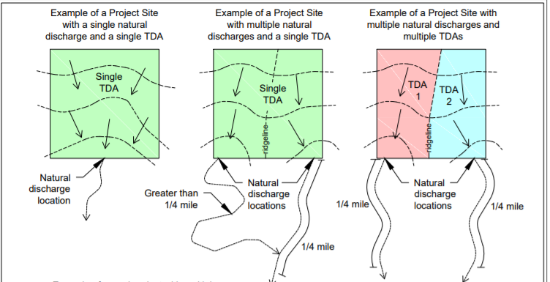
Threshold Discharge Areas
Threshold Discharge Area – An area within a project site drainage to a single natural discharge location or multiple natural discharge locations that combine within ¼ mile downstream (using shortest flowpath).

Slide 58
MR #6 – Runoff Treatment
Based on Impacts to the Threshold Discharge Area
5,000 square feet or more of pollution-generating hard surface or ¾ of acre of more of pollution-generating pervious surface from which there is a discharge from the site require treatment.
Treatment type depends on the project type and discharge location.
Notes:
Tell them to look at flowchart or not.

Slide 59
MR #6 – Treatment Types
Oil Control – Required For:
An area of a commercial or industrial site subject to an expected average daily traffic (ADT) count equal to or greater than 100 vehicles per 1,000 square feet of Gross building area, or 300 total trip ends per day.
An area of a commercial or industrial site subject to petroleum storage and transfer in excess of 1,500 gallons per year, not including routinely delivered heat oil.
An area of a commercial or industrial site subject to parking, storage, or maintenance of 25 or more vehicles that are over 10 tons Gross weight (trucks, buses, trains, heavy equipment, etc.)
A road intersection with a measured ADT count of 25,000 vehicles or more on the main roadway and 15,000 vehicles or more on any intersecting roadway, excluding projects proposing primarily pedestrian or bicycle use improvements.
Only required for those areas of a site that meet requirements above.

Slide 60
MR #6 – Treatment Type
Phosphorus Treatment required for:
Projects within watersheds that have been determined by local governments (ex. Lake management plan), Ecology (ex. TMDL), or the USEPA to be sensitive to phosphorus and are being managed to control phosphorus.

Slide 61
MR #6 – Treatment Type
Enhanced Treatment required for:
Discharges directly to fresh waters designated for aquatic life use or that have an existing aquatic life use,
Discharges to conveyance systems that are tributary to fresh waters designated for aquatic life use or that have an existing aquatic life (defined in WAC 173) use;
Infiltrate stormwater within ¼ mile of a fresh water designated for aquatic life use or that has an existing aquatic life use.
Types of project sites:
Industrial project sites
Commercial project sites
Multifamily residential project sites
High AADT roads
*The Following Do Not Require Enhanced Treatment Even if Site Meets Thresholds Above:
Areas that discharge directly, or indirectly through an MS4 to a Basic Treatment Receiving Water (SWMMWW – Appendix III-A)
Landscaped areas of industrial, commercial, and multifamily projects sites that do not involve any other pollution-generating sources
For TDAs with a mix of land use types, enhanced treatment BMPs are required when the runoff from the areas subject to enhanced treatment comprises 50% or more of the total runoff from the TDA.

Slide 62
MR #6 – Treatment Type
Basic Treatment
Areas that must provide phosphorus treatment or enhanced treatment do not have to provide additional basic treatment.
If phosphorus treatment or enhanced treatment are not provided, basic treatment are required before discharging runoff off site.
For TDAs with a mix of land use types, Basic Treatment BMPs are required when the runoff from the areas subject to basic treatment comprise 50% or more of the total runoff from the TDA.

Slide 63
MR #6 Facility Types
Pretreatment | Oil Control | Basic Treatment | Enhanced Treatment | Phosphorus Treatment
Presettling Basin | API Separator | Sand Filters | Large Sand Filter | Large Sand Filter
Any Basic Treatment Facility | CP Separator | Media Filter Drain | Stormwater Treatment Wetland | Large Wetpond
Proprietary Device | Linear Sand Filter | Biofiltration Swales | CAVFS | Proprietary Device (TAPE Technologies)
Detention BMP Designed for Flow Control | Proprietary Device | Filter Strips | Bioretention | Two Facility Treatment Train
 |  | Wetponds | Media Filter Drain | Infiltration if soils meet SSC
 |  | Stormwater Treatment Wetlands | Proprietary Device
 |  | Combined Detention/Wetpool Facilities | Two Facility Treatment Train
 |  | Bioretention | Infiltration if soils meet SSC.
 |  | Proprietary Device
 |  | Infiltration if soils meet SSC.
Notes:
Call out devices that you know are proprietary devices.

Slide 64
Proprietary Devices
https://ecology.wa.gov/Regulations-Permits/Guidance-technical-assistance/Stormwater-permittee-guidance-resources/Emerging-stormwater-treatment-technologies

Slide 65
MR #6 - Plan Review
SSP must show how MR #6 BMP was sized.
Include calculations as necessary
Include soils information as necessary to substantiate design
Most likely requires P.E. Stamp
Show full WWHM Report
Show BMPs on plan set.
BMP provided must provide the appropriate treatment type.
Provide details for each BMP on the plan set.
Cartridge Count, Cartridge Type, Manufacturer Model Number
Depths, Lengths
Vegetation Plans
Make sure plan sets match reports.
Does grading plan match contributing area calculations for facility size.
Need to size facilities for all water going to the facility even if non-pollution generating.
Is stormwater getting into facility?

Slide 66
Project Example
Is water quality treatment required for our project?
What type of treatment is required?
Yes – greater than 5,000 square feet of PGIS.
Enhanced Treatment

Slide 67
MR #7 – Flow Control
Based on Impacts to the Threshold Discharge Area
The following require construction of a flow control BMP (note or – if any are exceeded – must comply with MR#7):
10,000 square feet or more of effective impervious surface, or
Convert ¾ acre or more of native vegetation, pasture, scrub/shrub, or unmaintained non-native vegetation to lawn landscape, or
Through a combination of effective hard surface and converted vegetation cause a 0.15 cfs increase in the 100-year flow frequency as estimated using an approved continuous simulation model and 15-minute time steps.
Notes:
Talk about when last bullet happens – somewhere around 7,000 square feet of lawn to hard surface

Slide 68
Effective Impervious Surfaces
Those impervious surfaces that are connected via sheet flow or discrete conveyance to a drainage system. Impervious surfaces are considered ineffective if any of these apply:
The runoff is dispersed through at least 100 feet of native vegetation in accordance with BMP T5.30: Full Dispersion
Residential roof runoff is infiltrated in accordance with BMP T5.10A: Downspout Full Infiltration; or
Approved continuous runoff modeling methods indicate that the entire runoff file is infiltrated.

Slide 69
MR #7 – Flow Control
Flow control is not required for discharges directly or indirectly to Flow Control Exempt Receiving Waters (Puget Sound, larger rivers) if all the following are met:
Direct discharge to the exempt receiving water does not result in the diversion of drainage from any perennial stream classified as Type 1, 2, 3, or 4 in the State of Washington Interim Water Typing System, or Types “S”, “F”, or “Np” in the Permanent Water Typing System, or from any category I, II, or III wetland.
If flow splitters or conveyance elements are applied to route natural runoff volumes from the TDA to any downstream Type 5 stream or category IV wetland, then:
Design of the flow splitter or conveyance elements must be based on approved continuous simulation modeling analysis. The design must assure that flows delivered to Type 5 stream reaches will approximate, but in no case exceed, durations ranging from 50% of the 2-year to the 50-year peak flow.
Flow splitters or conveyance elements that deliver flow to category IV wetlands must also be designed using approved continuous simulation modeling to preserve pre-project wetland hydrologic conditions unless specifically waived or exempted by regulatory agencies with permitting jurisdiction.
The TDA must be drained by a conveyance system that is comprised entirely of manmade conveyance elements (e.g. pipes, ditches, outfall protection) and extends to the ordinary high water line of the exempt receiving water.
The conveyance system between the TDA and the exempt receiving water shall have sufficient hydraulic capacity to convey discharges from future build-out conditions (under current zoning) from contributing areas of the Site, and the existing condition from contributing off-site areas.
Any erodible elements of the manmade conveyance system must be adequately stabilized to prevent erosion under the conditions noted above.

Slide 70
MR #7 – Performance Standard
Stormwater discharges shall match developed discharge durations to predeveloped durations for the range of predeveloped discharge rates from 50% of the 2-year peak flow up to the full 50-year peak flow. The predeveloped condition to be matched shall be a forested land cover unless:
Reasonable, historic information is provided that indicates the site was prairie prior to settlement (modeled as pasture in the approved continuous simulation model); or,
The drainage area of the immediate stream and all subsequent downstream basins have had at least 40% total impervious area since 1985. In this case, the predeveloped condition to be matched shall be the existing land cover condition.

Slide 71
MR #5 and MR#7 Relationship
BMPs required for MR#5 compliance can help attain MR#7 compliance.
Residential roofs that are infiltrated according to manual are considered ineffective so help attain compliance.
A suite of onsite management BMPs may completely attain MR#7 compliance negating the need for a detention pond or may help to make that pond smaller.
Only certain MR#5 BMPs have “flow credits”.
Rain Gardens do not provide flow control credits so couldn’t help achieve MR#7 but bioretention without an underdrain could.

Slide 72
Our Project
Is flow control required?
Yes, greater than 10,000 square feet of impervious surface.

Slide 73
Flow Control BMPs
Infiltration
Permeable Pavement
Infiltration Trench
Bioretention without an Underdrain
Detention Ponds
Detention Tanks
Detention Vaults
Control Structures
Flow Splitting Devices
Notes:
k

Slide 74
SSPs and Flow Control
P.E. Stamped SSP Required
Complete Modeling Report Required
Does modeled facility match facility in plan set.
Check orifice sizes
Check orifice elevations
Check Facility Size
Check Contributing Areas
For infiltration, check soils report – does report rate match modeled rate.
Does plan set match modeling report?
Does Plan Set Match SSP?
Are details for all facilities on the plan set.
Is stormwater getting into the facility?
Are any areas being inadvertently bypassed – are they accounted for in model.

Slide 75
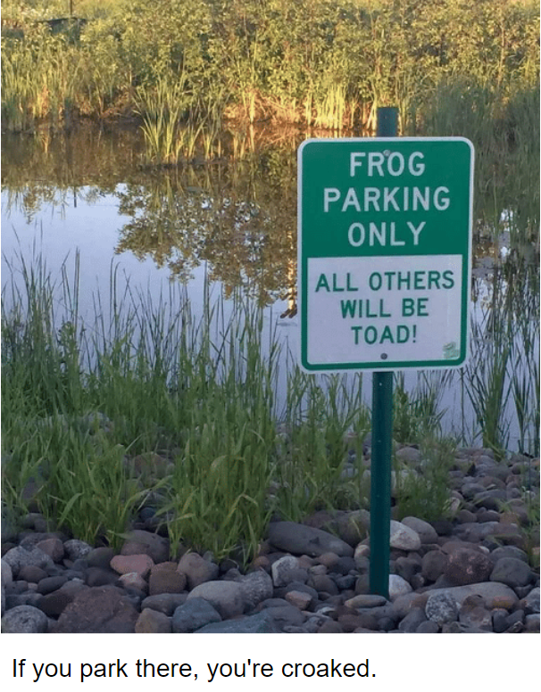
Minimum Requirement #8 – Wetlands Protection
Based on Impacts to the Threshold Discharge Area
Requirements based on what type of wetland the project will ultimately discharge into.

Slide 76
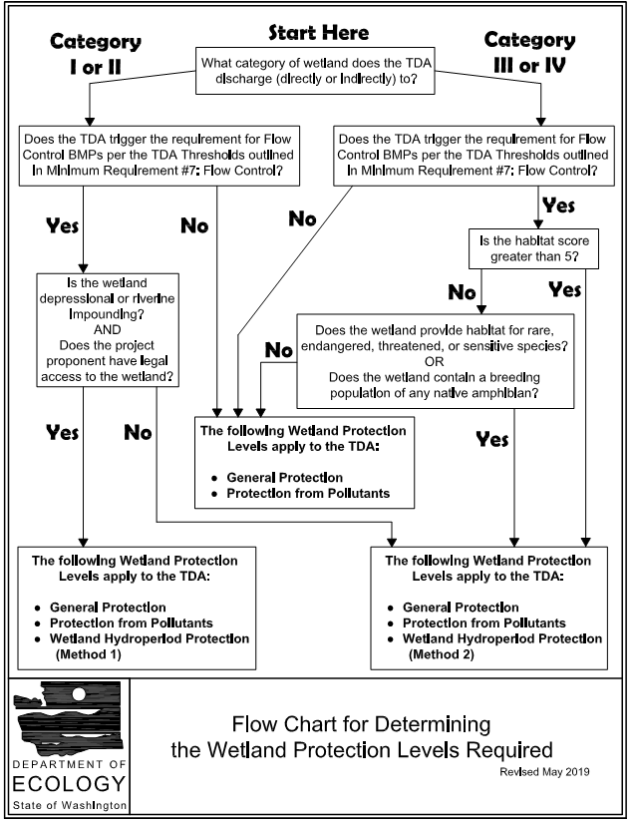
Wetland Flowchart

Slide 77
Wetland Protection Levels
General Protection
General Practices that Benefit Wetland of All Types
Protection from Pollutants
Measures to Protection the Wetland from Pollutants in Stormwater Runoff.
Wetland Hydroperiod Protection
Method 1 – Monitoring and Wetland Stage Modeling
Data collection specific to the wetland and continuous simulation modeling to demonstrate that the proposed project will not negatively alter the wetland hydrology. Potentially one year of monitoring required.
Ecology created a spreadsheet that take output from WWHM and evaluates for Method 1.
Method 2 – Site Discharge Modeling
Continuous simulation modeling of the runoff from the TDA to demonstrate that the changes in total discharge volume to the wetland will remain similar to the predevelopment condition.
WWHM has a module to calculate impacts.

Slide 78
SSPs and Wetlands Protection
Wetlands Report Needed to Verify Wetland Type.
Report must be completed by a qualified wetlands professional.
There is no state program for certifying wetlands specialists.
Some jurisdictions have requirements in code (Tacoma TMC 13.11.900.W)
Modeling outputs and report needed to verify wetland hydrology if required.

Slide 79
Our Project
Does MR#8 apply to this project?
No, assume no wetlands along path.
Notes:
Talk about how we might not have enough information.

Slide 80
Minimum Requirement #9 – Operation and Maintenance
Require an Operation and Maintenance Manual for all runoff treatment and flow control facilities.
Must identify party responsible for maintenance.
Copy must be kept onsite or within reasonable access to site.
O&M must be transferable to new property owner.
Must list maintenance activities and timelines for maintenance.
SWMMWW has examples for many facility types
Manufacturers often have these for their devices.
Covenant and Easement (C&E) Agreements
A legal means to ensure maintenance is performed on private properties.
Allows City access to the facilities for inspection
Recorded to title.

Slide 81
SSPs and O&M
Is a separate Operation and Maintenance Manual included?
Does it have all necessary components?
Does it speak to all system components?
Has the Covenant and Easement agreement been appropriately signed and recorded?
If this facility will be maintained by the jurisdiction – have you talked to your O&M staff? Are they familiar with the facility? Do they have the tools to maintain the facility? If not, do you have outside maintenance contracts or can you get them?
Many manufacturer’s will come and demonstrate how to perform maintenance for free.

Slide 82
Break 2!

Slide 83
Communicating to Applicant
Standard Comments
Ensures consistency amongst plan review staff
Gives one voice to your jurisdiction
Transparency
Quicker for reviewer
Comment Memos Provide Ability for Applicant to Respond Easily
Response based on how permits are processed
Example, City of Tacoma uses Acella, so “conversation” with applicant happens through Acella.
Yours might be email or USPS or Carrier Pigeon
Let applicant know how to contact you with questions.
Be open to talking to the applicant.
You are there to teach them about your requirements.
Be patient! This could be an applicant’s first permit in your jurisdiction or their first Permit ever.
Keep Records of Everything! – Especially any special decisions you have made with applicant.

Slide 84
Applicant Expectations
Applicants want Permits immediately.
Set realistic expectations for applicant.
Set realistic expectations for yourself – some plans take days to review.
Write these expectations clearly and in multiple places.
Example, comments will be received 4 weeks after complete submittal.
Make sure all departments agree on these expectations.
Provide as much information up-front to applicant so they are not surprised by requirements.
Tip Sheets
Preapplication Meetings
Meetings to discuss comments can be very helpful to both parties.

Slide 85
Professional Engineers (no, they are not all that)
If a report or design is stamped by a P.E. is review still required?
What if the reviewer is not a P.E.? Can they question the design of a P.E.?
If a facility is stamped by a P.E. can the design criteria be different than given in the Ecology SWMMWW?
Yes! It is your job as a plan review to ensure your jurisdictions standards and regulations are being following.
P.E.s work in many jurisdictions with varying rules and requirements. Yes, they are geniuses but even a rocket scientist can’t be all knowing (and everyone makes mistakes!)
Yes, their job is to ensure compliance with their jurisdictions standards, if these standards are not being following the P.E. must describe why. You are the expert for your jurisdiction standards.
Design criteria related to facility function in SWMM is considered AKART and is not open to interpretation by project engineers. If guidance in SWMM is not followed, this is the demonstrative approach.
Just because there is a P.E. stamp attached to SSP/plan set does not give engineers option to decide what AKART means.
SWMM does state some instances where professional judgment is allowed (read each BMP carefully).

Slide 86
QA Program!
Plan Review is Hard!
Every project is different and unique.
You will miss something!
Have a coworker (if you have anyone else) look at your work every single time (if that is just not possible at least do this for larger, more complex projects).
Trust but verify
Helps ensure consistent products.
Again you will miss something – try not to miss the BIG things!!

Slide 87
Getting the Project Out…Redlining Versus Designing
Very jurisdiction specific.
Sometimes the project just needs to get out the door but there are still minor issues.
Redline conditions/comments on the plan set.
Redlines should be comments/conditions not design changes made by you…you are not the stamping engineer.
There may be cases where the stamping engineer gives you permission to correct their plan set – note that you are making correction based on engineer recommendation on the plan set or in the project notes. Get their approval in writing for each specific item (email is generally okay).
Don’t redline major issues.
Don’t correct calculations via redline.

Slide 88
Oh Fudge, I missed something, now what…
Panic
Cry
Swear or…
If it is a permit compliance item, you need to tell the applicant as soon as possible.
Explain that a mistake was made and they must comply with requirements.
Apologize
Move on, you likely won’t miss that item again.

Slide 89
What makes a good plan reviewer?
Does not need to be a Professional Engineer
Attention to detail and ability to see the big picture
Critical thinker
Knowledge of the requirements and regulations
Ability and wisdom to check the Permit/SWMMWW every time
An understanding of Permit types and project types
Proficient at research
Patience and willingness to help others
Ability to take criticism
Ability to manage time and juggle many projects at once
Ability to explain technical concepts in a concise, simple manner – plan review staff guide applicant’s through their jurisdictions processes which are complex
Knowing how to get to “YES”

Slide 90
Example #1 – Residential Lot
Existing
Proposed
6,000 Square Foot Lot
100% Vegetation Cover
Thea Foss Waterway
1500 Square House (Roof Footprint Area)
200 Square Foot Driveway
80 Square Foot Patio
40 Square Foot Walkway
No offsite improvements – no sidewalks necessary, no street paving needed.
Project creates less than 2,000 square feet of new hard surface and disturbs less than 7,000 square feet. MR #2 applies to every project. No submittal required.

Slide 91
Example #2 – Residential Lot
Existing
Proposed
7,500 Square Foot Lot
100% Vegetation Cover
Thea Foss Waterway – Salt Waterbody – discharge is considered to be flow control exempt.
1500 Square House (Roof Footprint Area)
200 Square Foot Driveway
80 Square Foot Patio
40 Square Foot Walkway
No offsite improvements – no sidewalks necessary, no street paving needed.
Complete strip and rebuild of property.

Slide 92
Example 2 – Residential Lot
Project creates less than 2,000 square feet of new hard surface but disturbs more than 7,000 square feet. MR #1-#5 apply to project.
Short Form SSP and Short Form SWPPP can be used.
MR#5: Employ the following BMPs as feasible:
List #3 (below) or LID Performance Standard
Surface Type: Lawn/Landscaped Areas
BMP T5.13: Post Construction Soil Quality and Depth
Surface Type: Roofs:
BMP T5.10 A: Downspout Full Infiltration
BMP T5.10B: Downspout Dispersion System
BMP T5.10C: Perforated Stub-Out Connections
Surface Type: Other Hard Surfaces (Driveways, Sidewalks, Walkways, Patios, Etc.)
BMP T5.12: Sheet Dispersion OR
BMP T5.11: Concentrated Flow Dispersion

Slide 93
Example #3 – Residential Lot
Existing
Proposed
7,500 Square Foot Lot
100% Vegetation Cover
Flett Creek Watershed - Freshwater
2000 Square House (Roof Footprint Area)
200 Square Foot Driveway
80 Square Foot Patio
40 Square Foot Walkway
No offsite improvements – no sidewalks necessary, no street paving needed.
Complete strip and rebuild of property.

Slide 94
Example #3 – Residential Lot
Project adds greater than 2,000 square feet or new hard surface and disturbs more than 7,000 square feet. MR #1-#5 apply to project.
Short Form SSP and Short Form SWPPP can be used.
MR#5: Employ BMPs in order listed for each surface category (List #1) or use LID Performance Standard:
Surface Type: Lawn/Landscaped Areas
BMP T5.13: Post Construction Soil Quality and Depth
Surface Type: Roofs
BMP T5.30 – Full Dispersion or BMP T5.10A: Downspout Full Infiltration
BMP T 5.14.A – Rain Gardens or BMP T7.30 Bioretention Cells, Swales, and Planter Boxes
BMP T5.10B: Downspout Dispersion Systems
BMP T5.10C: Perforated Stub-Out Connections
Surface Type: Other Hard Surfaces
BMP T5.30: Full Dispersion
BMP T5.15 Permeable Pavements or BMP T 5.14.A – Rain Gardens or BMP T7.30 Bioretention Cells, Swales, and Planter Boxes
BMP T5.12: Sheet Flow Dispersion or BMP T5.11: Concentrated Flow Dispersion or BMP T5.11: Concentrated Flow Dispersion

Slide 95
Example #4 – Commercial Lot
Existing
Proposed
15,000 SF Gravel Lot
Flett Creek Watershed - Freshwater
3500 SF Building
6500 SF Driving Surface

Slide 96
Example #4 – Commercial Lot
MR#1-#9 apply to project.
MR #5 - Employ BMPs is order listed (List #2) or Use LID Performance Standard
Surface Type: Lawn/Landscaped Areas
BMP T5.13: Post Construction Soil Quality and Depth
Surface Type: Roofs
BMP T5.30 – Full Dispersion or BMP T5.10A: Downspout Full Infiltration
BMP T7.30 Bioretention Cells, Swales, and Planter Boxes
BMP T5.10B: Downspout Dispersion Systems
BMP T5.10C: Perforated Stub-Out Connections
Surface Type: Other Hard Surfaces
BMP T5.30: Full Dispersion
BMP T5.15 Permeable Pavements
BMP T7.30 Bioretention Cells, Swales, and Planter Boxes
BMP T5.12: Sheet Flow Dispersion or BMP T5.11: Concentrated Flow Dispersion or BMP T5.11: Concentrated Flow Dispersion
MR #6 – Water Quality – Enhanced Treatment, Possible Oil Treatment
MR#7 – Flow Control to Forested Conditions
MR#8 – If the project discharges to a wetland
MR#9 – Required for Permanent Stormwater Facilities.

Slide 97
Example #5 – Commercial Lot
Existing
Proposed
20,000 SF Lot
12,000 SF Building
7,000 SF Asphalt Parking Lot
1,000 Landscaping
Thea Foss Watershed
3,000 SF Building Addition → 15,000 SF Building
Replace Remaining Parking Lot with New Parking Lot →4,000SF
Existing Landscape to remain
Building will be where existing parking lot was located.

Slide 98
Example 5 – Commercial Lot
Redevelopment Site
New Building and Replaced Parking Lot are considered replaced hard surfaces (previous parking lot did not remain in place for construction of new building).
MR#1-#5 apply to new plus replaced hard surfaces (List #3) or LID Performance Standard.
Surface Type: Lawn/Landscaped Areas
BMP T5.13: Post Construction Soil Quality and Depth
Surface Type: Roofs:
BMP T5.10 A: Downspout Full Infiltration
BMP T5.10B: Downspout Dispersion System
BMP T5.10C: Perforated Stub-Out Connections
Surface Type: Other Hard Surfaces (Driveways, Sidewalks, Walkways, Patios, Etc.)
BMP T5.12: Sheet Dispersion OR
BMP T5.11: Concentrated Flow Dispersion
Replaced surfaces not required to comply with MR#6, 7, 8 because valuation of proposed improvements is less than 50% of existing improvements.

Slide 99
Lunch Time!

Slide 100
Shout Outs and Big Thanks!
Washington Stormwater Center
Apex Engineering, Tacoma
N.L. Olson and Associates, Port Orchard
City of Tacoma
City of Kelso
Kitsap County
Snohomish County
Washington State Department of Ecology

Slide 101
Tools of the Trade
A computer
Highlighters
To help you figure out where various utilities are going.
Red Pens
Engineer and Architect Scales
Plan Review Checklist
The Stormwater Management Manual
Other Manuals
Side Sewer Manual
Building Code
Right-of-Way Codes

Slide 102
Plan Set Abbreviations
Plan Set Legends tell you what the abbreviations and symbols mean:
D – Storm Pipe
RD – Roof Drain
FD – Footing Drain
CO – Cleanout
SD – Storm Pipe
ST – Storm Pipe
S – Storm or Wastewater Pipe
WW – Wastewater
W – Water
G – Gas
FM – Force Main
UG – Underground
OHP or OH – Overhead Power
T – Telecom
P - Power

Slide 103
Is this a Complete Application?
Do we have enough information to complete a plan review?
At very start of your review – quickly look through all your documents to see what you have.

Slide 104
Plan Sets – helpful items to consider
Is the plan set to scale?
Is a facility shown?
How does water get into that facility?
Is water flowing downhill?
Is site graded so water gets into system? Are all low points captured?
Are there utility conflicts?
Are pipes underground?
Does all PGIS go to the facility?
Is the building connected to stormwater?
Do stormwater pipes connect to stormwater mains?
Are there details?
Maintenance access?

Slide 105
Plan Set Calculations to Check
Pipe slopes
Invert elevations
Rim elevations
Facilities
Depth
Bottom Areas
Overflow
Rim Elevations
Head Calculations (some facilities require specific head to make facility work)

Slide 106
Lot 5
Look at the SSP and Plan Set for Lot 5 and fill out the Worksheet. Use the flowchart.
What MRs apply?
What Mitigation is required?
Does SSP match Plan Set?
Approvable or Fatal Flaws?
Notes:
15 Minutes Before Ask First Questions.

Slide 107
Six Pack Plat
Look at the SSP and Plan Set for the Six Pack Plat and fill out the Worksheet. Use the flowchart.
What MRs apply?
What Mitigation is required? See the Lists on the next slide.
Does SSP match Plan Set?
Approvable or Fatal Flaws?
Notes:
30-45 Minutes for This Exercise – Again about 15 minutes before ask first questions.

Slide 108
MR #5 Flowchart Exercise

Slide 109
MR #6 Flowchart Exercise

Slide 110
Notes:
Exercise here is to have someone go through MR #5 for the plat and talk about if they have enough information.

Slide 111
Six Pack Plat, Lot 5
Lot 5 is part of the Six Pack Plat, so now…
Look at the SSP and Plan Set for the Six Pack Plat, Lot 5 and fill out the Worksheet. Use the flowchart.
What MRs apply?
What Mitigation is required?
Does SSP match Plan Set?
Approvable or Fatal Flaws?
Notes:
About 10 minutes.

Slide 112
Six Pack Plat, Lots 2 and 6
Using the information for the Plat and fill out the Worksheets for Lots 2 and 6. Use the flowchart.
Then consider that you receive Lot 2 about 3 months after the plat is built and lot 6 another six months after that.
Think about each submittal that you receive as its own packet. What do you do?
What MRs apply?
What Mitigation is required?
Does SSP match Plan Set?
Approvable or Fatal Flaws?
Notes:
10-15 Minutes

Slide 113
Break

Slide 114
Commercial Plan Set
Look at the SSP and Plan Set for the Commercial Plan Set and fill out the Worksheet. Use the flowchart.
What MRs apply?
What Mitigation is required?
Does SSP match Plan Set?
Approvable or Fatal Flaws?
Notes:
30 minutes or so - just wrap up slides after this.

Slide 115
Hilariousness – Final Episode
What do nuclear engineers like to eat?
Fission Chips.

Slide 116
Wrap Up
Thanks for attending this training
We hope it is helpful to you now and in future
Let us know what would be helpful to change in this workshop
Contact us if you have specific questions
Ecology is also a resource for everything related to their Permits and Manuals.

